Slide 1
Subgrid orographic drag: Beljaars vs TMS
τ_{TMS}~SGH30 ➔ τ_{Blj}~SGH30²
D_{TMS}(LM)~C|U|U(LM); D_{TMS}=0 for k<LM
D_{Blj}~F(z)|U|U; F is shallow but grid-independent
Ridge-based (anisotropic) orographic GW scheme:
wave model follows Scinocca and McFarlane
Own “ridge” feature identification

Slide 2
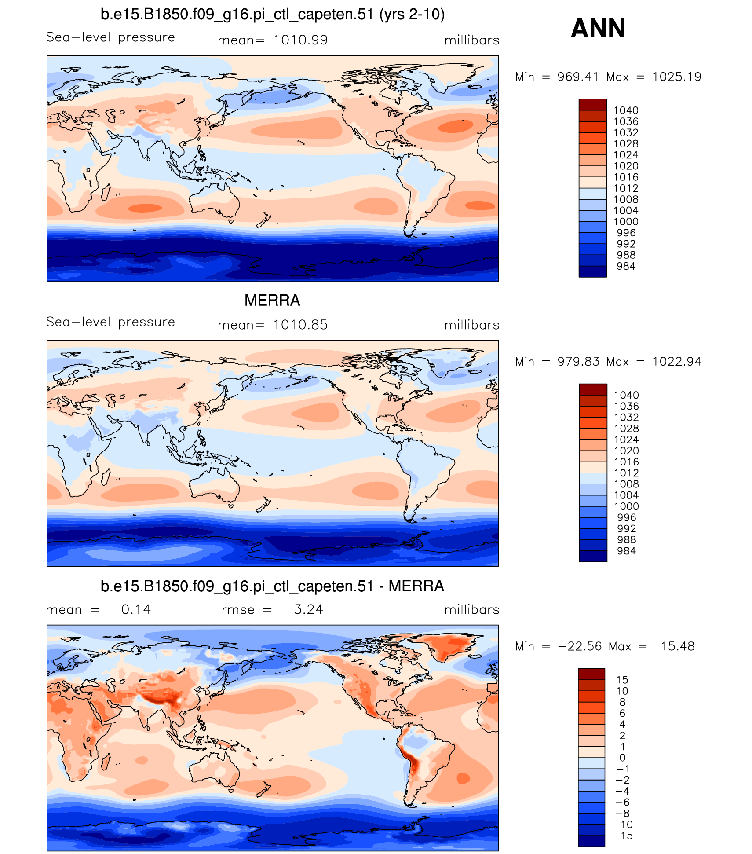
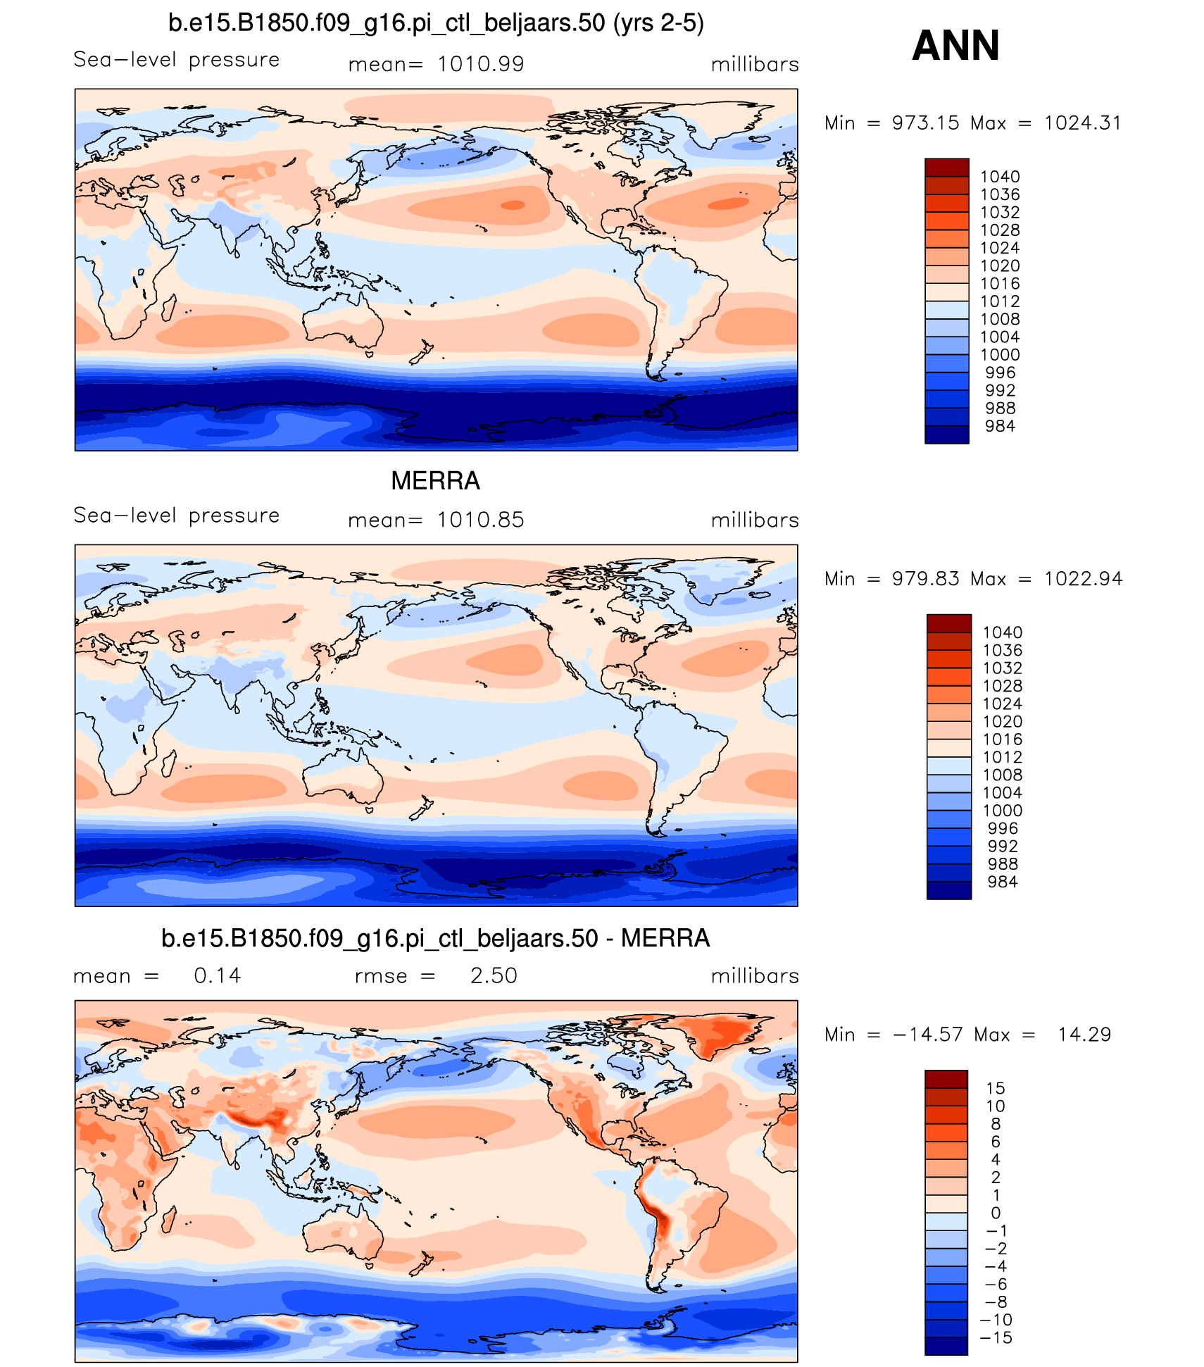
Annual mean sea-level pressure
CTL
Beljaars + ridges

Slide 3
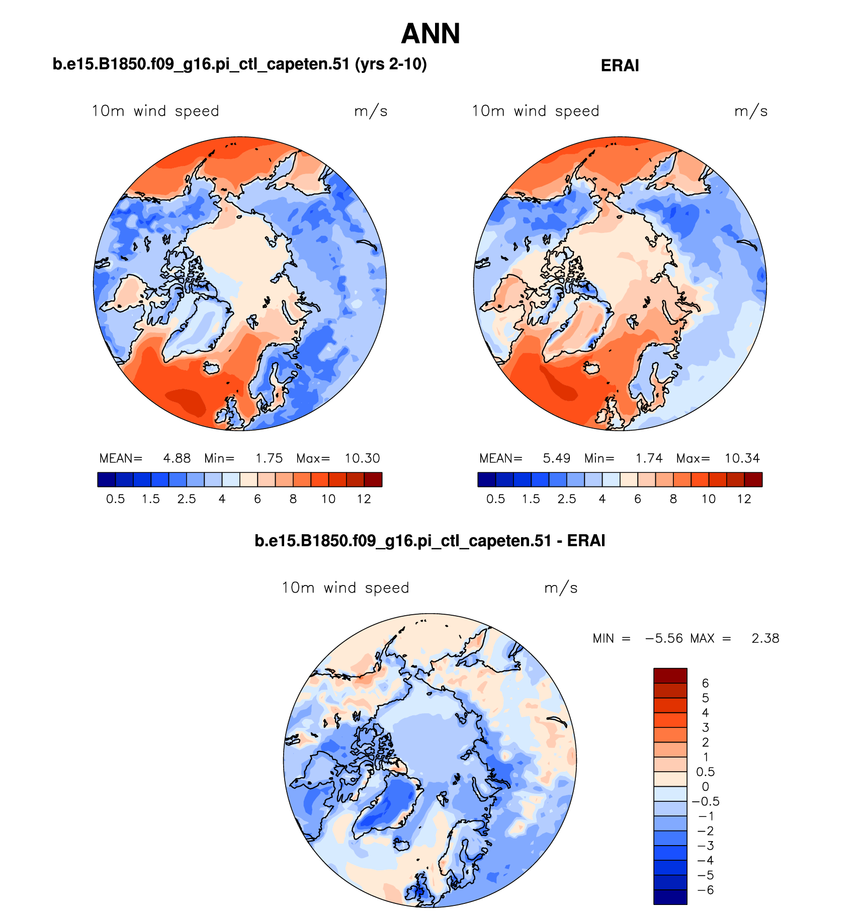
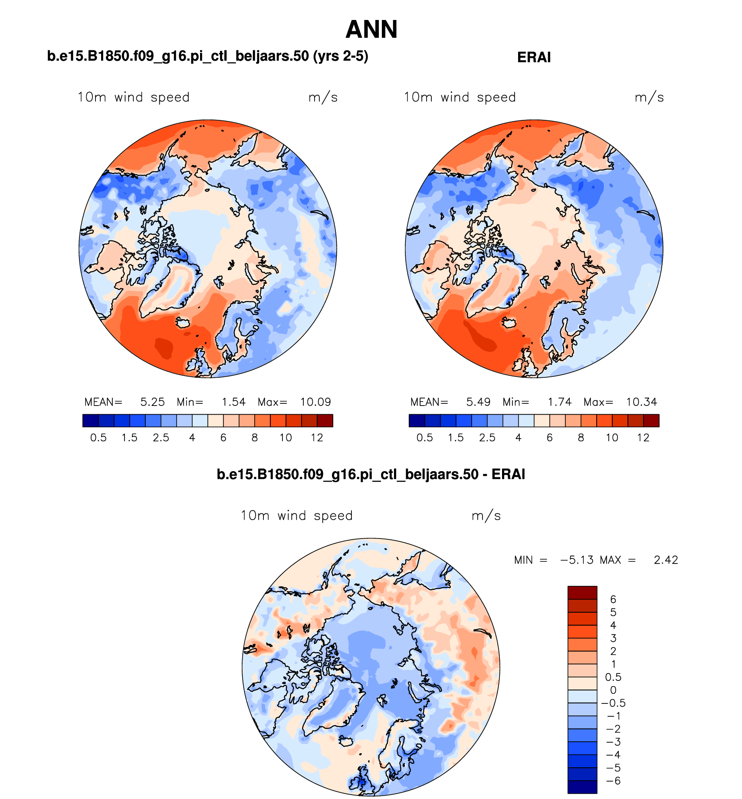
Annual mean 10m winds
CTL
Beljaars + ridges

Slide 4
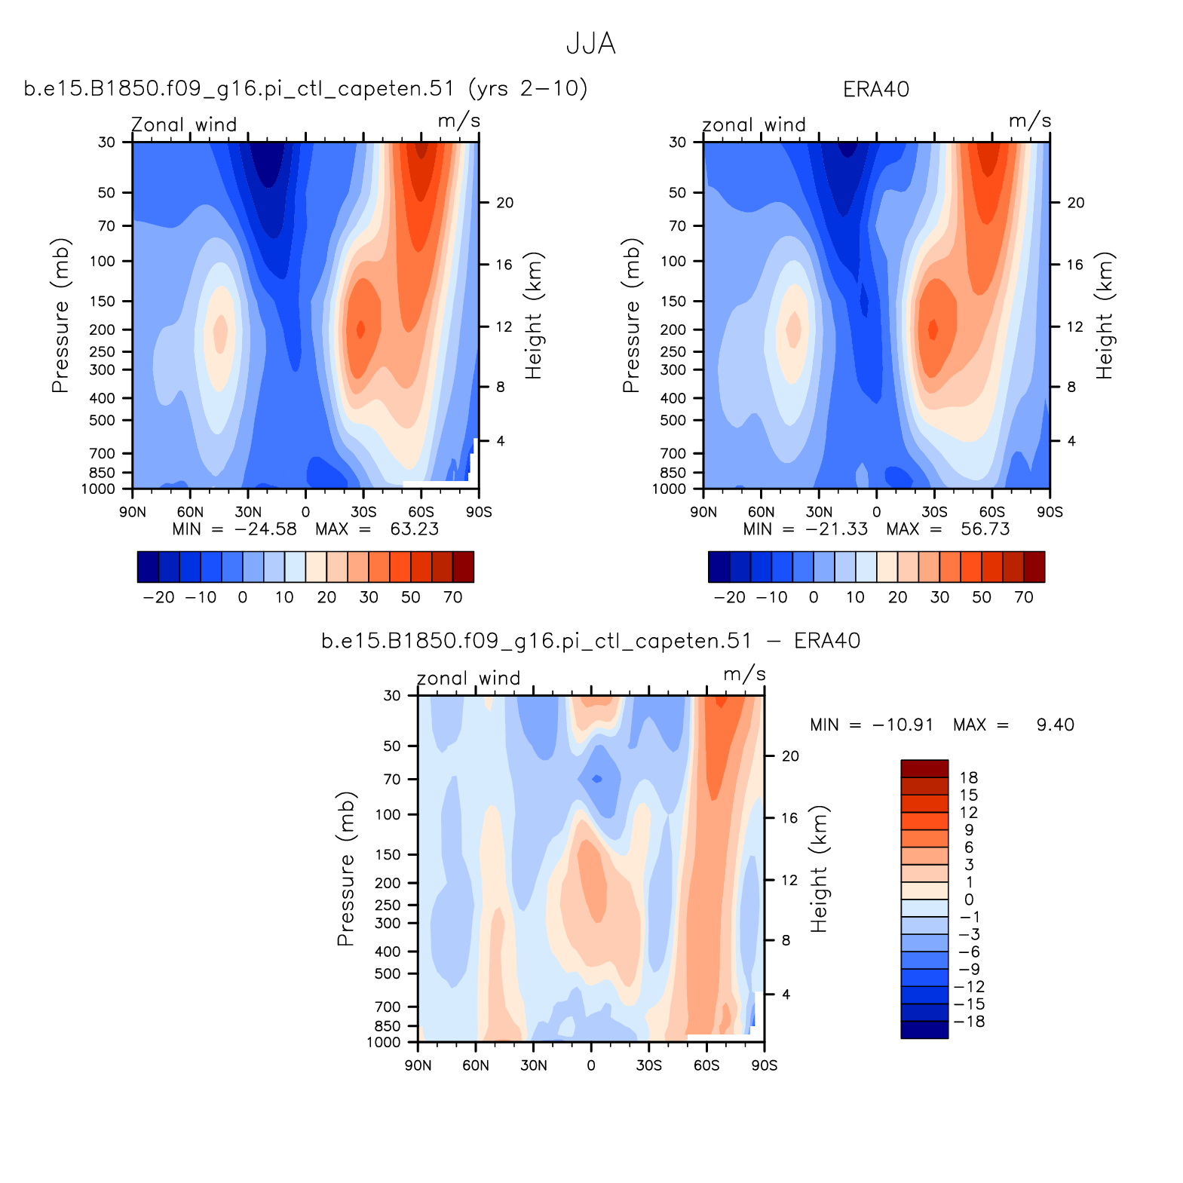
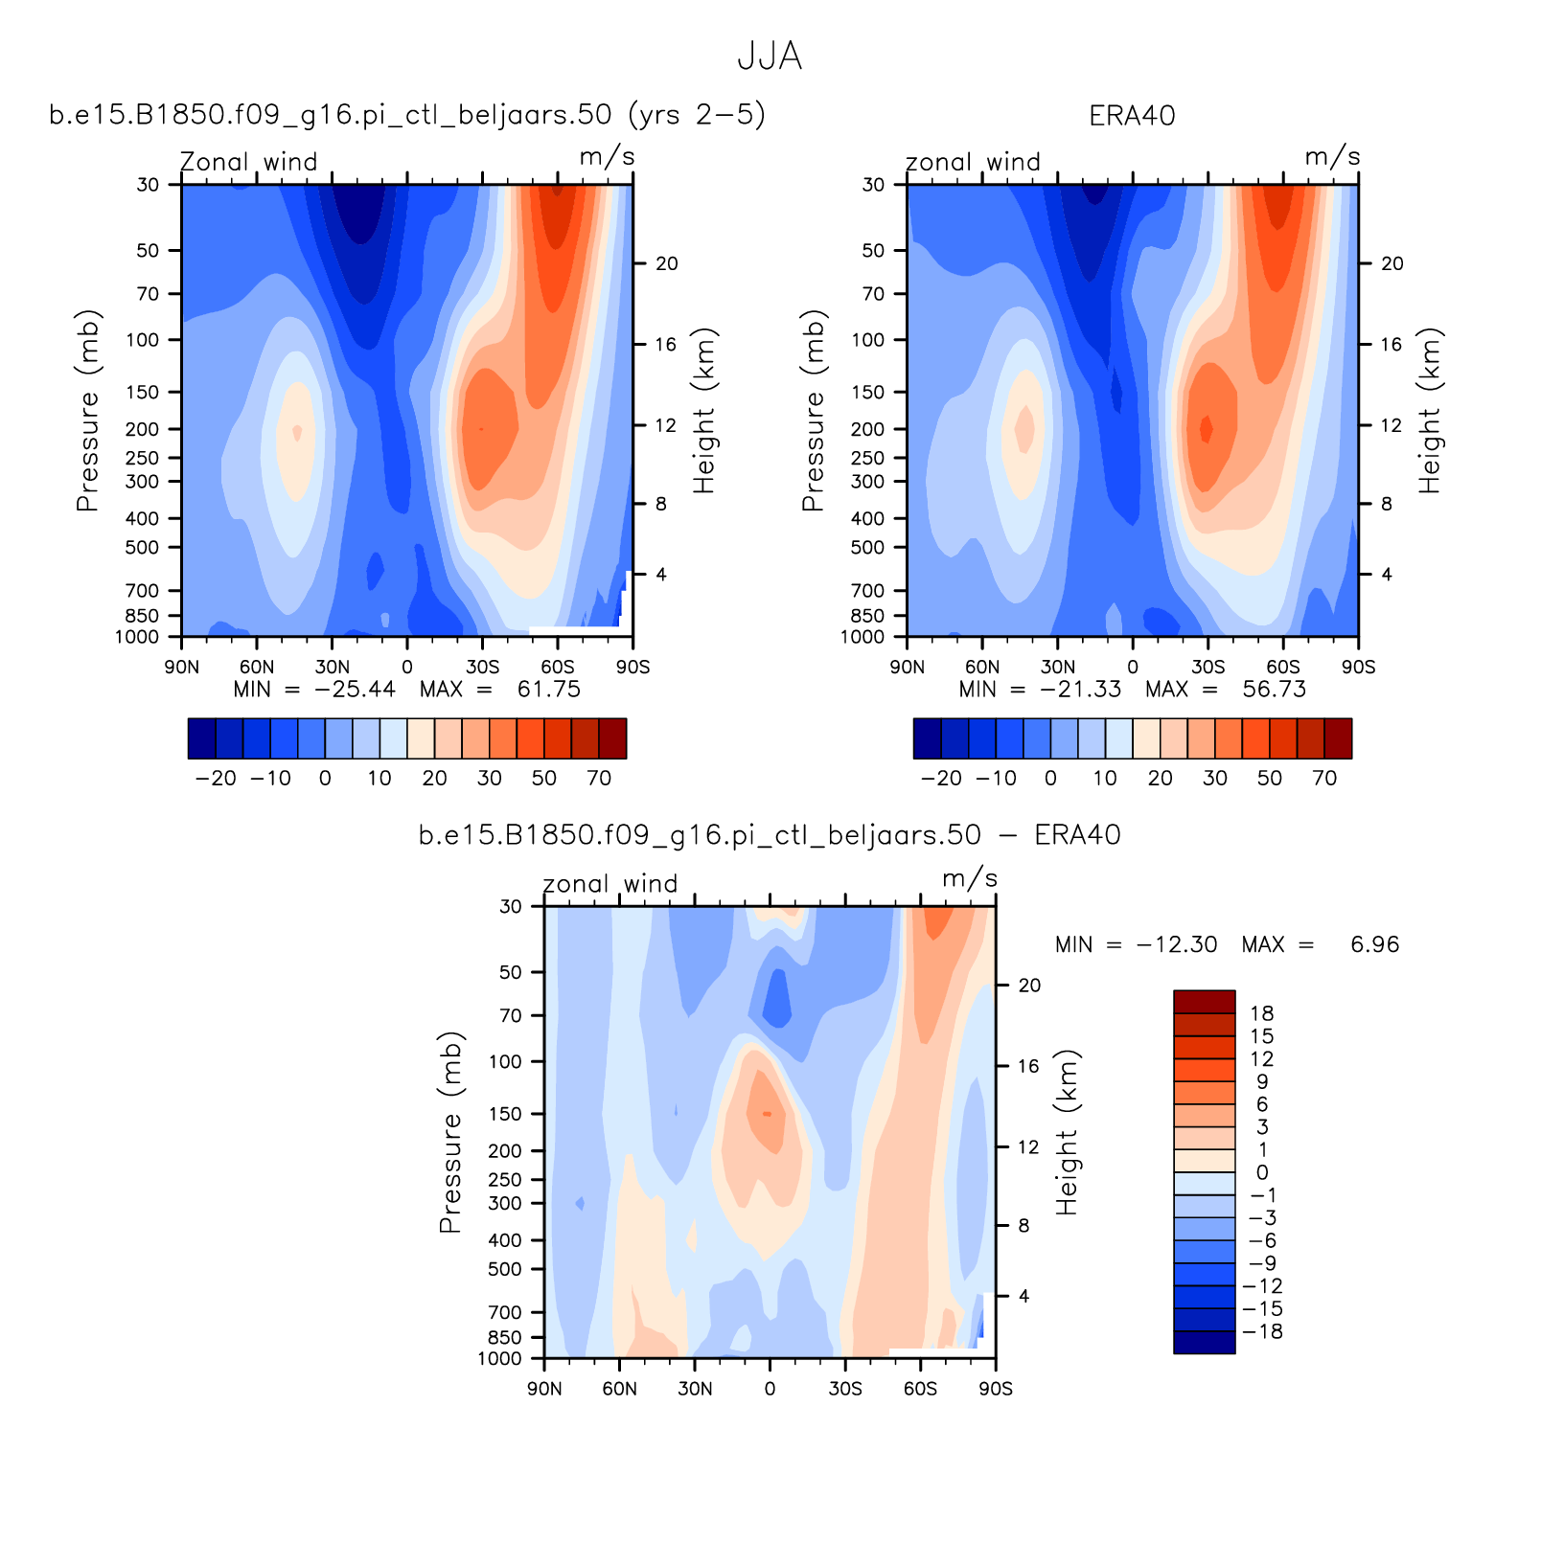
Zonal Mean winds in JJA
(note AMWG plots reversed latitudes N➔S)
CTL
Beljaars + ridges

