Slide 1
An update on CMIP(6), obs4MIPs and the
WGCM/WGNE Diagnostics and Metrics Panel
Peter J. Gleckler
WGNE 31, Pretoria, South Africa, April 27, 2016 - REMOTE PRESENTATION
Program for Climate Model Diagnosis and Intercomparison, LLNL

Slide 2
2
Talk outline
CMIP6 status
obs4MIPs – what and why
The WGNE/WGCM climate metrics (and diagnostics) panel

Slide 3
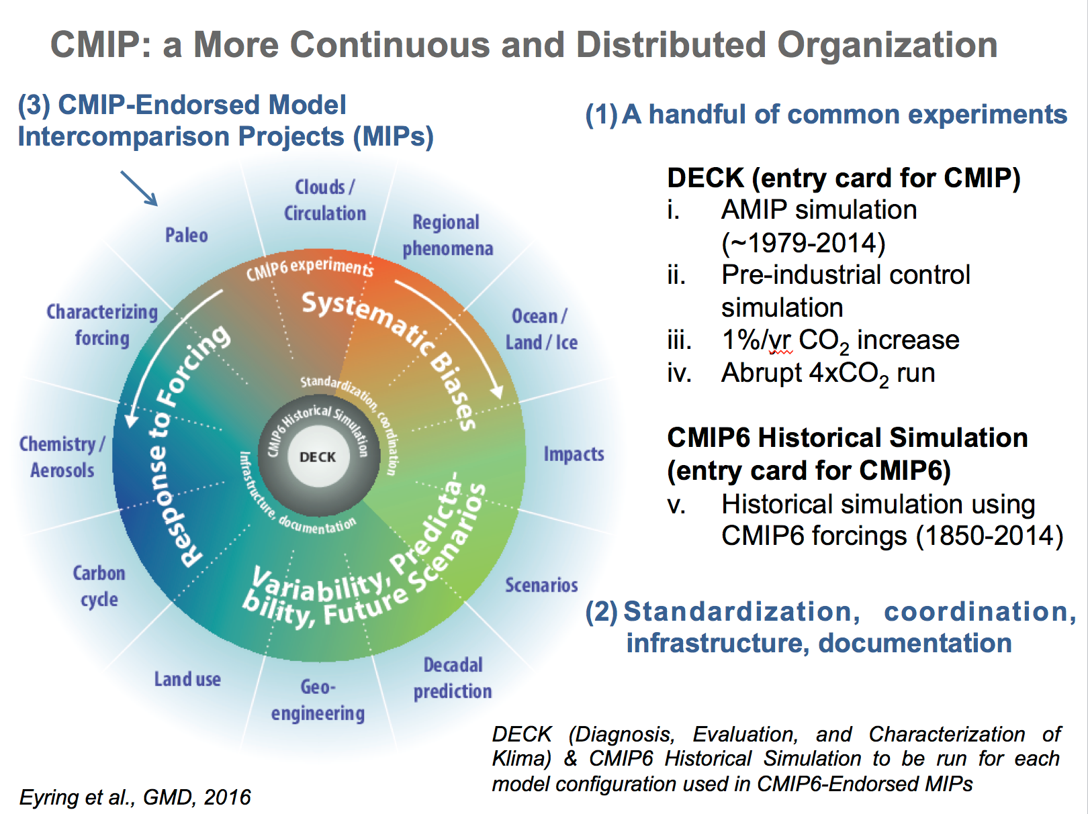
3

Slide 4
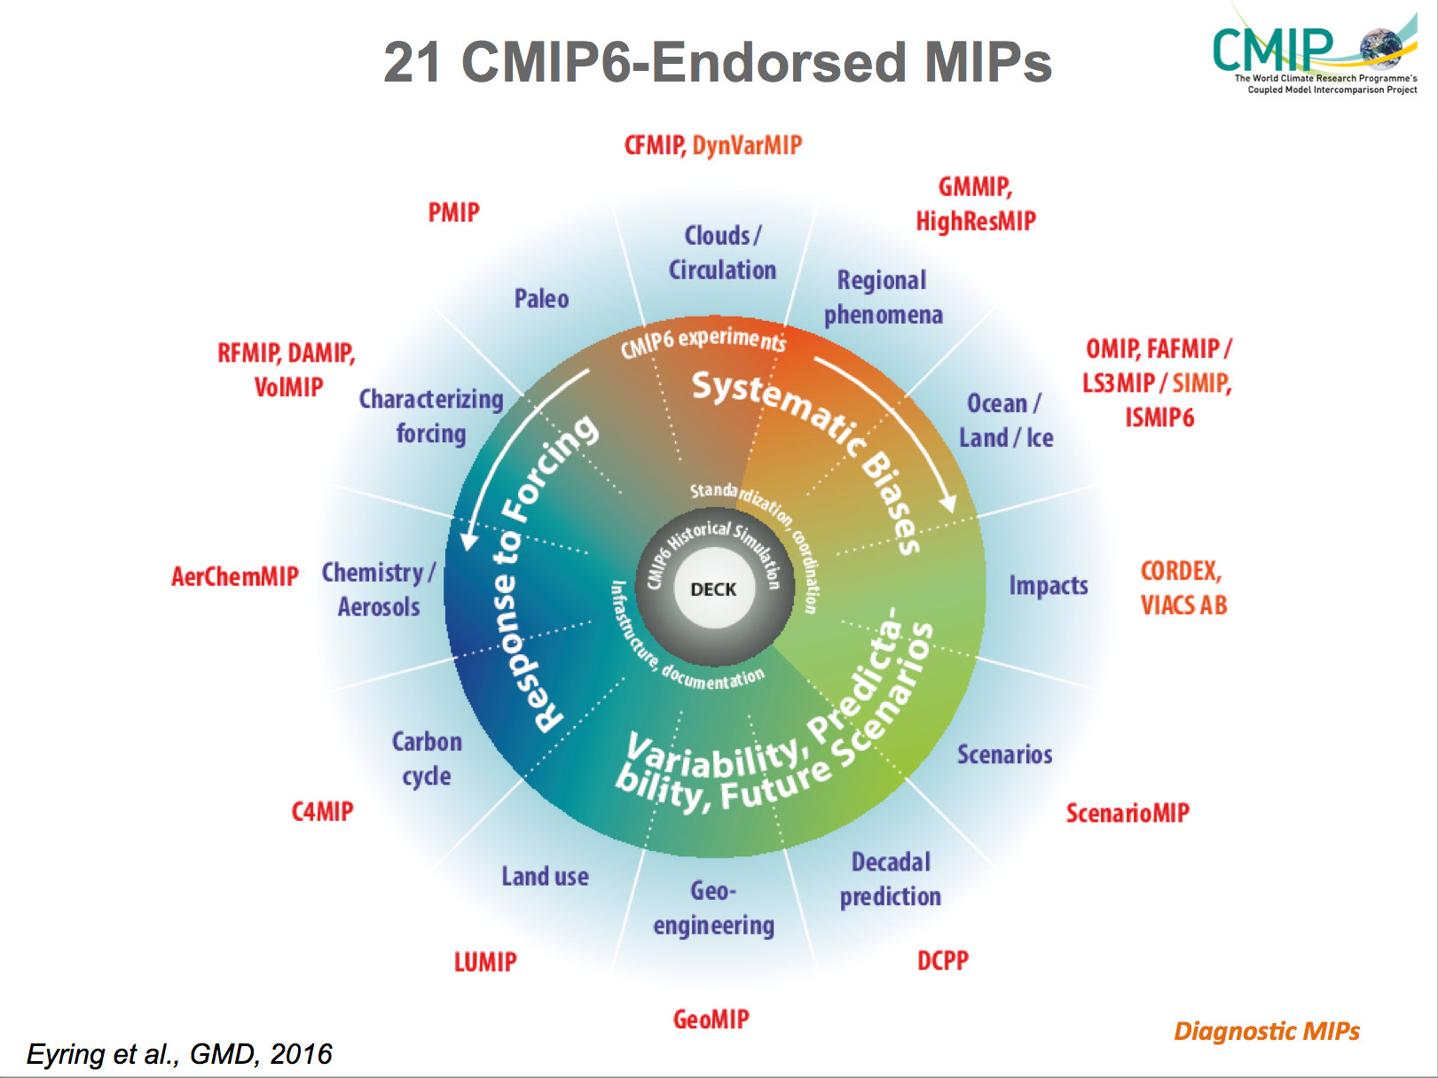
4

Slide 5

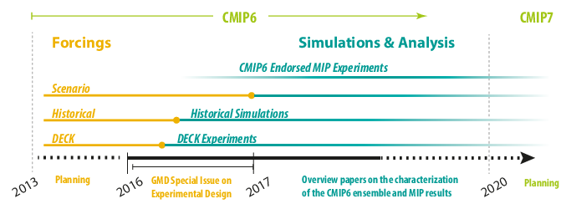
CMIP6 Timeline
5
Eyring et al., GMD, 2016
Notes:
VIA AB includes members from the Global Programme of Research on Climate Change Vulnerability, Impacts and Adaptation (PROVIA), the IPCC Task Group on Data and Scenario Support for Impact and Climate Analysis (TGICA), the World Climate Research Programme (WCRP) Working Group on
Regional Climate (WGRC), the International Committee On New Integrated Climate change assessment Scenarios (ICONICS), and the Climate Services community

Slide 6
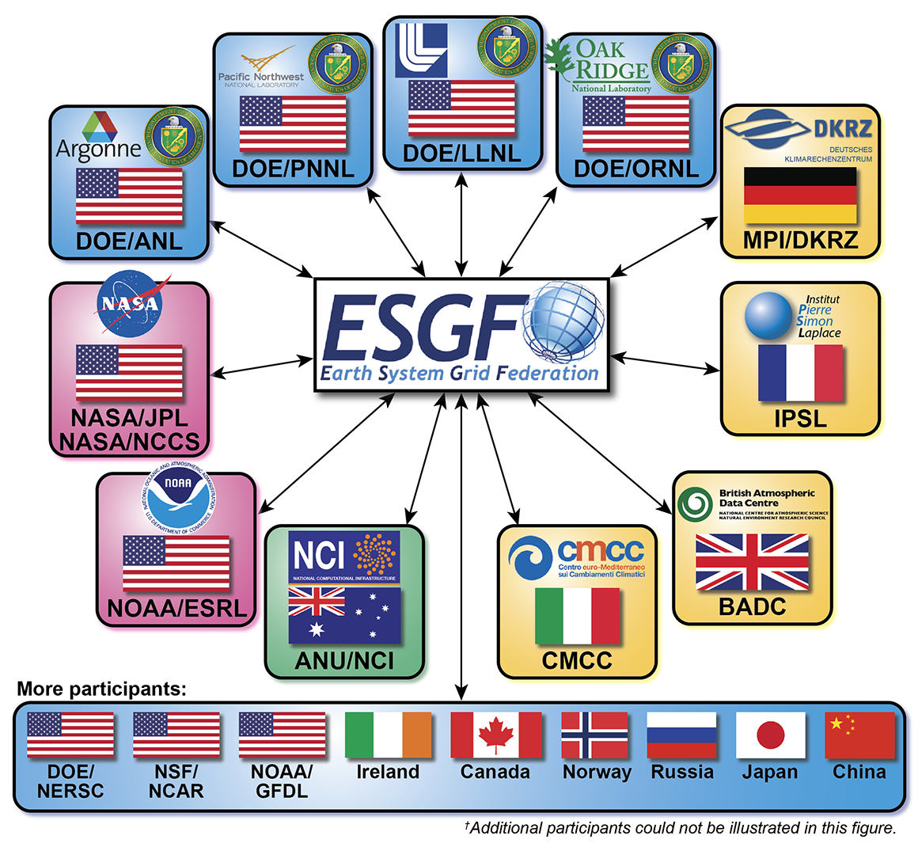
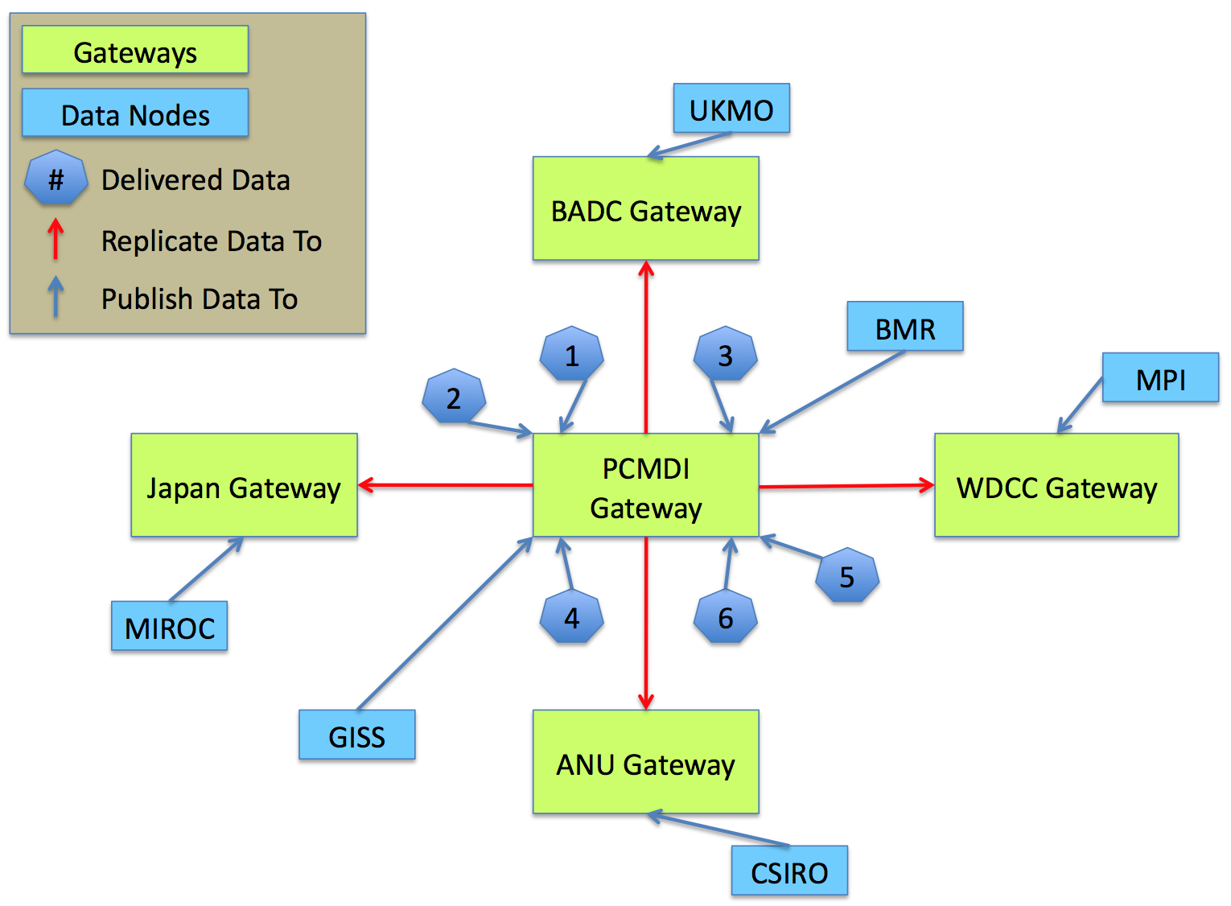
Data accessibility for
WCRP Climate Model Intercomparions (MIPs):
6
For CMIP3 (circa IPCC AR4) and earlier, data from CMIP and several other MIPs were centralized
Since CMIP5, data is now distributed via the Earth System Grid Federation (ESGF)… there have been challenges but the system is demonstrably improving
CMIP5 data ~5Pb
The conventions for CF (Climate and Forecast) metadata are used in the organization of all CMIP data

Slide 7
Status and Outlook
7
CMIP6 Status
CMIP6 Experimental Design finalized
Forcing datasets for DECK and CMIP6 historical simulations finalized by en
CMIP6 Simulation Period (2016-2020)
Infrastructure in preparation (including data request) by WGCM Infrastructure Panel (WIP)
CMIP6 Participating Model Groups: > 30 using a wide variety of different model versions
21 CMIP6-Endorsed MIPs that build on the DECK and CMIP historical simulations to address a large range of specific questions with WCRP Grand Challenges as scientific backdrop.
CMIP6 Climate Projections part of a CMIP6-Endorsed MIP (ScenarioMIP)
New scenarios span the same range as the RCPs, but fill critical gaps for intermediate forcing levels and questions for example on short-lived species and land-use.
Forcings for future scenarios available by end of 2016, climate model projections expected to be available within the 2018-2020 time frame.
A Central Goal of CMIP6 is Routine Evaluation of the Models with Observations
Efforts to develop community tools and to couple them to the ESGF are underway
Geosci. Model Dev. Special Issue on CMIP6
Overview of the CMIP6 Experiment Design and Organization (Eyring et al., GMD, 2016)
Experimental design from all CMIP6-Endorsed MIPs
Description of the CMIP6 forcing data and infrastructure
=> We expect CMIP6 to continue CMIP’s tradition of major scientific advances
http://www.wcrp-climate.org/index.php/wgcm-cmip/about-cmip
Notes:
(http://www.earth-system-science-data.net/) and the newly formed
Nature Scientific Data (http://www.nature.com/scientificdata/).
The machinery for QC of data and metadata standards falls under this.
These will require a "non-trivial"
amount of work to develop (as promised in the WIP charter!) and may
involve surveys of data providers and users
7

Slide 8
Status and Outlook
8
CMIP6 Status
CMIP6 Experimental Design finalized
Forcing datasets for DECK and CMIP6 historical simulations finalized by en
CMIP6 Simulation Period (2016-2020)
Infrastructure in preparation (including data request) by WGCM Infrastructure Panel (WIP)
CMIP6 Participating Model Groups: > 30 using a wide variety of different model versions
21 CMIP6-Endorsed MIPs that build on the DECK and CMIP historical simulations to address a large range of specific questions with WCRP Grand Challenges as scientific backdrop.
CMIP6 Climate Projections part of a CMIP6-Endorsed MIP (ScenarioMIP)
New scenarios span the same range as the RCPs, but fill critical gaps for intermediate forcing levels and questions for example on short-lived species and land-use.
Forcings for future scenarios available by end of 2016, climate model projections expected to be available within the 2018-2020 time frame.
A Central Goal of CMIP6 is Routine Evaluation of the Models with Observations
Efforts to develop community tools and to couple them to the ESGF are underway
Geosci. Model Dev. Special Issue on CMIP6
Overview of the CMIP6 Experiment Design and Organization (Eyring et al., GMD, 2016)
Experimental design from all CMIP6-Endorsed MIPs
Description of the CMIP6 forcing data and infrastructure
=> We expect CMIP6 to continue CMIP’s tradition of major scientific advances
http://www.wcrp-climate.org/index.php/wgcm-cmip/about-cmip
Notes:
(http://www.earth-system-science-data.net/) and the newly formed
Nature Scientific Data (http://www.nature.com/scientificdata/).
The machinery for QC of data and metadata standards falls under this.
These will require a "non-trivial"
amount of work to develop (as promised in the WIP charter!) and may
involve surveys of data providers and users
8

Slide 9
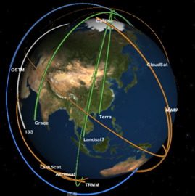
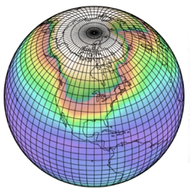
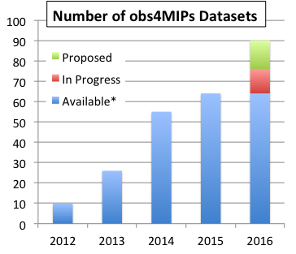







9
obs4MIPs
https://www.earthsystemcog.org/projects/obs4mips/
Obs4MIPs
A Project for identifying, documenting and disseminating observations for climate model evaluation.
Data sets accessible on the Earth System Grid Federation (ESGF) in parallel with CMIP model output, adhering to the same data conventions, greatly facilitating research
Guided by the World Climate Research Program (WCRP) Data Advisory Council obs4MIPS Task Team
Model Output
Target Quantities
Gridded datasets
…. and growing!

Slide 10
Air Temperature
Specific Humidity
Air Temperature
Specific Humidity
Sea Surface Temperature
TOA Outgoing Longwave Radiation
TOA Outgoing Clear-Sky Longwave Radiation
TOA Outgoing Shortwave Radiation
TOA Outgoing Clear-Sky Shortwave Radiation
TOA Incident Shortwave Radiation
Surface Downwelling Longwave Radiation
Surface Downwelling Clear-Sky Longwave Radiation
Surface Upwelling Longwave Radiation
Surface Downwelling Shortwave Radiation
Surface Downwelling Clear-Sky Shortwave Radiation
Surface Upwelling Shortwave Radiation
Surface Upwelling Clear-Sky Shortwave Radiation
Total Cloud Fraction
Sea Surface Height Above Geoid
Precipitation - monthly
Precipitation – 3 hourly
Precipitation - daily
Precipitation - monthly
Near-Surface Wind Speed
Eastward Near-Surface Wind
Northward Near-Surface Wind
Leaf Area Index
Mole Fraciont of Ozone
Ambient Aerosol Opitical Thickness at 550 nm
Ambient Aerosol Opitical Thickness at 550 nm
Water Vapor Path
ISCCP Cloud albedo
ISCCP Cloud albedo
CALIPSO Scattering Ratio, srbox1
CALIPSO Scattering Ratio, srbox2
CloudSat Radar Reflectivity CFAD
CALIPSO Cloud Fraction
CALIPSO Clear Cloud Fraction
CALIPSO High Level Cloud Fraction
ISCCP Cloud Fraction
CALIPSO Low Level Cloud Fraction
CALIPSO Mid Level Cloud Fraction
CALIPSO 3D Clear Fraction
CALIPSO Total Cloud Fraction
CLOUDSAT Total Cloud Fraction
ISCCP Total Cloud Fraction
ISCCP Cloud Top Temperature
ISCCP Cloud Top Temperature
Missing data fraction
Overpasses
PARASOL Reflectance
Solar Zenith Angle
ISCCP Cloud Top Pressure
ISCCP Cloud Top Pressure
MISR CTH-OD Cloud Fraction
CALIPSO 3D Undefined fraction
Obs4MIPs: Status of Observation Holdings/Submissions
April 2016
10
Near-Surface Air Temperature
Air Temperature
Geopotential Height
Eastward Near-Surface Wind
Northward Near-Surface Wind
Near-Surface Wind Speed
Near-Surface Specific Humidity
Surface Downward Latent Heat Flux
Surface Downward Sensible Heat Flux
Near-Surface Air Temperature
Precipitation
Sea level pressure
Sea Surface Temp
Total Chlorophyll Mass Concentration
Infrared brightness temperatures (11 μm, 0.6 μm, 6.7 μm)
Leaf Area Index
normalized difference vegetation index
Fraction of Photosynthetically Active Radiation
Sea Surface Temperature
precipitation
air temperature
Burnt Area Fraction
Surface Snow Amount
Mid Tropospheric Humidity
Upper Tropospheric Humidity
Air Temperature
geopotential height
bending angle
refractivity
CLARA cloud_area_fraction; CFMIP 45
surface albedo
cloud_area_fraction
cloud top phase; area_fraction_of_liquid_cloud_water_particles_at_cloud_top
cloud top pressure; air_pressure_at_cloud_top
cloud optical thickness; atmosphere_optical_thickness_due_to_cloud
cloud ice water path; atmosphere_cloud_ice_content
surface_downwelling_shortwave_flux_in_air
surface downwelling clear sky shortwave flux
surface_downwelling_shortwave_flux_in_air
cloud ice water path; atmosphere_cloud_ice_content
cloud liquid water path
cci cloud area fraction (7x7 table); CFMIP 45 (tbd)
cloud area fraction
cloud top phase; area_fraction_of_liquid_cloud_water_particles_at_cloud_top
cloud top pressure; air_pressure_at_cloud_top
cloud optical thickness; atmosphere_optical_thickness_due_to_cloud
Sea Ice Area Fraction
Surface Temperature
Sea Ice Area Fraction
surface (2m) air temperature anomaly
Near-Surface Specific Humidity
Near-Surface Relative Humidity,
Near-Surface Air Temperature
Water Vapor Path
Fraction of Absorbed Photosynthetically Active Radiation
Snow area fraction
Ambient Aerosol Extinction Optical Thickness at 550 nm
Sea Ice fraction
Sea Ice fraction
Sea Surface Temp
Sea Surface Temp
Sea Surface Temp
TOA Outgoing Longwave Radiation
TOA Outgoing Longwave Radiation
TOA Outgoing Shortwave Radiation
TOA Outgoing Longwave Radiation
Mole Fraction of Ozone
albedo; Ratio of two variables
Ice Sheet Temperature?
Ambient Aerosol Opitical Thickness at 550 nm
Surface Aqueous Partial Pressure of CO2
dry_atmosphere_mole_fraction_of_carbon_dioxide
Near-Surface Wind Speed
Complete* (~57)
In Progress* (~20)
Submissions After Data Call (~80)
*some tech notes remain and ESGF re-loading
Datasets Currently Hosted at obs4MIPs
(Variable Long Name)
Air Temperature
Ambient Aerosol Optical Thickness at 550 nm
CALIPSO 3D Clear fraction
CALIPSO 3D Undefined fraction
CALIPSO Clear Cloud Fraction
CALIPSO Cloud Fraction
CALIPSO High Level Cloud Fraction
CALIPSO Low Level Cloud Fraction
CALIPSO Mid Level Cloud Fraction
CALIPSO Scattering Ratio
CALIPSO Total Cloud Fraction
Cloud Fraction retrieved by MISR
CloudSat 94GHz radar Total Cloud Fraction
CloudSat Radar Reflectivity CFAD
Eastward Near-Surface Wind
Eastward Wind
Fraction of Absorbed Photosynthetically Active Radiation
ISCCP Cloud Area Fraction (Joint histogram of optical thickness and cloud top pressure)
ISCCP Mean Cloud Albedo (Cloud-fraction weighted & daytime only)
ISCCP Mean Cloud Top Pressure (Cloud-fraction weighted & daytime only)
ISCCP Mean Cloud Top Temperature (Cloud-fraction weighted & daytime only)
ISCCP Total Cloud Fraction (daytime only)
Leaf Area Index
Mole Fraction of O3
Near-Surface Wind Speed
Northward Near-Surface Wind
Northward Wind
PARASOL Reflectance
Precipitation
Sea Surface Height Above Geoid
Sea Surface Temperature
Specific Humidity
Surface Downwelling Clear-Sky Longwave Radiation
Surface Downwelling Clear-Sky Shortwave Radiation
Surface Downwelling Longwave Radiation
Surface Downwelling Shortwave Radiation
Surface Upwelling Clear-Sky Shortwave Radiation
Surface Upwelling Longwave Radiation
Surface Upwelling Shortwave Radiation
TOA Incident Shortwave Radiation
TOA Outgoing Clear-Sky Longwave Radiation
TOA Outgoing Clear-Sky Shortwave Radiation
TOA Outgoing Longwave Radiation
TOA Outgoing Shortwave Radiation
Total Cloud Fraction
Water Vapor Path

Slide 11
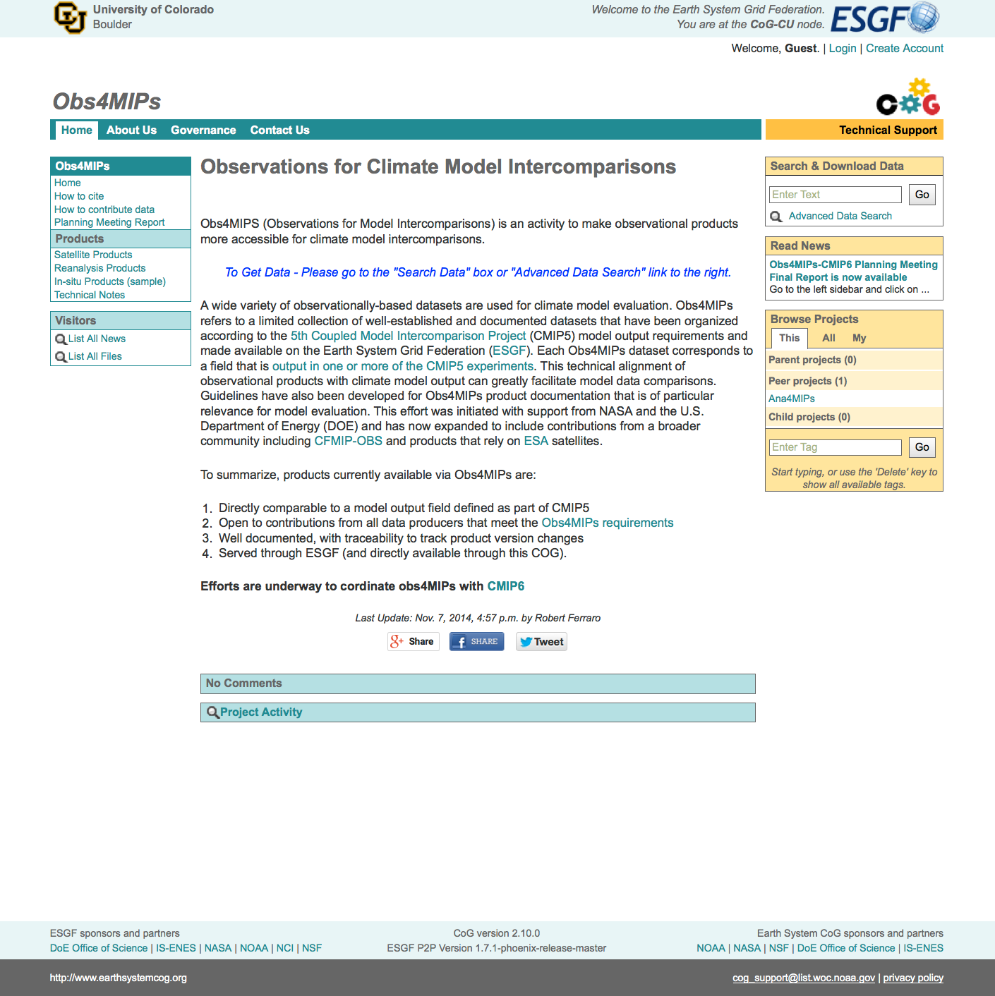
Data access and project connectedness using
The CoG for CMIP6, obs4MIPs and many other projects
11
CoG is integrated with ESGF
CMIP5 and obs4MIPs data (and ana4MIPs) are available through the CoG
CMIP6 will be hosted on the CoG, as are many other projects

Slide 12
12
Surge in research topics related to model metrics…
Succinct performance summaries, monitoring performance changes over time
Process-oriented metrics
Exploring the dependence between different models
Use in model tuning
Comparing error characteristics of MME and PPE
Weighting model projections
“Emergent constraints”
A few examples to follow

Slide 13
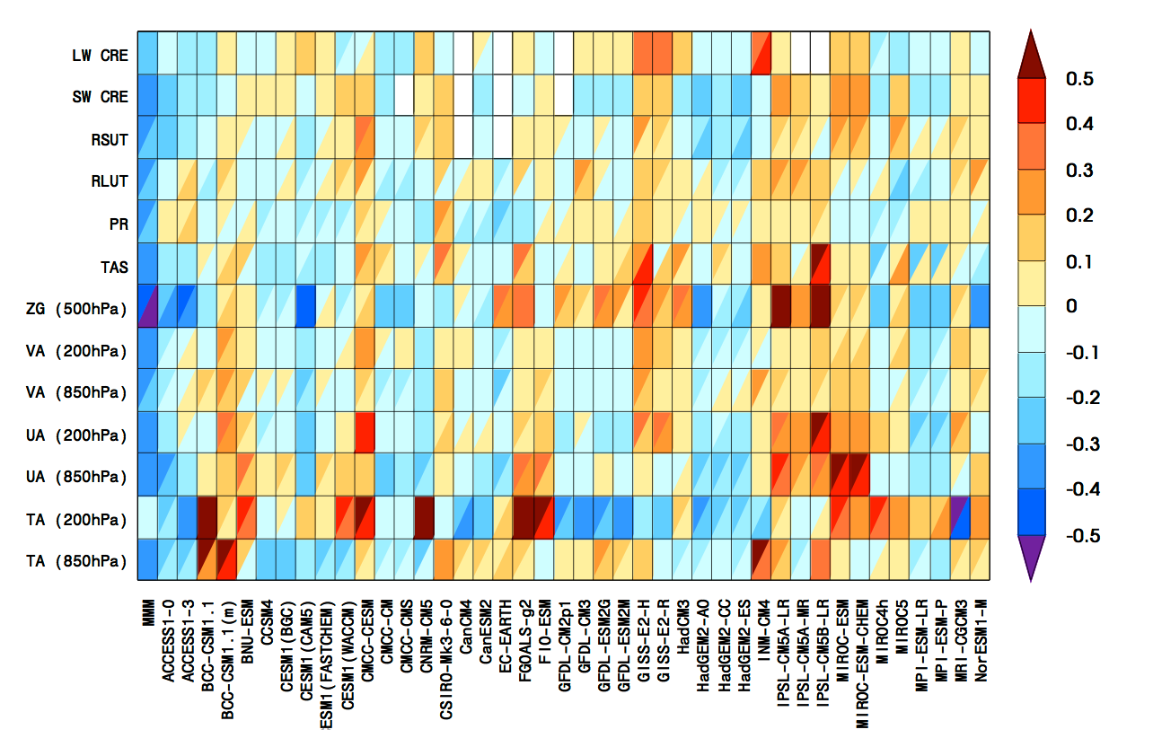
13
Assessing model strengths and weaknesses
relative to other models
Performance portrait examples
Annual cycle and extremes
Some models clearly simulating mean state and variability better than others
but
Which metrics to choose?
Some errors are correlated
Little relation to climate projections
Collapse to a single skill score?
Variables
Annual cycle
AR5 WGI Figure 9.7
Models
Variables
Extremes
AR5 WGI Figure 9.7
Models

Slide 14
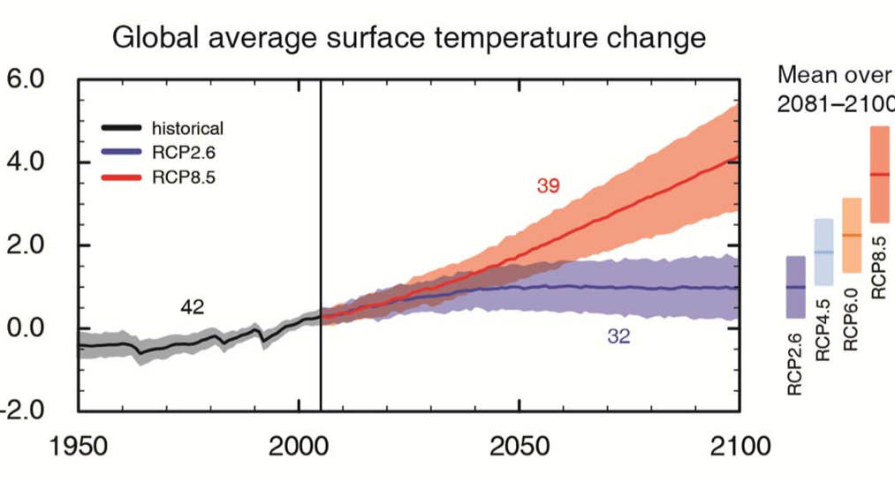
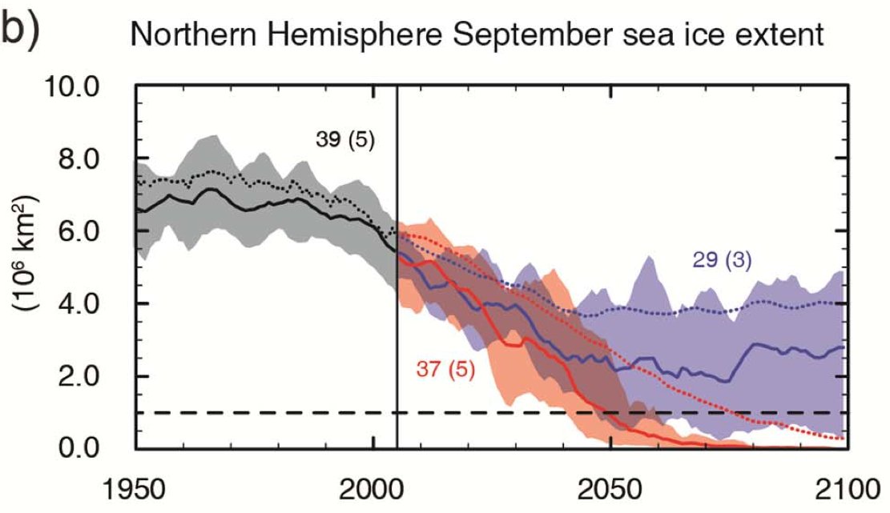
14
Multi-model projections: weighting model projections?
CMIP5 for different forcing scenarios
All models treated equally:
standard IPPC approach
AR5 WGI Figure SPM.7a
Subset of 5 models averaged together, selected by how well they simulate the present day annual cycle and observed trends (sea ice loss)
Weighting projections: A first in IPCC
AR5 WGI Figure SPM.7b

Slide 15
15
Model dependence
Masson and Knutti (2011), Knutti (2013)
Quantifying the distance between control runs of two models, accounting for mean state, seasonal cycle, and interannual variations
Demonstrates a level of dependence
between model pairs
Active area of research - how to use this information in producing multi-model projections?

Slide 16
16
Scientific challenges
  Limited opportunities to verify climate model simulations
  Metrics used for many purposes; appropriate set is application dependent
  Observations lacking for many processes believed important for climate change
  Identifying what is most important for ESM projections remains very much a research topic
  No consensus on a short list of metrics or how/if such a list should be used (e.g., in model tuning, weighting, …)

Slide 17
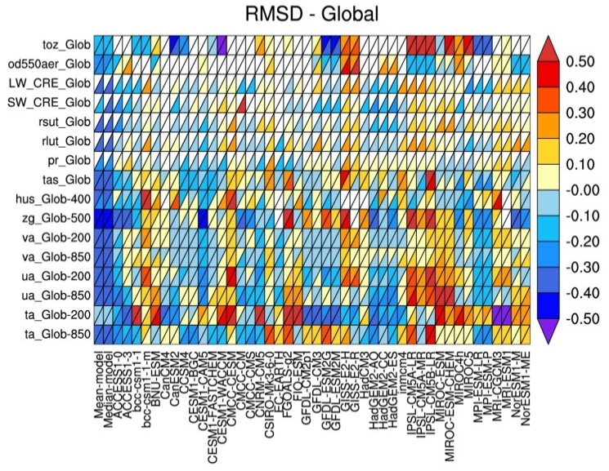
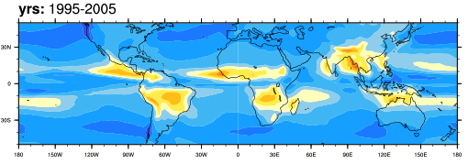
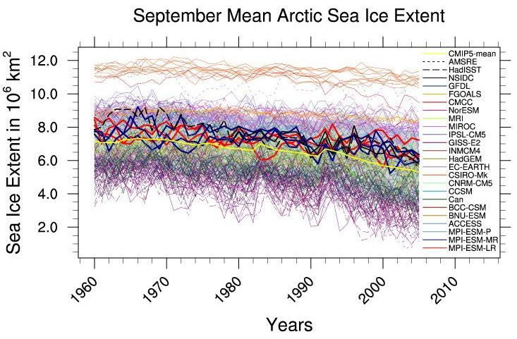
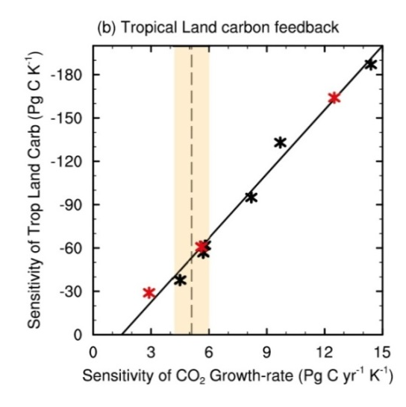
How to characterize the wide variety of models in CMIP6?
- Routine Benchmarking and Evaluation Central Part of CMIP6 -
17
Tools such as the community-wide Earth System Model Evaluation Tool (ESMValTool) and the PCMDI metrics package to produce well-established analyses as soon as CMIP model output is submitted.
Broad Characterization of Model Behavior
(incl. IPCC AR5 Chap 9 & 12 diagnostics in ESMValTool)
Similar to Figure 9.7 of AR5
CMIP5 MMM
Monsoon Precipitation Intensity
Running alongside the ESGF
CMIP5 MMM - OBS
Link to projections
Similar to Figure 9.5 of AR5
Similar to Figure 9.24 of AR5
Net Cloud radiative effect against CERES EBAF (2001–12)
Similar to Figure 9.24 of AR5

Slide 18
18
A variety of developing and lingering capabilities of potential value for CMIP benchmarking
ESMValTool
PCMDI Metrics Package
International Land Atmosphere Benchmarking (ILAMB)
CFMIP Diagnostic Repository
Recently funded process oriented metrics activities from NOAA’s Climate Program
NCAR’s Climate Variability Diagnostics Package (CVDP)
MJO task force
ENSO CLIVAR Pacific Basin Panel
……..
Additionally, new analysis tools are being used … many of them Python based, e.g., IRIS

Slide 19
19
WGNE has encouraged objective tests of climate models
WGNE formed a panel to identify performance metrics for climate models (2011)
Panel expanded and identified as a joint effort with WGCM/WGNE effort (2013)
Additional scope recommended by WMAC to include “diagnostics” (2015)
    Members selected by relevant and diverse experience, and potential for liaison with key WCRP activities:
      Beth Ebert (BMRC) – JWGV/WWRP, WMO forecast metrics
      Veronika Eyring (DLR Germany) – WGCM/SPARC/CMIP6, stratosphere, ESMs
      Pierre Friedlingstein (U. Exeter) – IGBP, carbon cycle
      Peter Gleckler (PCMDI), chair – WGNE/WGCM, atmosphere and ocean
      Simon Marsland (CSIRO) – CLIVAR OMDP, WGCM, ocean
      Robert Pincus (NOAA) – GEWEX/GCSS, clouds/radiation
      Karl Taylor (PCMDI) – WGCM, atmosphere, CMIP
      Keith Williams (U.K. Met Office) – WGNE, Transpose AMIP, clouds

Slide 20
20
The Metrics Panel terms of reference
In support of advancing benchmarking of
the CMIP DECK and Historical Experiments
Foster an environment to advance community-based routine evaluation of climate models
Coordinate with other WCRP/CLIVAR activities that are actively developing diagnostics and performance metrics
Identify analysis routines and packages that may be of potential use to modeling groups and researchers, and encourage functionality with the CMIP data conventions
Ensure that well-established capabilities are applied to the CMIP DECK and Historical experiments, with results made readily accessible
Encourage and facilitate performance metrics research by identifying key areas needing work and possibly organizing workshops

Slide 21
21
The role of the panel in support of CMIP6
  Identify existing diagnostic/metrics capabilities, document their status and summarize their potential use for the DECK. Make this information available via an online catalogue
  Identify synergies between efforts in attempt to strengthen collaborations
  Evaluate what is needed to improve a community-based DECK evaluation capability (e.g., a team devoted to developing coding best practices applicable to popular open-source tools currently in use by climate scientists)
  Objective: to ensure that community-based diagnostic and metrics capabilities are developed in a way to ensure repeat/routine use for the CMIP DECK

