Slide 1
WGNE intercomparison of
Tropical Cyclone Track forecast, 2014
Junichi Ishida
Presentation is prepared by Hitoshi Sato, Takahiro Ito, Masahiro Sawada and Munehiko Yamaguchi

Slide 2
Contents
Standard verification of global model
  By Mr. Hitoshi Sato
Standard verification of regional model
  By Mr. Takayuki Ito
Additional verification of global model part 1; False alarm rate
  By Mr. Hitoshi Sato
Additional verification of global model part 2; TC size and intensity scatter diagram
  By Dr. Masahiro Sawada
Future Plan; Paper submission to BAMS
  By Dr. Munehiko Yamaguchi

Slide 3
Standard Verification
Verification of Global Models

Slide 4
History of the Project
1991 : commencement with three centers: ECMWF, UKMO and JMA. The verification area was only western North Pacific.
1994 : CMC joined.
1999 : Verification for the North Atlantic started.
2000 : DWD joined. Verification for the eastern North Pacific started.
2002 : Verification for 2 Southern Hemispheric regions, north Indian Ocean and the Central Pacific started.
2003 : NCEP and BoM joined. A website for this intercomparison project was launched.
2004 : Meteo-France and CMA joined.
2006 : CPTEC and NRL joined.
2011 : KMA joined. CMA came back.
2015: 11 NWP centers participated in the project.
〔BOM CMA CMC DWD ECMWF JMA KMA France NCEP NRL UKMO 〕

Slide 5
Specification of Data
NWP centers | Participate Year | Bogus data / Relocation | Horizontal Res. of provided data | Model Res. as of 2014
BoM | 2003 | - | 0.562x0.375 | 40kmL70
CMA | 2004 | used in WNP | 1.25x1.25 (~Jul. 10) 0.2812x0.2812 (Jul. 11~) | T_{L}213L31 (~Jul. 10) T_{L}639L60 (Jul. 11~)
CMC | 1994 | - | 1.0x1.0 | 25km L80
DWD | 2000 | - | 0.25x0.25 | 20kmL60
ECMWF | 1991 | - | 0.125x0.125 | T_{L}1279L137
JMA | 1991 | used in WNP | 0.25x0.25 | T_{L}959L60 (~Mar. 17) T_{L}959L100 (Mar. 18~)
KMA | 2011 | used | 0.3515x0.2343 | 25kmL70
France | 2004 | used*¹ | 0.5x0.5 | T_{L}798C2.4L70
NCEP | 2003 | used in NH | 1.0x1.0 | T574 L64
NRL | 2006 | used | 0.5x0.5 | T359L50
UKMO | 1991 | - | 0.3515x0.2343 (~Jul. 14) 0.2343x0.1562 (Jul. 15~) | 25kmL70 (~Jul. 14) 17kmL70 (Jul. 15~)
*¹ except for South Pacific and north Indian-Ocean

Slide 6
Method of TC verification using MSLP
TCs to be verified
TCs which intensity reached tropical storm (TS) with the maximum sustained wind of 34 knots or stronger are set as targets for this verification. The tropical depression (TD) stage of the targeted TCs is also included in this verification. However, the TCs which stayed at TD level all through their life are excluded.
1. Tracking Method
local pressure minimum;
a) First position (FT +0hr) : search from the best track position
b) Second position (FT +6hr) : search from the first position
c) Third and after (FT +12hr~) : search from estimated position
from the latest two positions
(all position searched within 500km radius)

Slide 7
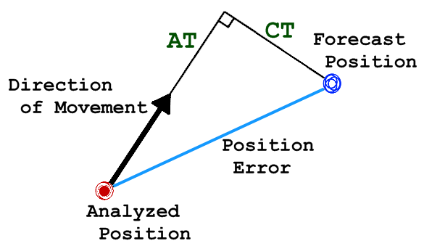
Verification Method
・Position Error 〔km〕
The distance between
the best-track (analyzed) position
and the forecast position.
・Along Track – Cross Track bias
AT(along-track)-bias : The bias in the direction
of TC movement
CT(cross-track)-bias : The bias in the rectangular
direction of TC movement
・Detection Rate
Detection Rate (t) = A(t)/ B(t)
A(t) : The number of forecast events in which a TC is analyzed at forecast time t on the
condition that a NWP model continuously expresses the TC until the forecast time t.
B(t) : The number of forecast events in which a TC is analyzed at forecast time t.
Notes:
Note that following verification results are using inhomogeneous samples otherwise noticed.
This verification method for TC detection rate may be in favor of the NWP model that generates more TCs than actual, because the false alarm is not considered in the metric.

Slide 8
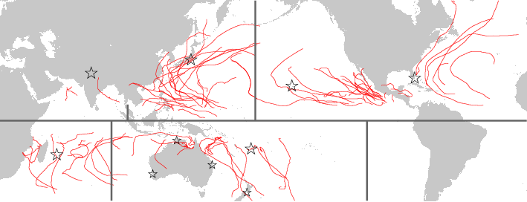
TC Verification
TC tracks on 2014 season
Northern-Hemisphere [2014/01/01 to 2014/12/31]
Southern-Hemisphere [2013/09/01 to 2014/08/31]
Number of TCs , [best-track data provider]
23 western North-Pacific [RSMC Tokyo]
22 eastern North-Pacific (including Central-Pacific) [RSMC Miami, Honolulu]
8 North Atlantic [RSMC Miami]
3 north Indian-Ocean [RSMC New-Delhi]
11 south Indian-Ocean [RSMC La-Reunion]
14 around Australia [RSMC Nadi and 4 TCWCs ]
23
22
8
3
11
14

Slide 9
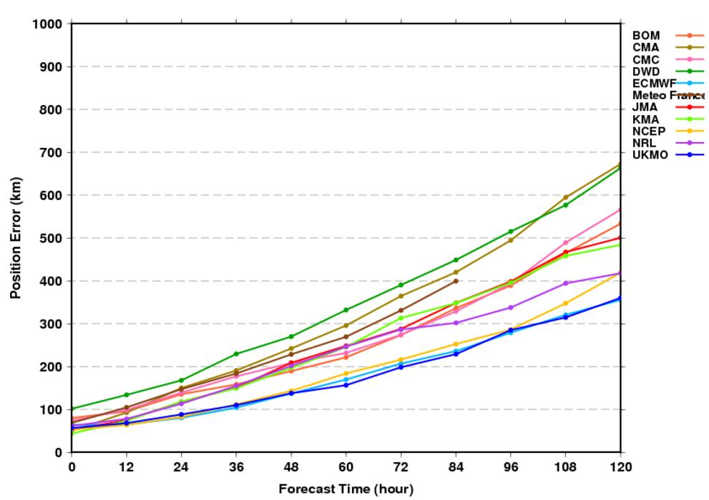
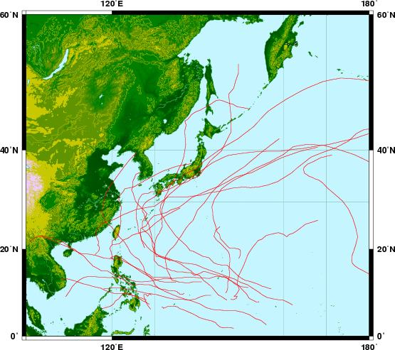
(a) western North-Pacific (WNP) domain Position Error
23 TCs in 2014
ECMWF, Met Office and NCEP achieve the best performance on average. Other centres such as NRL, BoM, JMA, CMC and KMA follow.
Notes:
ECMWF, Met Office and NCEP achieve the best performance on average. Other centres such as NRL, BoM, JMA, CMC and KMA follow.

Slide 10
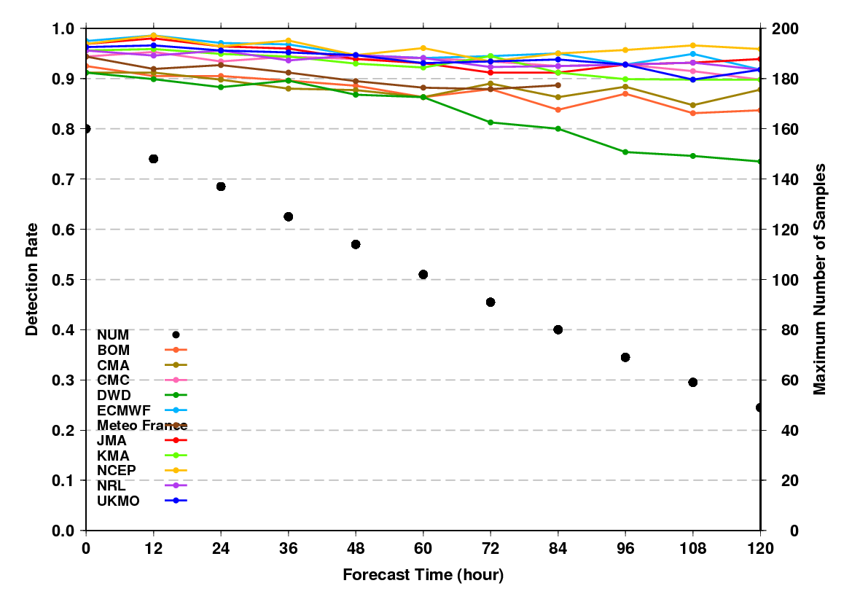
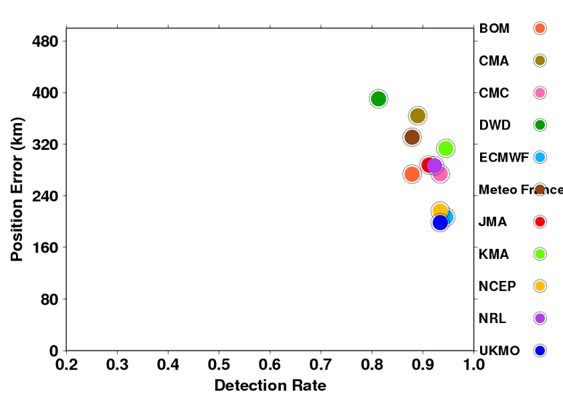
(a) WNP domain Detection Rate
Detection Rate – Position Error map (FT +72)
better
Overall, ECMWF, Met Office and NCEP performed the best followed by CMC, NRL, JMA and BoM.
Notes:
Overall, ECMWF, Met Office and NCEP performed the best followed by CMC, NRL, JMA, BoM.

Slide 11
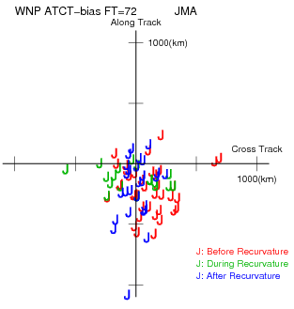
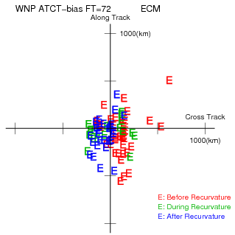
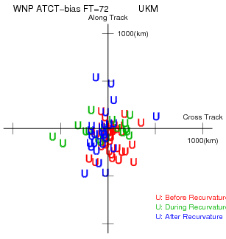
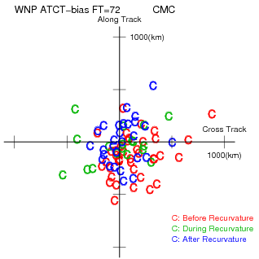
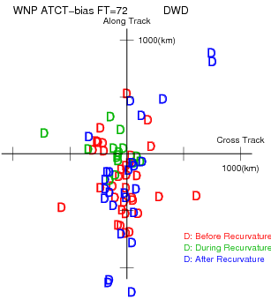
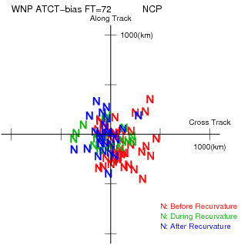
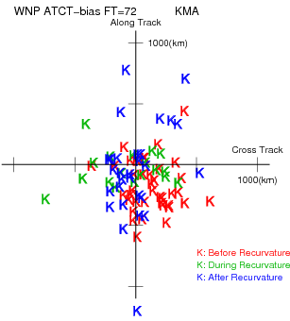
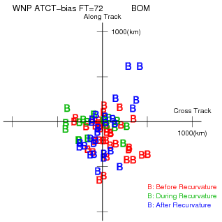
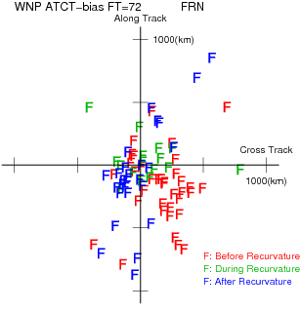
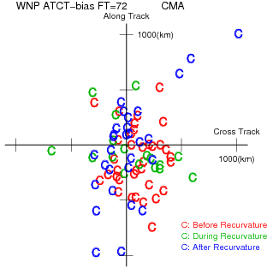
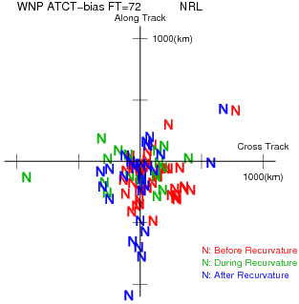
(a) WNP domain AT-CT bias map (FT +72)
JMA
ECMWF
UKMO
CMC
DWD
NCEP
KMA
BOM
Meteo France
CMA
NRL
Scatter diagram of TC positions at 72 hour forecast.
Red : Before recurvature
Green : During recurvature
Blue : After recurvature
Y-axis represents position errors in Along Track (AT) direction
and X-axis does that in Cross Track (CT) direction.
Unit: km
Theire is a significan slow bias in JMA, BoM and NRL.
Notes:
There is a significant slow bias in JMA, BoM and NRL.

Slide 12
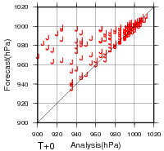
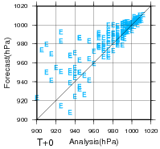
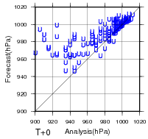
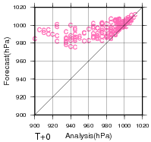
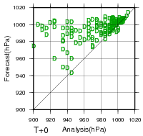
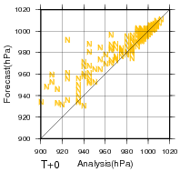
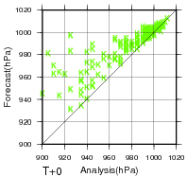
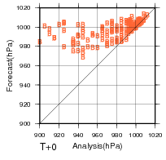
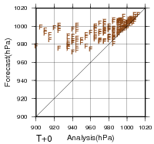
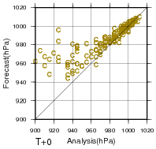
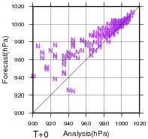
(a) WNP domain Central Pressure scatter diagram (FT +0)
JMA
ECMWF
UKMO
CMC
DWD
NCEP
KMA
BOM
Meteo France
CMA
NRL
Scatter diagram of central pressure at initial. Y-axis represents central pressure of forecast and X-axis does that of analysis. Unit: hPa
Good linear relationship is found for NCEP, CMA and NRL especially in weak TC at initial time. Some good linear relationship for strong TC is found by ECMWF.
Notes:
Good linear relationship is found for NCEP, CMA and NRL especially in weak TC at initial time. Some good linear relationship for strong TC is found by ECMWF.

Slide 13
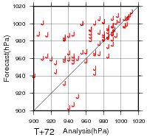
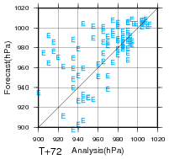
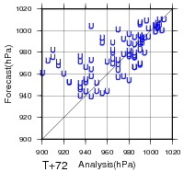
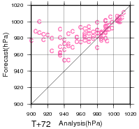
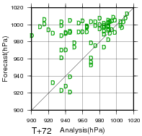
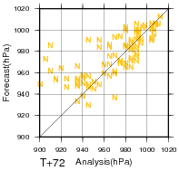
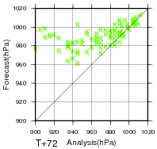
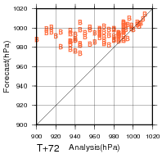
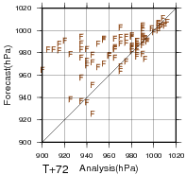
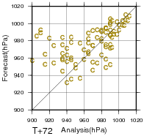
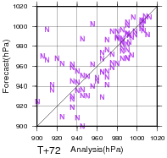
(a) WNP domain Central Pressure scatter diagram (FT +72)
JMA
ECMWF
UKMO
CMC
DWD
NCEP
KMA
BOM
Meteo France
CMA
NRL
Scatter diagram of central pressure at initial. Y-axis represents central pressure of forecast and X-axis does that of analysis. Unit: hPa
Met Office, CMC, DWD, KMA, BoM and Meteo France predict relatively shallow TCs, while JMA, ECMWF, NCEP and NRL has small bias in deep TC though the spread is not small.
Notes:
Met Office, CMC, DWD, KMA, BoM and Meteo France predict relatively shallow TCs, while JMA, ECMWF, NCEP and NRL has small bias in deep TC though the spread is not small.

Slide 14
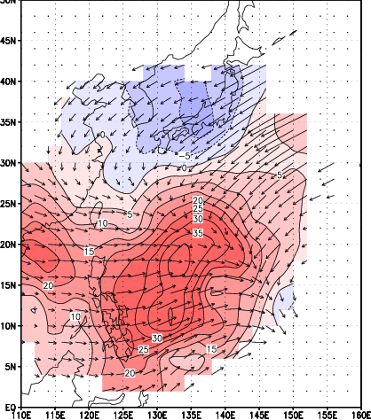
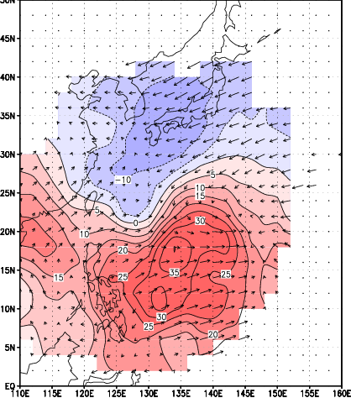
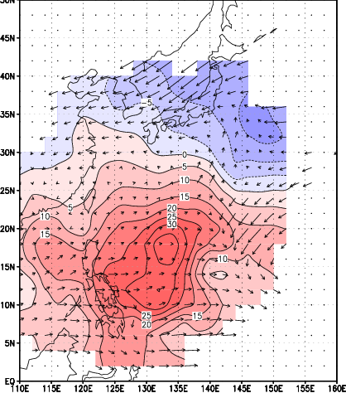
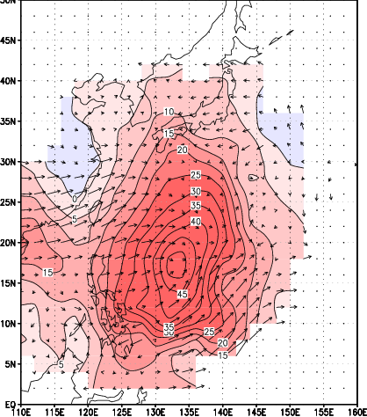
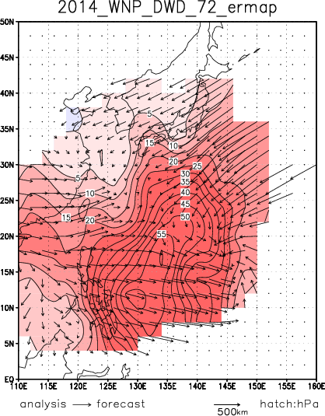
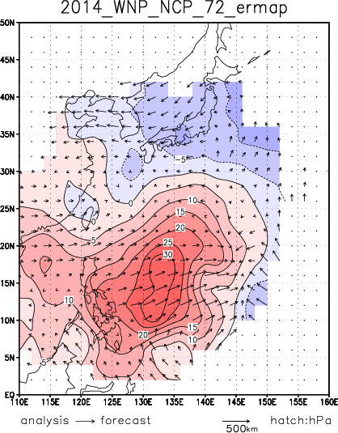
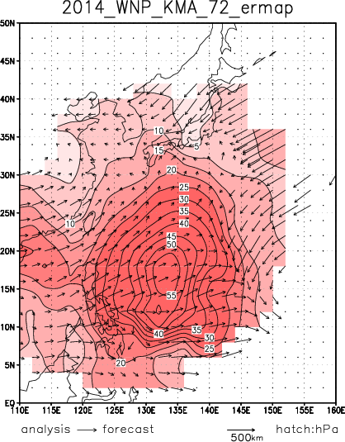
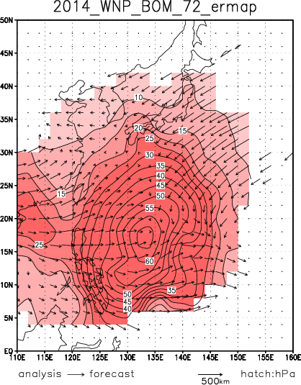
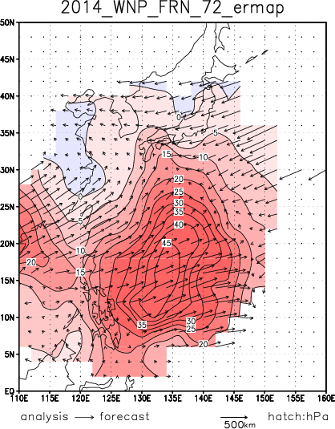
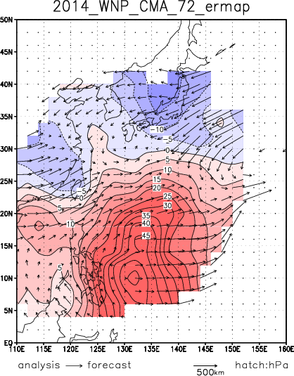
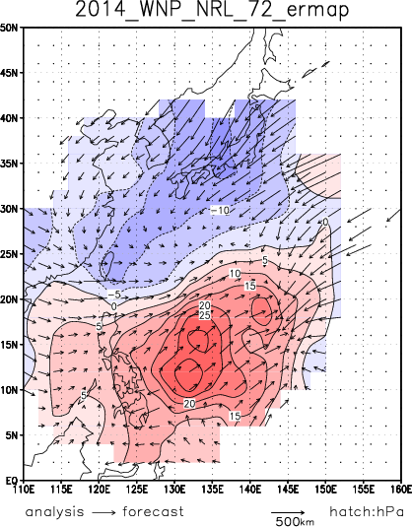
(a) WNP domain Error Map (FT +72)
JMA
ECMWF
UKMO
CMC
Forecast position
DWD
NCEP
KMA
BOM
Analysis position
Meteo France
CMA
NRL
Error map of central pressure and position at 72 hour forecast.
Color:Central pressure error Units:hPa
(Red:forecast is shallow. Blue:forecast is deep)
Arrow: average position error
All models failed to predict deep TCs around the east of Philippine and the east of Mariana Islands.
Notes:
All models failed to predict deep TCs around the east of Philippine and the east of Mariana Islands.

Slide 15


Position Error
2013 season
2014 season
Detection Rate
Generally, TC position forecast error has been reduced for most NWP centers.
Mean forecast position error of Met Office and NCEP got almost equal to that of ECMWF.
Notes:
Generally, TC position forecast error has been reduced for most NWP centers.
Mean forecast position error of Met Office and NCEP got almost equal to that of ECMWF.

Slide 16


(b) North-Atlantic (NAT) domain Position Error
8 TCs in 2014
Sample numbers is very small (13 TCs in 2013) in this season.
Met Office, KMA, ECMWF, NCEP and JMA achieved the best performance around T+48 to T+72.
Notes:
Sample numbers is very small (13 TCs in 2013) in this season.
Met Office, KMA, ECMWF, NCEP and JMA achieved the best performance arount T+48 to T+72.

Slide 17


(b) NAT domain Detection Rate
Detection Rate – Position Error map (FT +72)
better
Relatively small detection rate for NAT region compared to that for other region.
Notes:
Relatively small detection rate for NAT region compared to that for other region.

Slide 18


(c) eastern North-Pacific (ENP) domain Position Error
22 TCs in 2014
ECMWF achieved the best on average and NCEP and Met Office follows.
Notes:
ECMWF achieved the best on average and NCEP and Met Office follows.

Slide 19


(c) ENP domain Detection Rate
Detection Rate – Position Error map (FT +72)
better
ECMWF achieved the best performance in detection rate and position error. NCEP and Met Office follow.
Notes:
ECMWF achieved the best performance in detection rate and position error. NCEP and Met Office follow.

Slide 20


(d) “around Australia” (AUR) domain Position Error
14 TCs in 2013/2014
NCEP and ECMWF achieved the best performance and Met Office and Meteo France, CMC, NRL and BoM follows.
Notes:
NCEP and ECMWF achieved the best performance and Met Office and Meteo France, CMC, NRL and BoM follows.

Slide 21


(d) AUR domain Detection Rate
Detection Rate – Position Error map (FT +72)
better
NCEP performed well in detection rate with small position error.
Notes:
NCEP performed well in detection rate with small position error.

Slide 22


(e) South Indian Ocean (SIO) domain Position Error
11 TCs in 2013/14
ECMWF performed very well and NCEP, NRL, Meteo France follow.
Notes:
ECMWF performed very well and NCEP, NRL, Meteo France follow.

Slide 23


(e) SIO domain Detection Rate
Almost the perfect detection in SIO basin for this season (except for CMA).
Detection Rate – Position Error map (FT +72)
better
Notes:
Almost the perfect detection in SIO basin for this season (except for CMA).

Slide 24












visualization with “pie-chart”
JMA
ECMWF
UKMO
CMC
DWD
NCEP
KMA
BOM
Meteo France
CMA
NRL
ECMWF, Met Office and NCEP provide accurate TC track forecast for all basins.
The error dispersions by NCEP, JMA and CMC are relatively small.
Notes:
ECMWF, Met Office and NCEP provide accurate TC track forecast for all basins.
The error dispersions by NCEP, JMA and CMC are relatively small.

Slide 25






Transition of T+72 position error over decade(s)
WNP
ENP
NAT
SIO
AUR
Recent improvements of Met Office and NCEP are quite significant in WNP region.
The forecast for TCs in SIO region in 2014 was more difficult than that in 2013 for almost all centres except ECMWF.
Notes:
Recent improvements of Met Office and NCEP are quite significant in WNP region.
The forecast for TCs in SIO region in 2014 was more difficult than that in 2013 for almost all centres except ECMWF.

Slide 26

TC intercomparison website is now available!
<http://nwp-verif.kishou.go.jp/wgne_tc/index.html>
Login ID: verif
Password: wgne2015 (beyond xx April 2016)
Contact:

Slide 27
Standard Verification
Verification of Regional Models

Slide 28
Specification of Regional Models
NWP centers | Name of Model | Verification Region | Boundary | Bogus data | Model Res. as of 2014
JMA | MSM | WNP | GSM | Used | 5kmL48
KMA | RDAPS | WNP | GDAPS | Used | 10kmL40
Meteo France | ALADIN | NAT SIO | IFS(NAT) ARPEGE(SIO) | Used | 8kmL70
NCEP | HWRF | NAT,ENP | GFS | Used | 3/9/27kmL61 (triple nest )
Notes:
HWRFは2014年に鉛直層数を43→61層へと増強した。

Slide 29




Position Error of homogeneous samples(2014)
MSM/GSM(WNP)
JMA
RDAPS/GDAPS(WNP)
KMA
HWRF/GFS(ENP)
NCEP
HWRF/GFS(NAT)
NCEP
Position errors of regional model in 2014 are almost as same as those of global model which provides initial and boundary conditions.
Notes:
進路誤差の等サンプル検証の結果。
KMAは若干全球モデルの方が精度が良いが、
他は全球と領域モデルで進路誤差に大きな差は見られず、
傾向・精度は全球も領域も大きく違わない。

Slide 30



Position Error of homogeneous samples(2013)
MSM/GSM(WNP)
JMA
HWRF/GFS(ENP)
NCEP
HWRF/GFS(NAT)
NCEP
In 2013, position errors of JMA regional model in 2013 are smaller than those of global model, while those of NCEP regional model are larger over about T+48.
Notes:
2013年の進路誤差の等サンプル検証の結果（KMAは昨年はデータ提供なし）。
JMAは2013年、2014年で大きな違いは見られない。
HWRFは予報後半で全球より誤差が大きくなっていたが、
2014年は予報期間を通してほぼ同等の精度となった。

Slide 31




Position Error of homogeneous samples(2014)
Meteo France
ALADIN/ARPEGE(SIO)
ALADIN/IFS(NAT)
Position Error of homogeneous samples(2013)
Meteo France
ALADIN/ARPEGE(SIO)
ALADIN/IFS(NAT)
In 2013, position errors of ALADIN was larger than those of ARPEGE, but they are almost equal in 2014 in SIO region.
Notes:
進路誤差の等サンプル検証の結果。
SIO領域では他のセンター同様に進路誤差の傾向・精度について全球も領域も大きく違わないが、
NAT領域はサンプル数が少ないためかそのような傾向はみられない。

Slide 32




Intensity RMSE of homogeneous samples(2014)
MSM/GSM(WNP)
JMA
RDAPS/GDAPS(WNP)
KMA
HWRF/GFS(ENP)
NCEP
HWRF/GFS(NAT)
NCEP
RMSE of intensity of regional model is smaller than those of global model which provides initial and boundary condition in 2014.
Notes:
強度誤差の等サンプル検証の結果。
いずれのセンターも強度誤差では概ね領域モデルの方が誤差が小さくなっている。

Slide 33



Intensity Error of homogeneous samples(2013)
MSM/GSM(WNP)
JMA
HWRF/GFS(ENP)
NCEP
HWRF/GFS(NAT)
NCEP
In 2013, the difference of RMSE of intensity of regional model and those of global model was not very large.
Notes:
2013年の強度誤差の等サンプル検証の結果（KMAは昨年はデータ提供なし）。
JMAでは予報後半でGSM・MSMは同程度の誤差となるが、2014年は後半でもMSMの方が誤差が小さい
HWRFについて全球より強度誤差の優位性があるのは
2013年はENP領域の予報前半だけだったが、
2014年はどちらの領域も予報期間を通して領域モデルの方が良くなっている。

Slide 34




Intensity RMSE of homogeneous samples(2014)
Meteo France
ALADIN/ARPEGE(SIO)
ALADIN/IFS(NAT)
Intensity Error of homogeneous samples(2013)
Meteo France
ALADIN/ARPEGE(SIO)
ALADIN/IFS(NAT)
IALADIN in NAT region shows better performance of intensity forecast both in 2013 and 2014, while the performance in SIO region in 2014 is different from that in 2013.
Notes:
強度誤差の等サンプル検証の結果。
SIO領域では全球と領域モデルであまり大きな差はなく、
予報後半は領域モデルの方が誤差が大きくなっている。
NAT領域は領域モデルの方が誤差が小さいが、サンプル数が少ないことに注意。

Slide 35
ADDITIONAL VERIFICATION
Probability of False Alarm

Slide 36

Verification Method
Cyclone Detection using MSLP and 850 hPa winds
Interpolate all forecast fields to 1.25x1.25 lat-lon grids
Search grid points where
- mean sea-level pressure (MSLP) becomes minimum within 500 km radius,
- its minimum value is at least 0.5 hPa less than average MSLP within 500 km radius, and
- average 850 hPa relative vorticity within 300 km is larger than 30x10⁻⁶ s⁻¹
(opposite sign for Southern Hemisphere)
Domain and Period
WNP, ENP, NAT : May 1, 2014 to November 30, 2014
SIO, AUR : December 1, 2013 to March 31, 2014
WNP
ENP
NAT
SIO
AUR
Probability of False Alarm (FAR: False Alarm Ratio)
FAR = FX / (FO + FX)
 |  | Event analyzed
 |  | Yes | No
Event forecast | Yes | FO | FX
 | No | XO | XX
Success Ratio (SR)
SR = 1 - FAR

Slide 37






Probability of False Alarm
WNP
ENP
NAT
SIO
AUR
ECMWF achieved best performance of False Alarm and JMA, BoM and NCEP follow in WNP and NAT region. JMA and NCEP achieved best performance of False Alarm in ENP region and ECMWF follows.
The discrepancy of False Alarm in AUR is relatively small. CMA shows small False Alarm before T+12-24.
Notes:
ECMWF achieved best performance of FAR and JMA, BoM and NCEP follow in WNP and NAT region.
JMA and NCEP achieved best performance of FAR in ENP region and ECMWF follows.
The discrepancy of FAR in AUR is relatively small.
CMA shows small FAR before T+12-24.

Slide 38






Detection Rate – Success Ratio diagram (FT +72)
better
WNP
ENP
Critical Success Index
Bias
NAT
SIO
AUR
ECMWF achieved best performance in WNP and JMA and BoM follows.
All centres have large bias especially in AUR and NAT regions.
Notes:
ECMWF achieved best performance in WNP and JMA and BoM follows.
All centres have large bias especially in AUR and NAT regions.

Slide 39
ADDITIONAL VERIFICATION
Tropical Cyclone size verification

Slide 40
Tropical cyclone size verification
Motivation: TC size such as gale-/hurricane force wind area is important factor for disaster preparedness. However, there are few documents/studies on TC size verification. So, the purpose of this investigation is to quantify;
How do the TC size in the analyses differ between the models?
What kind of relationship between TC size, central pressure and central pressure departure from besttrack at initial in the models?
TC size: RMW (radius of maximum wind speed) and R34 (34knots radius) is calculated from azimuthally averaged tangential wind speed at 850hPa.
Data: Western north pacific on 2014 season.
Case: TCs which intensity reached tropical storm (TS) with the maximum sustained wind of 34 knots or stronger are set as targets for this verification.

Slide 41

Scatter diagram between CP and RMW (FT+0)
(km)
X-axis: central pressure at initial.
Y-axis: RMW at initial.
Color: central pressure departure from besttrack.
(hPa)
There is a large discrepancy of RMW among models. ECMWF reproduces smallest RMW followed by JMA and UKMO. BOM, CMC and FRN show large RMW with large initial central pressure difference.
Note: the result depend on the horizontal resolution of model and product data.

Slide 42

Scatter diagram of RMW w.r.t. ECMWF(FT+0)
(km)
X-axis: RMW for ECMWF at initial.
Y-axis: RMW for each model at initial.
Color: central pressure difference between ECMWF and each model.
(km: ECMWF)
There is a large discrepancy of RMW with regards to ECMWF. BOM, CMC, FRN tends to become larger RMW than that of ECMWF. CMA, JMA, NCEP, NRL shows deeper central pressure at initial when RMW is smaller than that of ECMWF.

Slide 43

Scatter diagram between CP and R34 (FT+0)
(km)
X-axis: central pressure at initial.
Y-axis: R34 at initial.
Color: central pressure departure from besttrack.
(hPa)
Compared to the RMW, difference in R34 among models is small. BOM, CMC, FRN, KMA show linear relationship between CP & R34. ECMWF, JMA, NCEP, UKMO express a wide horizontal scale of R34 for the same intensity. There is no clear relationship between R34 and central pressure departure from besttrack at initial.

Slide 44

Scatter diagram of R34 w.r.t. ECMWF(FT+0)
(km)
X-axis: R34 for ECMWF at initial.
Y-axis: R34 for each model at initial.
Color: central pressure difference between ECMWF and each model.
(km: ECMWF)
Compared to the RMW, R34 at each model is consistent with that of ECMWF. BOM, CMC, FRN, NCEP, UKMO is linear relationship with ECMWF. CMA, KMA, NRL have a relatively large difference from ECMWF.

Slide 45
Future plan
Paper submission to BAMS

Slide 46
Paper submission for publication in BAMS
As the WGNE marks 25 years since the start of this intercomparison, it is an opportune time to review the achievements of the project, and how much the accuracy of TC track forecasts by the global models has improved over the last quarter century.
Title:
WGNE Intercomparison of Tropical Cyclone Forecasts by Operational Global Models: A Quarter-Century and Beyond
Schedule
BAMS requires that an Author Proposal be submitted (to the web site) and then approved before a full manuscript will be considered.
A proposal consists of a single abstract of 250 words or less, plus a cover letter of 250 words or less.
A draft abstract and a cover letter are ready, so we plan to submit them once we get a approval from the WGME members.
We plan to submit the manuscript to BAMS before the next session of the WGNE meeting if the proposal is approved by BAMS.
History of the project
Time series of position errors (both globally and in each TC basin)
Benefit of multi-model ensembles
Verification of intensity forecasts and forecasts by regional models
Future challenges to TC track forecasting that have been identified at the 8th WMO International Workshop on Tropical Cyclones (IWTC)

