Slide 1
WGNE-31, CSIR, Pretoria, South Africa, 26-29 April 2016
Recent progresses in convective-scale and next generation global modeling at KMA
Dong-Joon Kim
Numerical Modeling Bureau
National Institute of Meteorological Sciences (NIMS) / KMA

Slide 2
Outlines
Convective-scale NWP Systems
  Domain expansion of local model (LDAPS)
  A new very short-range NWP system (VDAPS)
  Convective-scale EPS (LENS)
Next-generation Global Model Development (KIAPS)
  Recent progresses in KIM development
  (Dynamical Core / Physical Parameterization / D.A.)

Slide 3
Convective-scale (Very) Short-range NWP Systems

Slide 4
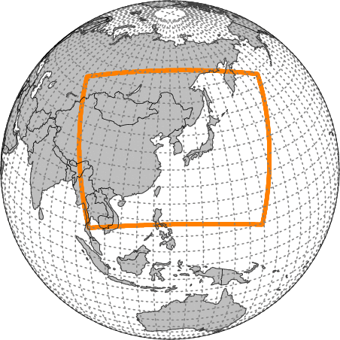
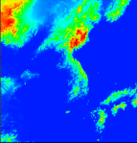
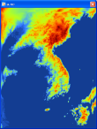
Operational NWP Systems
Global Medium-range Prediction (Operation in June 2016)
Deterministic : UM 17km L70 / T+288hrs (00/12UTC) / Hybrid Ensemble 4DVAR
Ensemble : UM 32km L70 / T+288hrs (00/12UTC) / Members : 1(Control)+24+24(lagged)
Short-range Prediction (E-Asia)
UM 12km L70 / T+87hrs (6 hourly) / 4DVAR / Deterministic
(Very) Short-range Prediction (Local)
Deterministic : UM 1.5km L70 / T+36hrs (6 hourly) / 3DVAR (3 hourly)
Ensemble : UM 3km L70 / T+72hrs / Members : 1(Control)+12+12(lagged)

Slide 5
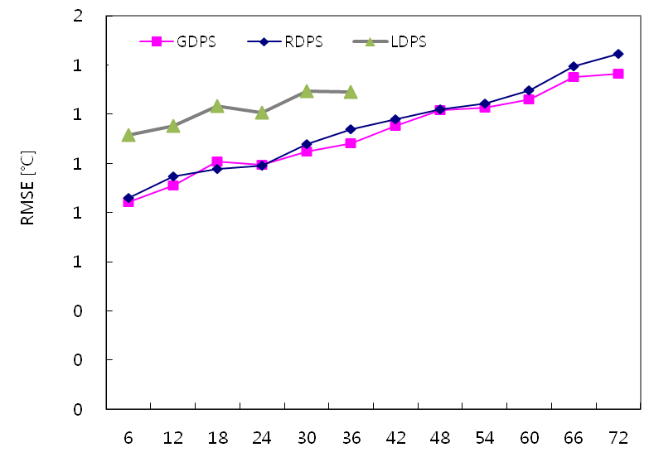
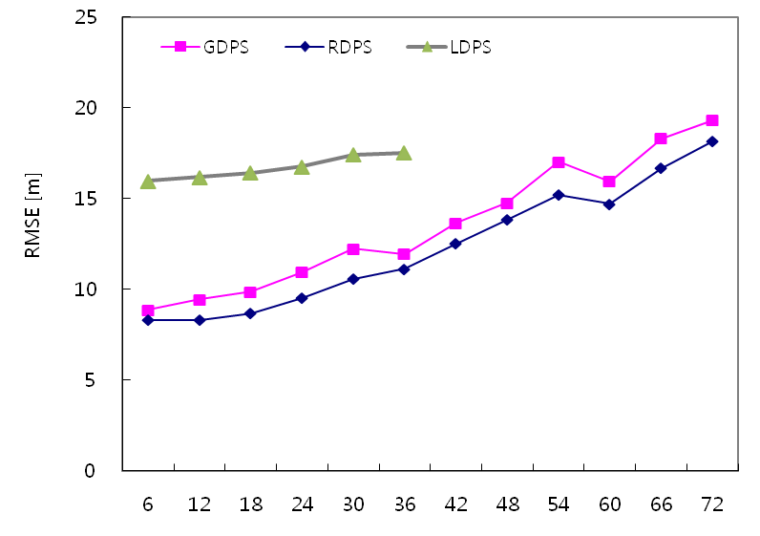
[Trial 1] Domain Expansion of Local Model
Local Data Assimilation and Prediction System (LDAPS)
Domain : Korean Peninsula
Horizontal resolution : 1.5km (744x928 / variable grid)
Vertical levels : 70 (top = 40km)
Target length / cycle : +36 hours
Data Assimilation : 3DVAR
Motivation : degradation of LDAPS performance
Threshold | Threat Score
 | Global | Regional | Local
0.1mm/12hr | 0.44 | 0.48 | 0.48
5.0mm/12hr | 0.43 | 0.45 | 0.40
15mm/12hr | 0.39 | 0.38 | 0.33
25mm/12hr | 0.31 | 0.30 | 0.28
50mm/12hr | 0.15 | 0.20 | 0.16
Global Model
Regional Model
Local Model
72-hour averaged TS during JJA 2015
(verification for same area [the Korean Peninsula])
RMSE / T850 (left) and Z500 (right)
Verification against RAOBs

Slide 6
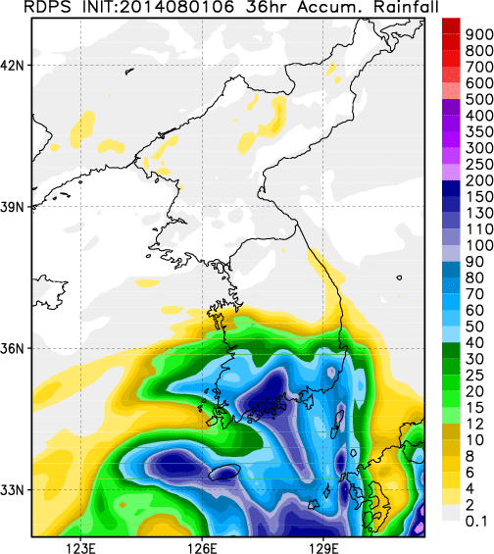
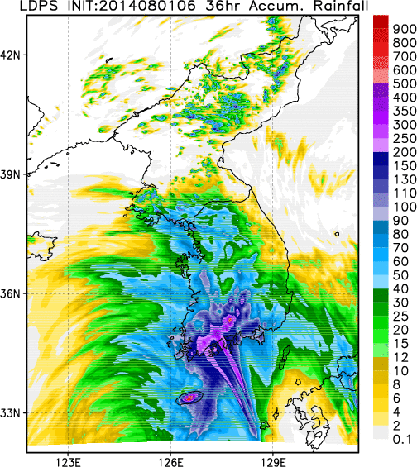
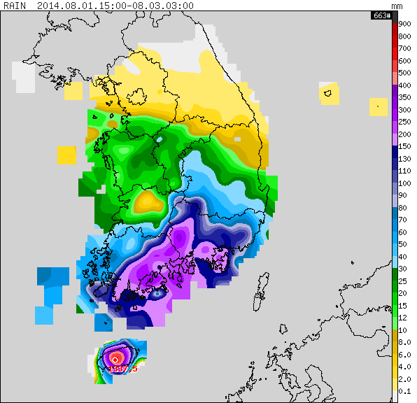
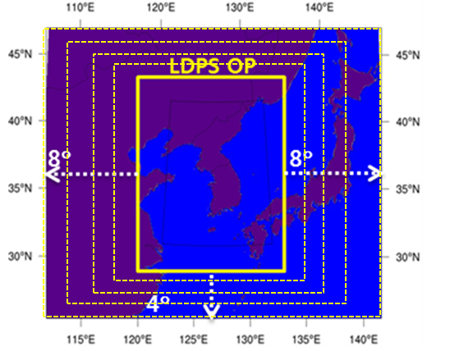
[Trial 1] Domain Expansion of Local Model
Mitigating negative impact of lateral B.C. from global model which sometimes degrades the forecast accuracy
RDAPS
LDAPS
Typhoon NAKRI case (July 2014) : 36hr accumulated precipitation
OBS
Expansion of (variable grid) domain
Number of Grid-points
744(E-W)x928(N-S) → 1188(E-W)x1148(N-S)
(twice as many calculation)

Slide 7
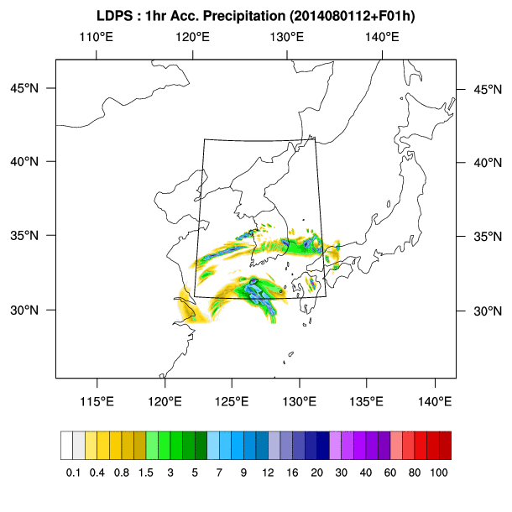
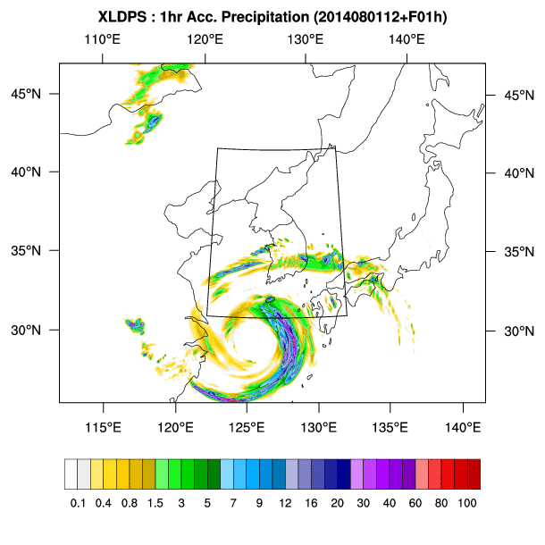
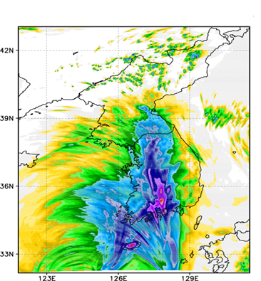
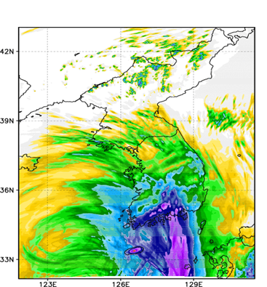
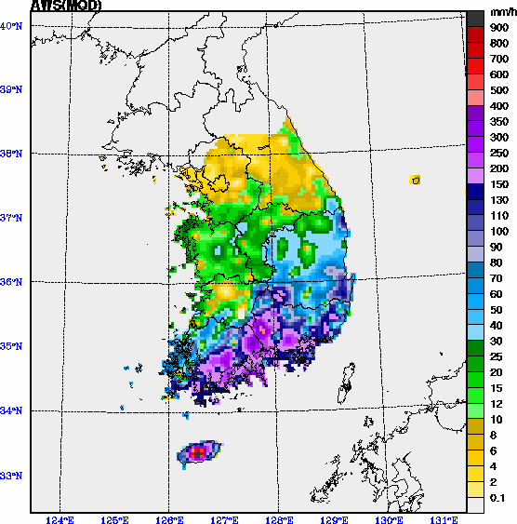
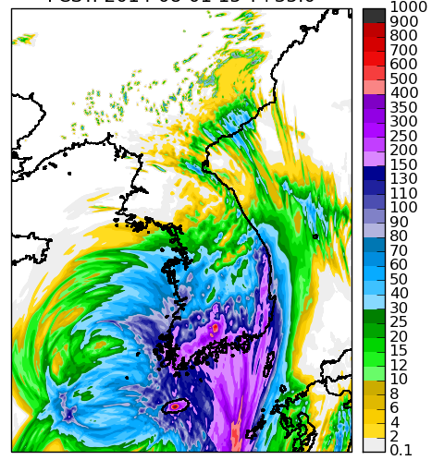
[Trial 1] Domain Expansion of Local Model
OBS
Original Domain
(UM vn8.2)
Expanded Domain
(UM vn8.2)
Expanded Domain
(UM vn10.1)

Slide 8
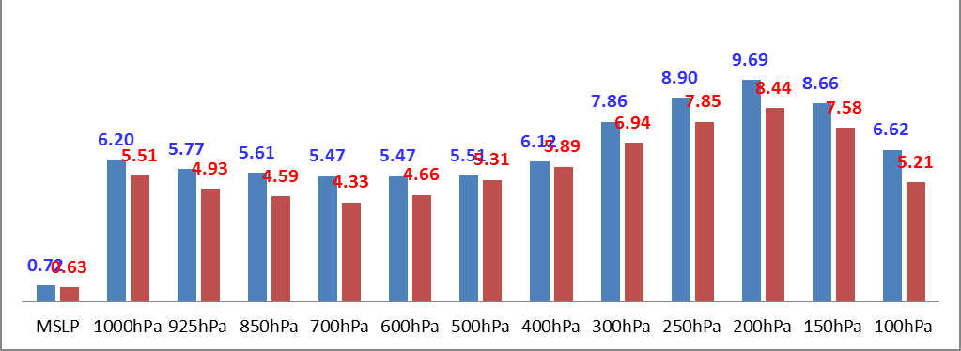
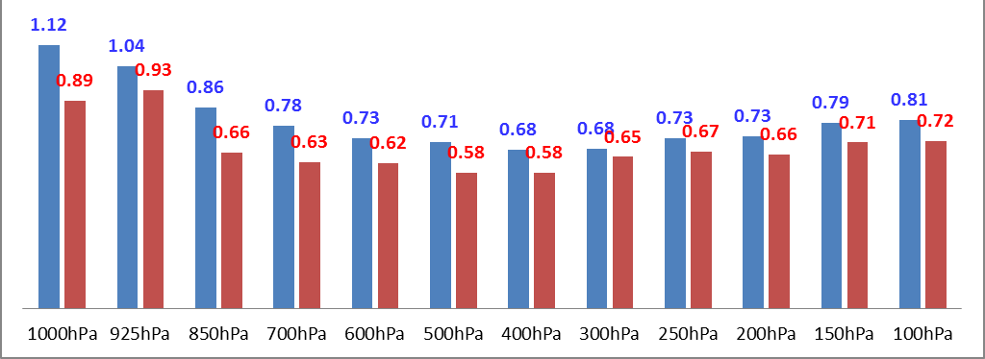
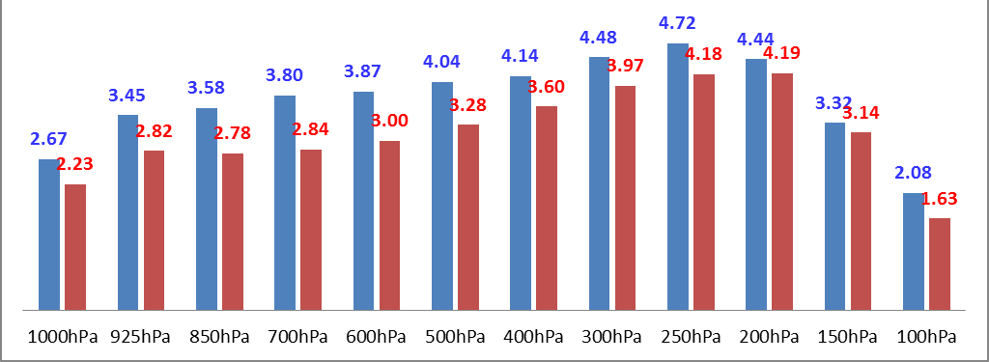
[Trial 1] Domain Expansion of Local Model
Preliminary verification result : verification against analysis / July 2015
Geopotential Height
Operation (UM 8.2)
Domain Expansion (UM 10.1)
Temperature
Wind

Slide 9
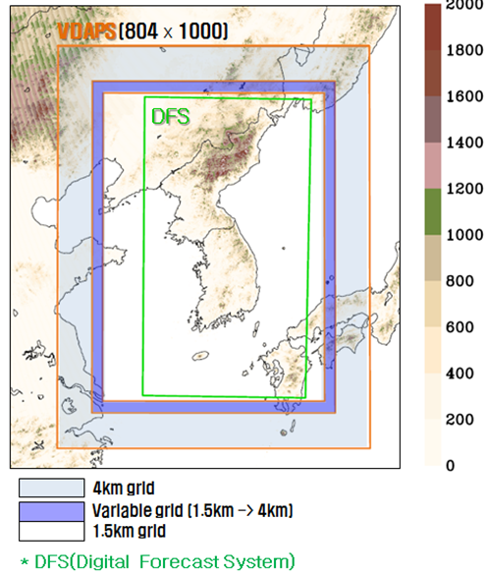
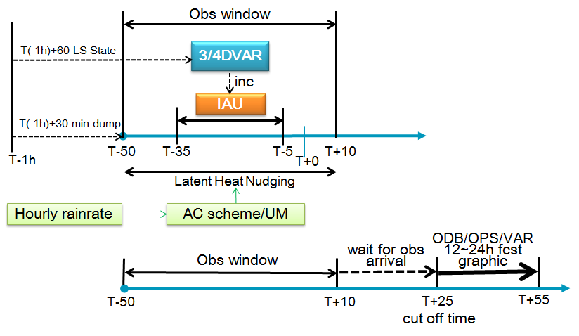

[Trial 2] A new Very Short-range NWP system
VDAPS (Very short-range Data Assimilation and Prediction System) Configuration
1.5km resolution (804x1000) / 70 vertical layers (~40km)
3DVAR(’16) -> 4DVAR(‘17) / 1-hour cycling / T+12
Obs. Assimilated : Surface, Sonde, Aircraft, Scatwind, Visibility, Rain rate, Radar reflectivity(‘17)
Main Purpose : 2018 PyeongChang Winter Olympics
Notes:
VDAPS0.9: 측면경계장 생산 문제로 현재 VDAPS0.9는 국지모델과 같은 영역에서 1시간 순환으로 구축되어 2016년 2월 평창 테스트 이벤트 지원
VDAPS1.0: 3DVAR와 1시간 순환시스템으로 구성되며 동네예보 영역을 포함하기 위해 국지예보모델 보다 영역이 확대 2016년 10월까지 개발 예정
VDAPS2.0: 4DVAR가 적용되고 레이더 반사도 자료동화가 포함되며 2017년 10월까지 개발 예정
참고(약자)
VDAPS: Very-short-range Data Assimilation and Prediction System)
IAU: incremental analysis update (initialization)
AC: analysis correction (latent heat nudging)

Slide 10
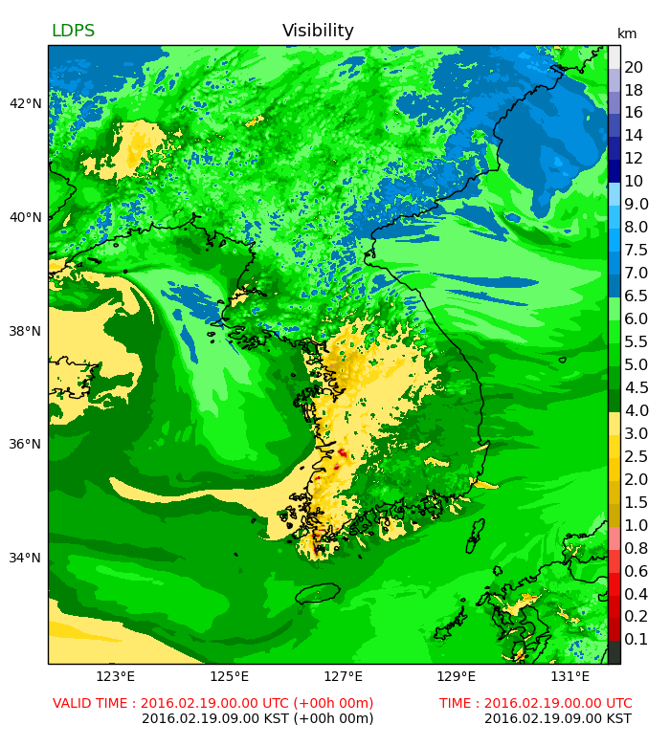
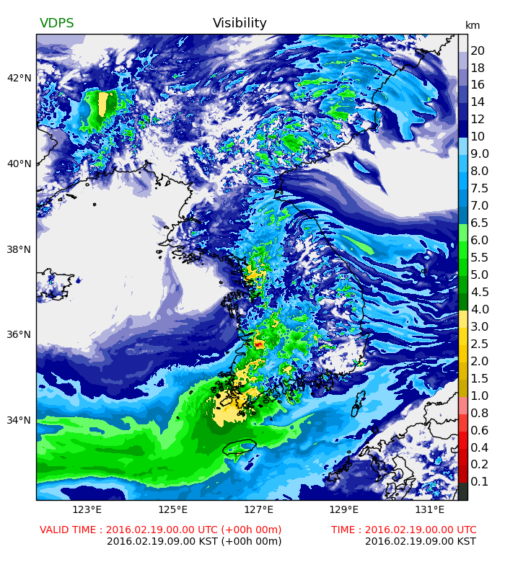
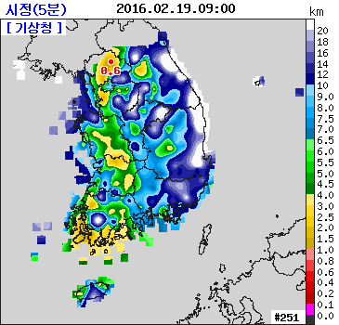
[Trial 2] A new Very Short-range NWP system
Analysis field comparison
Visibility observation (238 obs. network)
LDAPS
(Operational local model, w/o Vis. D.A.)
VDAPS
(New model, w/ Vis. D.A.)
Quite realistic visibility is seen in VDAPS analysis field, but
Quantitative verification scores not available yet…
Visibility observation is not available in precipitation cases
Notes:
Visibility 자료동화 사례 실험
그림은 분석장: 관측(왼쪽), 시정자료동화를 하지 않는 국지모델(가운데), 시정자료동화를 수행한 VDAPS0.9결과(오른쪽)
결과 설명:
관측: 중부지방은 시정이 좋고, 남쪽은 강수의 영향으로 시정이 낮음.
VDAPS0.9는 시정자료동화를 통하여 실황에 가까운 시정을 모의
2월에 안개 사례가 거의 없어 객관적인 검증 스코어 계산은 어려움
(2월에는 관측된 대부분의 저시정은 강수를 동반함. 시정관측은 강수시 사용 불가)
현재 시정 사례에 대한 실험 추가 분석 중

Slide 11
[Trial 3] Convective-scale EPS (since Oct. 2015)
System design of LENS (Local ENSemble prediction system)
00 UTC
06 UTC
12 UTC
18 UTC
Background
GDAPS
Early
Update
Early
Update
Early
Update
Early
Update
Hybrid Ensemble and 4dVar
Initial T+0
Obs.
BG_ERRs
Early
(12d)
288h
Early
9h
Early
(12d)
288h
Early
9h
EPSG
Downscaling
Pert. IC (T+3)
Pert. BC
Pert. IC (T+3)
Pert. BC
LENS
03UTC
T+72
1(CNTL) + 12 members
for 2 days forecast
15UTC
T+72

Slide 12
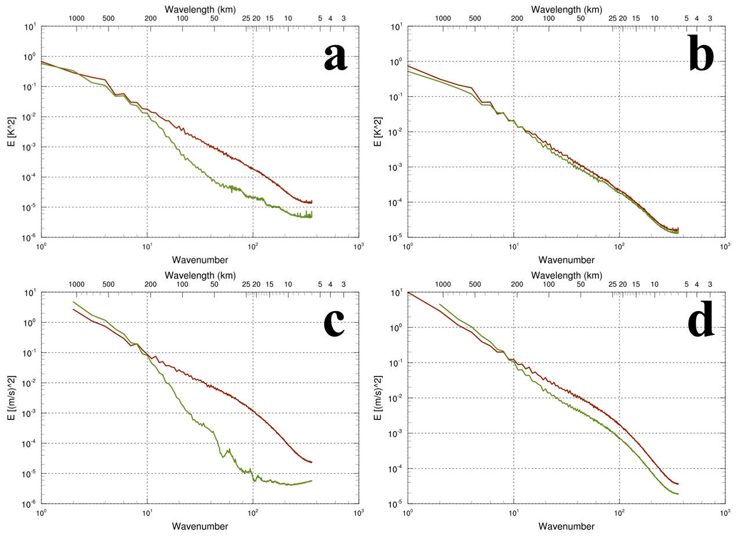
[Trial 3] Convective-scale EPS : LETKF trial
Downscaling from global EPS vs. LETKF
T850
Average power spectrum of ensemble members
Downscaling
LETKF
U500
Small-scale features are better resolved in the initial condition (T+3) when using LETKF method
T+3
T+6

Slide 13
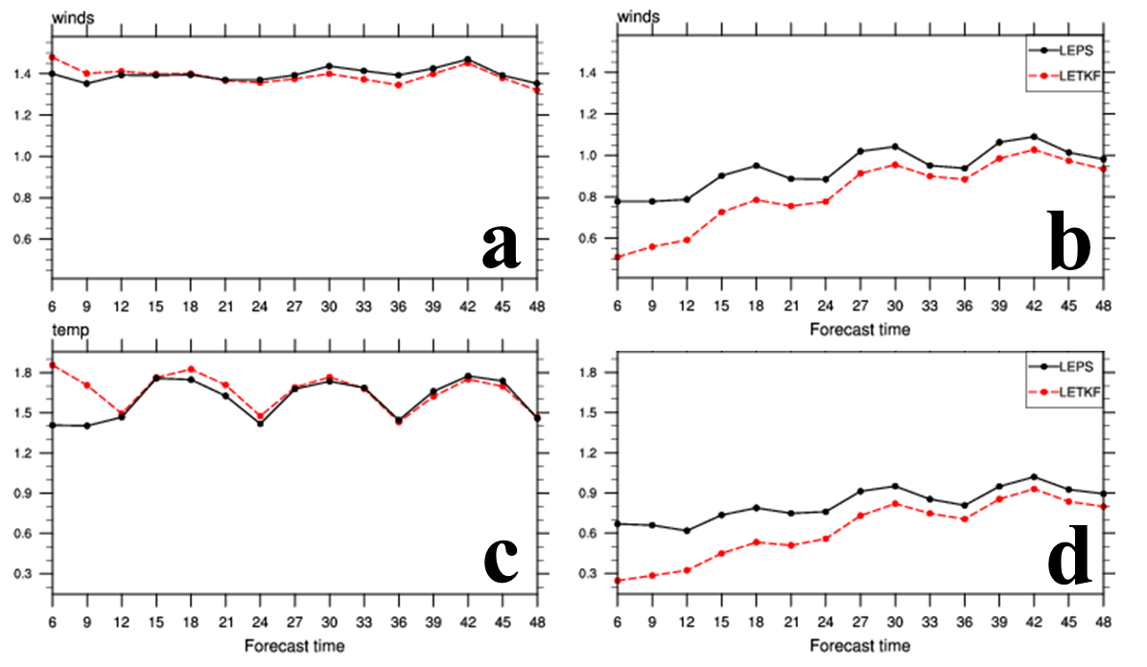
[Trial 3] Convective-scale EPS : LETKF trial
Downscaling from global EPS vs. LETKF
10m Wind
1.5m Temp.
RMSE
Spread
Spread from LETKF is smaller than that from downscaling : Further research area

Slide 14
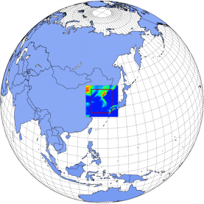
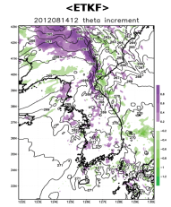
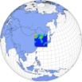

[Trial 3] Convective-scale EPS : Plan
ICs downscaled from Global EPS
Short-range Probabilistic Forecast
◆
◆
◆
◆
◆
●
●
●
●
●
●
●
●
●
●
LBCs from Global EPS
★
★
★
★
★
Breeding
■
■
■
■
■
Blended LENS ICs at T+00h
LENS FCSTs
●
●
●
●
●
●
●
●
●
●
★
★
★
★
★
LETKF with local obs.
■
■
■
■
■
Blended LENS ICs at T+12h
T-12h
T-09h
T+00h
T+12h
Downscaling from global EPS (Synoptic-scale features) + Local observation information from LETKF (Small-scale features)

Slide 15

KIAPS Development
Korea Institute of Atmospheric Prediction Systems (2011~2019)

Slide 16
KIM (KIAPS Integrated Model) System
Observation
KPOP
KPOP23DVAR
6h Forecast
Remap
Background
3DVAR
analysis
increment
Remap
3DVAR2KIM
analysis
increment
Analysis
KIM
3DVAR: 100 km resolution
Analysis: 25 km resolution
for KIM-SW initial condition

Slide 17
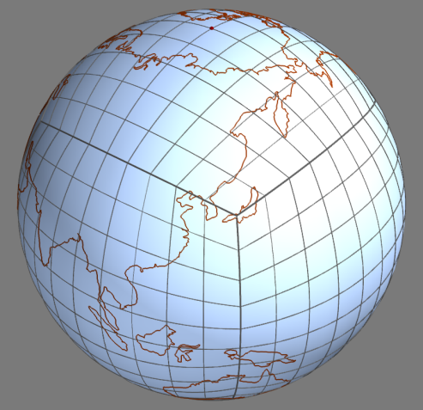
Dynamical Core of KIM (KIAPS Integrated Model)
KIM(KIAPS Integrated Model) : Hydrostatic/Non-hydrostatic system with spectral element method over cubed sphere grid
 | KIM-SH (High Order Method Modeling Environment model; NCAR’s CAM-SE) | KIM-SW (KIAPS Integrated Model – Spectral element method, WRF-Type)
Spherical grid | Cubed-sphere (Equiangular gnomonic projection)
Horizontal approximation | Spectral Element
Vertical approximation | Finite Element | Finite Difference
Temporal approximation | Fully Explicit Leapfrog, first-order due to Robert-Asselin filter | Split-explicit RK3, second-order for nonlinear equation
Equation | Hydrostatic (Full variables) | Non-hydrostatic (Perturbation variables)
Explicit spatial diffusion | 4th order linear horizontal diffusion | 4th order horizontal diffusion + divergence damping

Slide 18
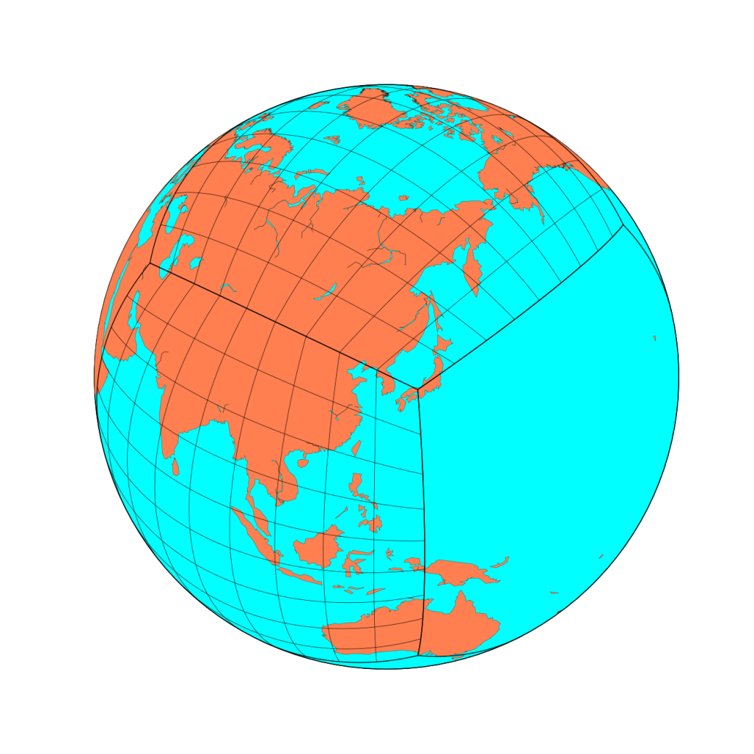
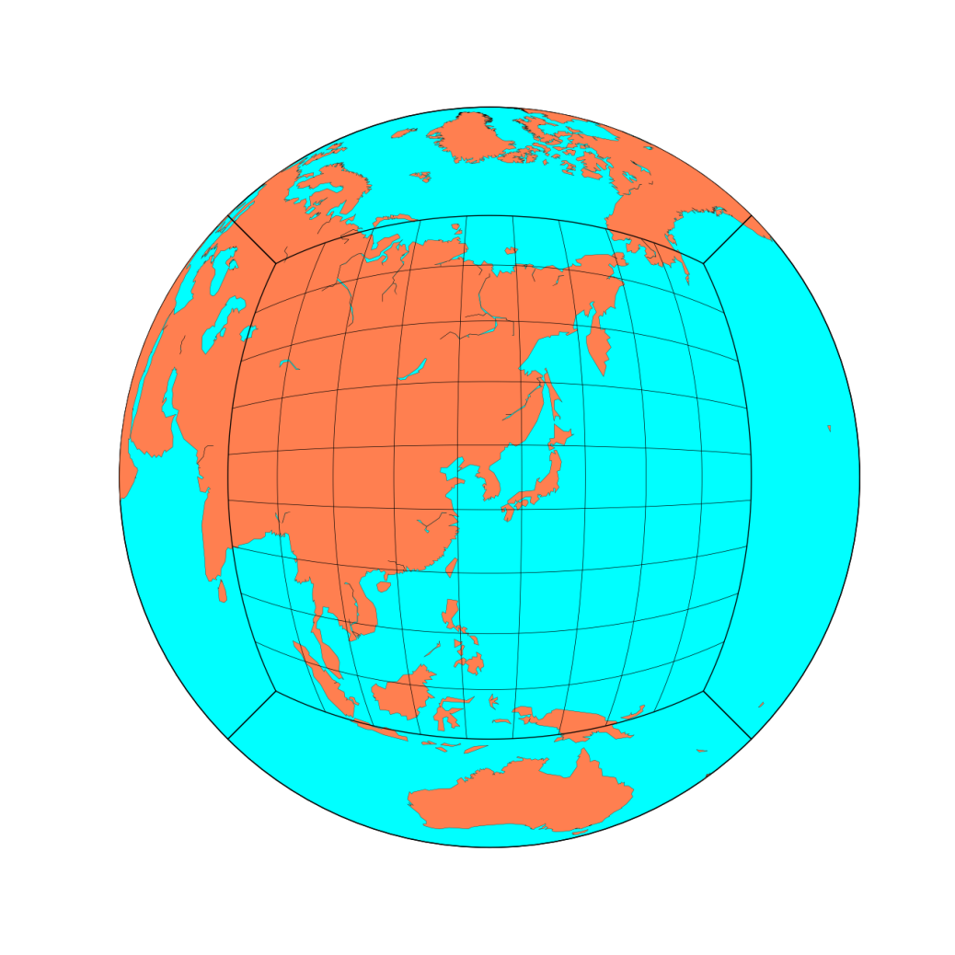
Dynamical Core of KIM (KIAPS Integrated Model)

Slide 19
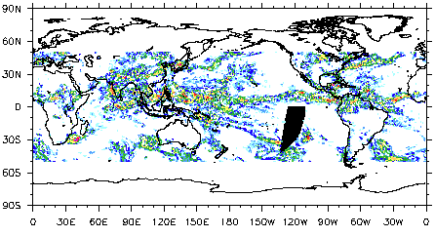
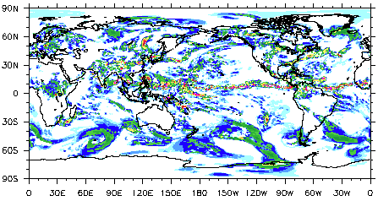
Non-hydrostatic Dynamical Core
OBS (TMPA)
KIM-SW (non-hydrostatic)
Dry simulation (Orographic gravity wave)
DCMIP (Dynamical Core Model Intercomparison Project)

Slide 20
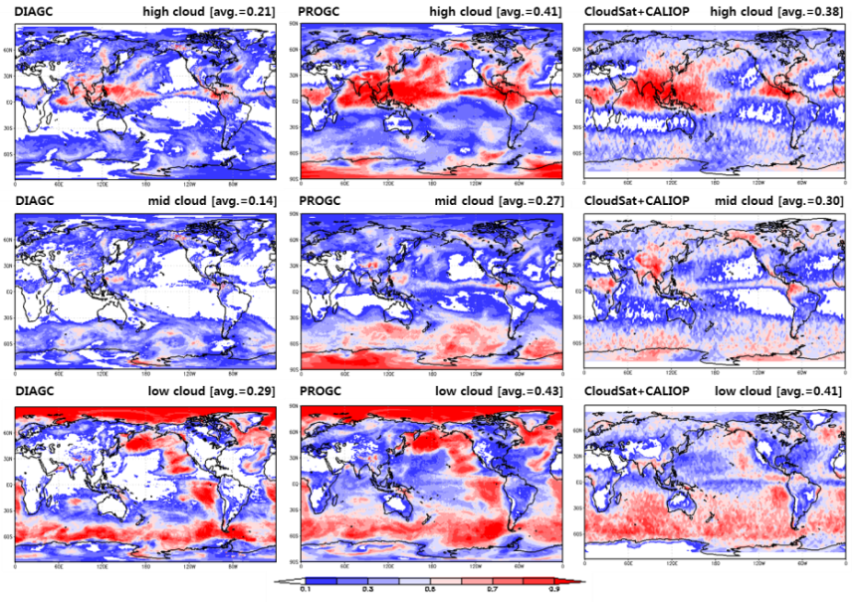
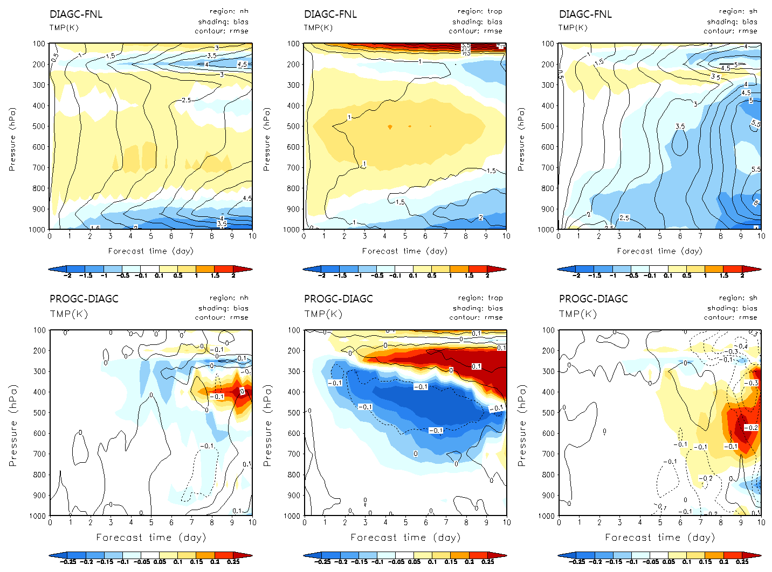
Physical Parameterizations : Prognostic Cloudiness
Prognostic cloud fraction (Tiedtke, 1993)
Improvement of prognostic cloud fraction (PROGC) : Park et al., MWR, 2016
Improvement of cloud fraction and NWP performance via PROGC

Slide 21
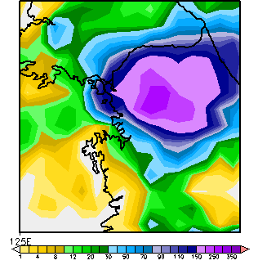
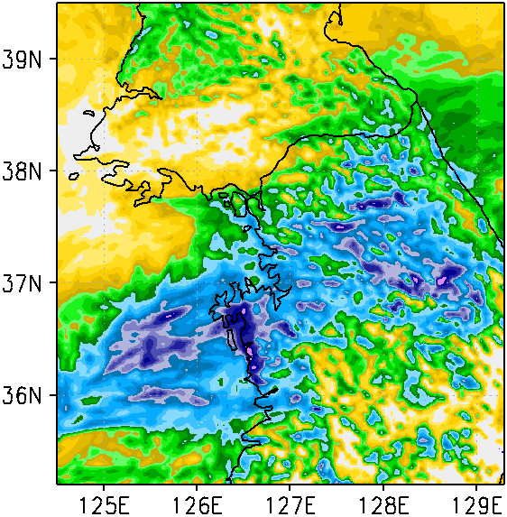
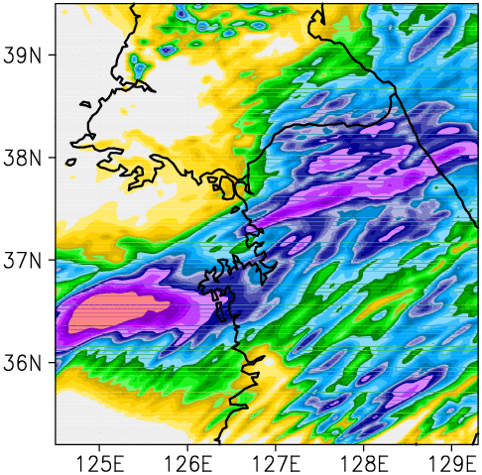
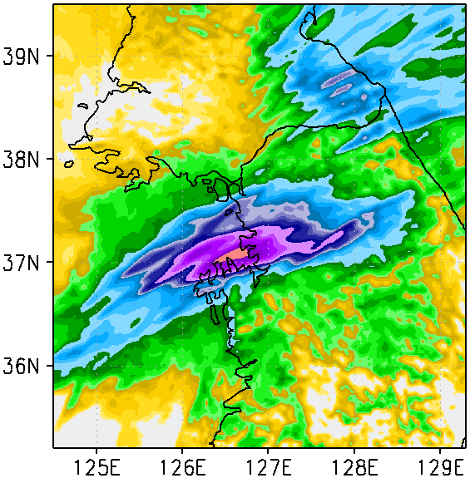
Physical Parameterizations : Scale-aware CPS
Scale-aware (grid-size dependency) cumulus parameterization scheme
TMPA
Original SAS / Δx = 3 km
Adapted from Hong and Pan (1998, MWR)
Cloud-base mass flux [∝ (1 – σ)]
Conversion parameter for cloud water detrained from deep convection (∝ σ)
Moisture detrained at the cloud-top levels (∝ σ)
No CPS / Δx = 3 km
Modified SAS / Δx = 3 km
Kwon and Hong, submitted to MWR
24-hour accumulated precipitation

Slide 22
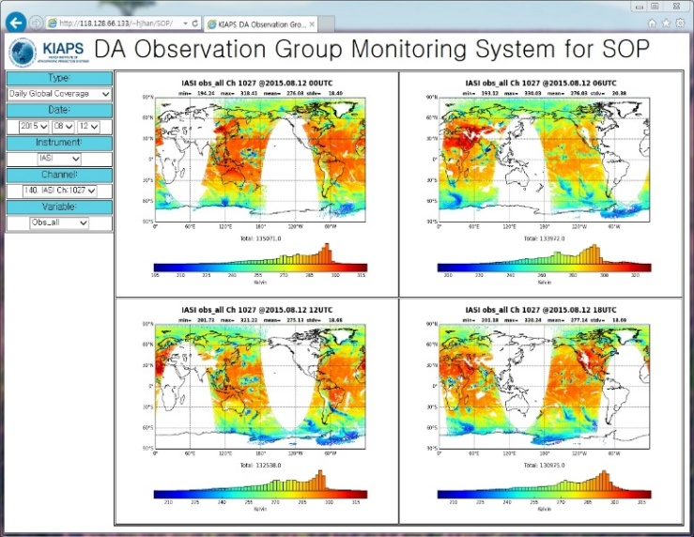
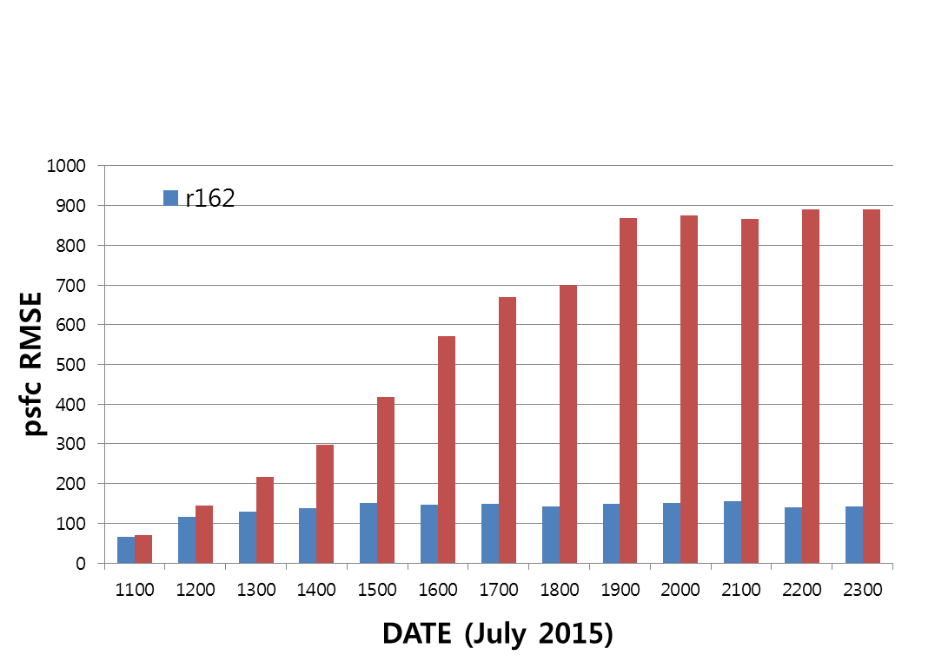
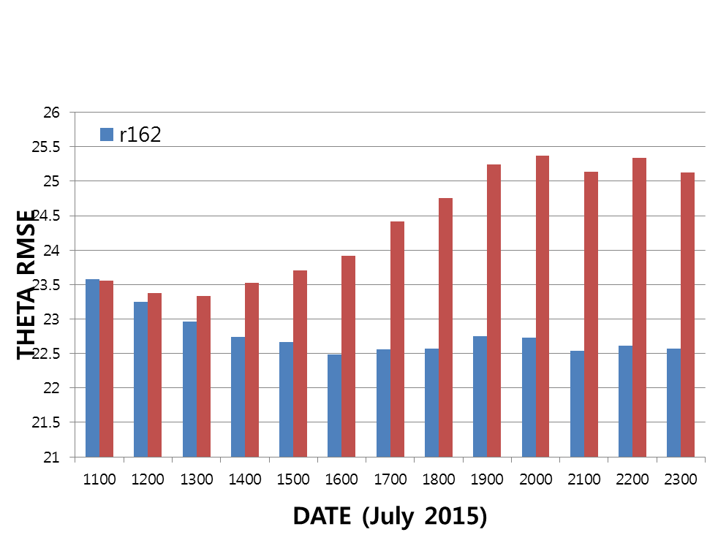
Data Assimilation : KPOP + 3DVAR
KPOP : KIAPS Package for Observation Processing
Observation currently used : Sonde, Surface, Aircraft, AMSU-A, GPO-RO, CrIS, ATMS, AMV, IASI
3DVAR System
    Improving computational efficiency by spectral transform algorithm
    Improving 3DVAR performance with better background error covariance
KIM2.1 Warm
KIM2.2 Warm
KIM2.1 Warm
KIM2.2 Warm
Psfc RMSD
Theta RMSD
RMS difference between KIM 3DVAR and KMA’s Operational analysis data

Slide 23
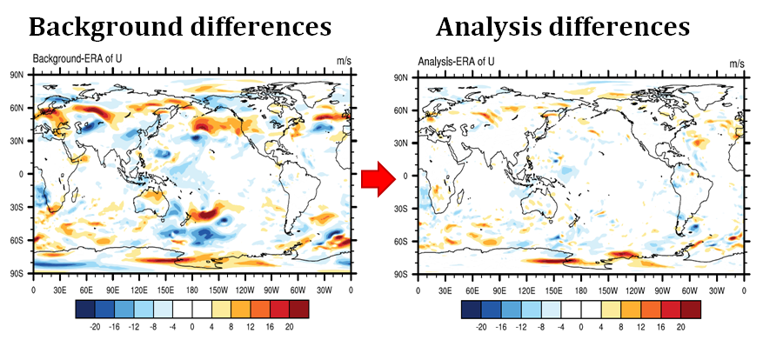
Data Assimilation : Ensemble D.A.
LETKF-KIM : Ensemble D.A. system is also being developed.
Assimilation of real observation data after idealized tests
Improvement of additive/multiplicative inflation
Observation currently used : Sonde, Surface, AMSU-A, GPO-RO
RMS difference of 925 hPa zonal winds compare to ERA-Interim data

Slide 24
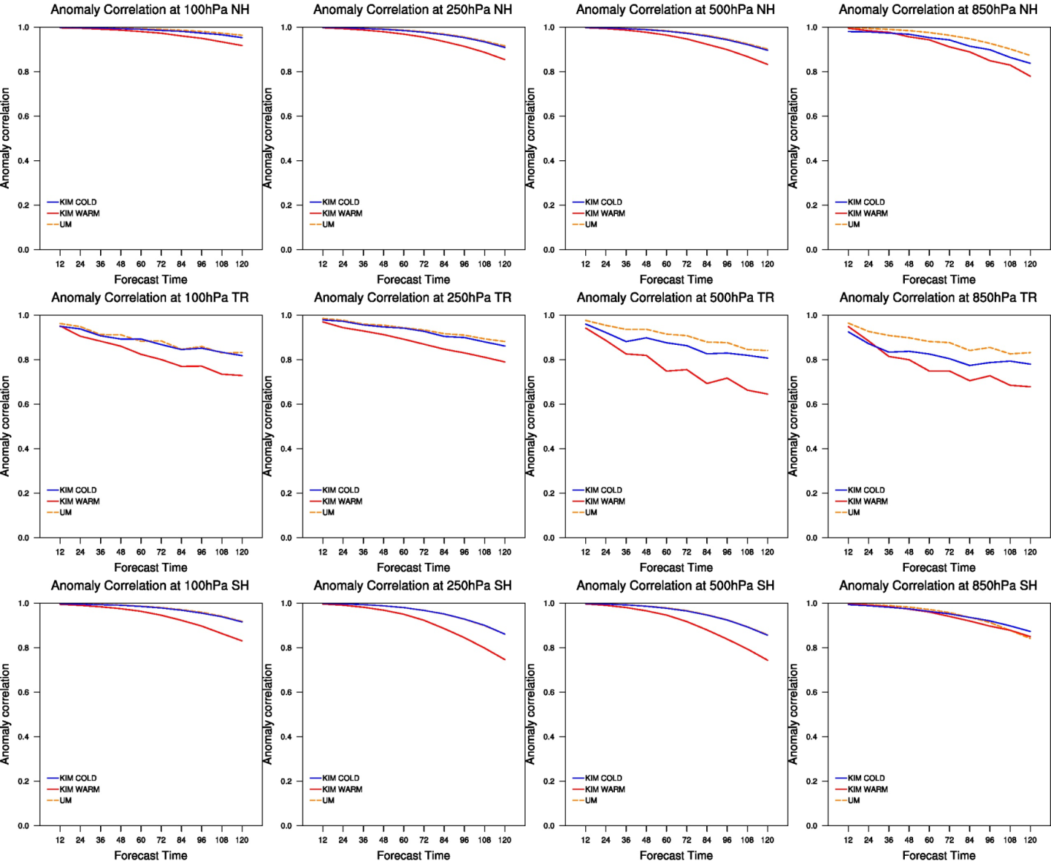
Preliminary Result : Verification
Anomaly correlation of Geopotential Height (Feb. 2016)
KMA’s Oper.
N.H.
KIM Cold
KMA Warm
Tropics
S.H

Slide 25
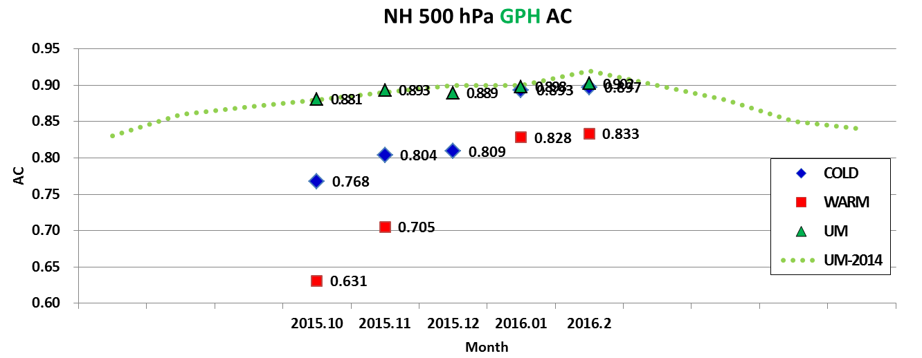
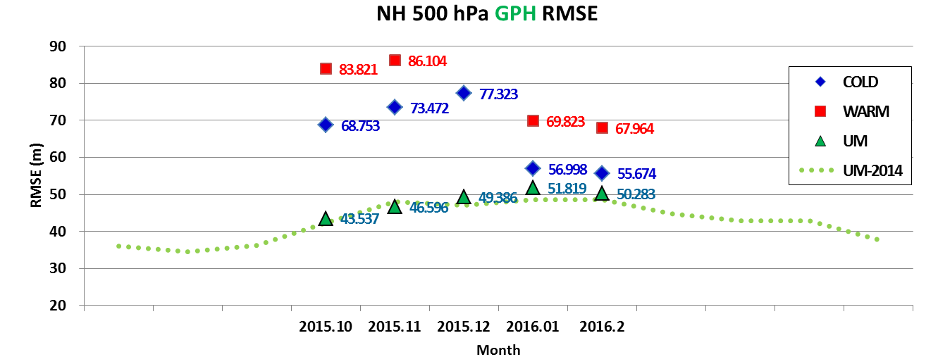
Preliminary Result : Verification
KIM2.1
KIM2.2
N.H.
Z500
AC
N.H.
Z500
RMSE

Slide 26


Summary
Convective-scale
Modeling
VDAPS (1.5km UM) : Under development
1-hour 4DVAR cycle (‘17)
visibility D.A. tested
LDAPS (1.5km UM) : Domain expansion
consistency ↑ , performance ↑
LENS (1.5km UM M12+1) : In operation since Oct. ‘15
LETKF being tested
Downscaled IC will be blended with small-scale information from LETKF
Dynamical Core
Non-hydrostatic Dynamical Core developed
Physical Parameterization
Physics package being updated with advanced schemes considering grey zone (1~10km)
Data Assimilation
3DVAR, LETKF being developed in parallel.
→ Finally merged to build 4D ensemble D.A. system
Global
Modeling

Slide 27
Thank You
Questions?

