Slide 1
Improving ECMWF’s IFS model
by Nils Wedi
wedi@ecmwf.int
Anna Agusti-Panareda, Gianpaolo Balsamo, Peter Bauer, Peter Bechtold, Willem Deconinck,
Mikhail Diamantakis, Mats Hamrud, Christian Kuehnlein, Martin Leutbecher, Sarah-Jane Lock,
Sylvie Malardel, Kristian Mogensen, George Mozdzynski, Pirkka Ollinaho, Irina Sandu,
Piotr Smolarkiewicz, and many other colleagues …
European Centre for Medium Range Weather Forecasts

Slide 2

Fit for the future …
Research and development into
  physics & dynamics coupling
  quantifying uncertainty
  Earth-System complexity
  novel and adaptive numerical methods
A flexible support infrastructure for European NWP science and services to
  maximise energy-efficiency
  assure the best possible use of the available computing resources

Slide 3
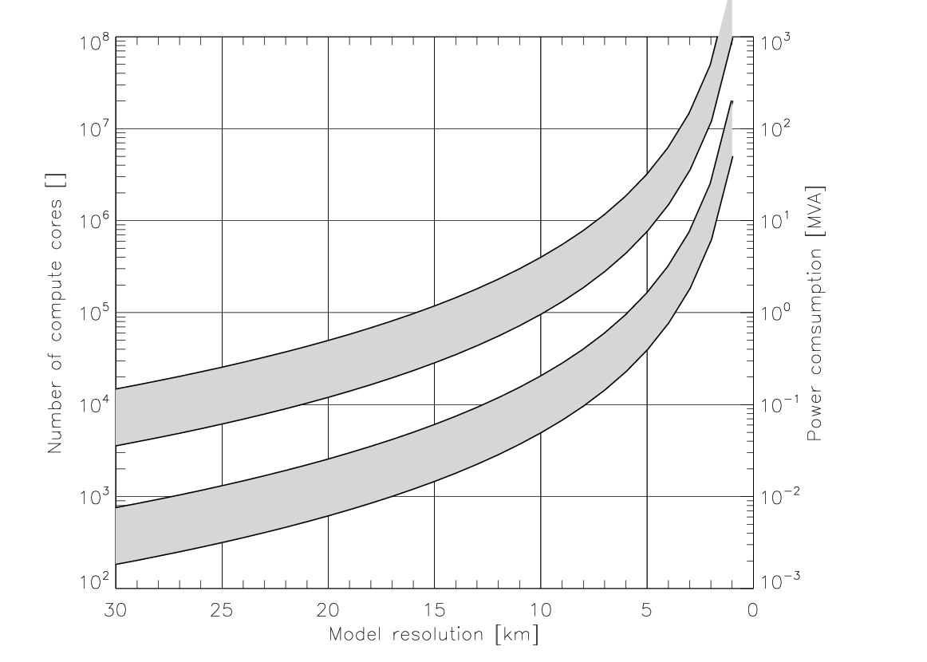
Affordability – the art and cost of computing
(Bauer et al, 2015)
50 member ensemble
1 member
Hard limit for
entire HPC ~20MW ?
≈ M€ electricity/year
2015/6
2025
Technology advances may move the energy scale by one order of magnitude, so we need to be ready! (Aurora 180PF, HPCwire April 2015)

Slide 4
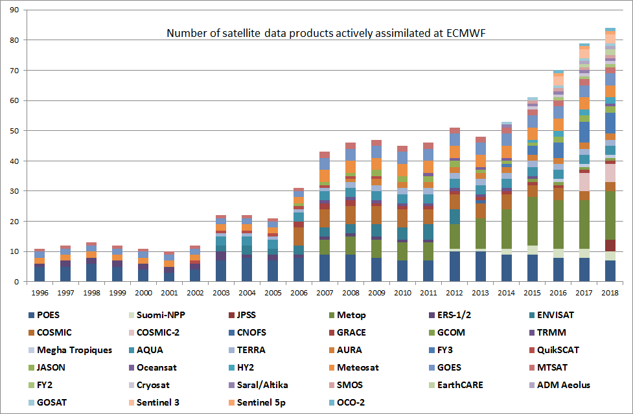
Big Data challenge: 3Vs
high Volume, high Velocity, high Variety
Velocity: Exponentially growing data archive: 1995: 14 Tbytes / year
2015: 100 Tbytes / day
Volume:
Satellite observations 1996 – 2018 (projected)
Variety: Increase in products

Slide 5
Is the global spectral transform model dead ?
Technology applied at ECMWF for 30+ years …

Slide 6
SISL-semi-implicit semi-Lagrangian
Grid-point space
-semi-Lagrangian advection
-physical parametrizations
-products of terms
FFT
Inverse FFT
No grid-staggering of
prognostic variables
Fourier space
Fourier space
LT
Inverse LT
Spectral space
-horizontal gradients
-semi-implicit calculations
-horizontal diffusion
FFT: Fast Fourier Transform, LT: Legendre Transform

Slide 7
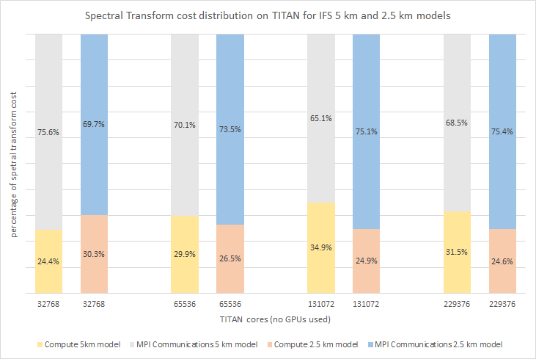
MPI communication cost at large core counts …
230K cores

Slide 8
Application performance XC30
MPI_send/recv
Alltoallv
Alltoallv
MPI_send/recv
TCo1279 on 360 nodes; TCo1999 on 720 nodes ; dt=450s; 48h forecast

Slide 9
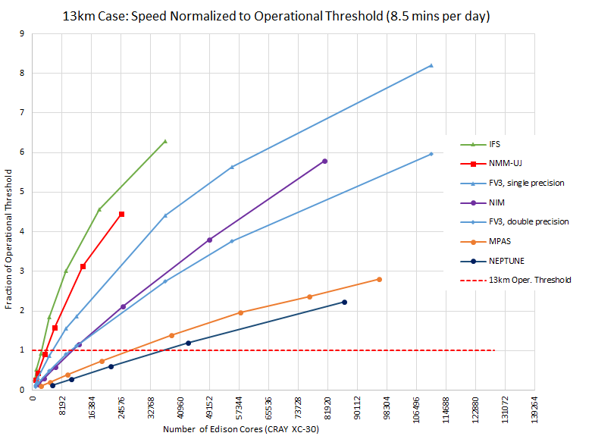
Time-to-solution at 13km
IFS
use FV discretization
(Michalakes et al, NGGPS AVEC report, 2015)

Slide 10
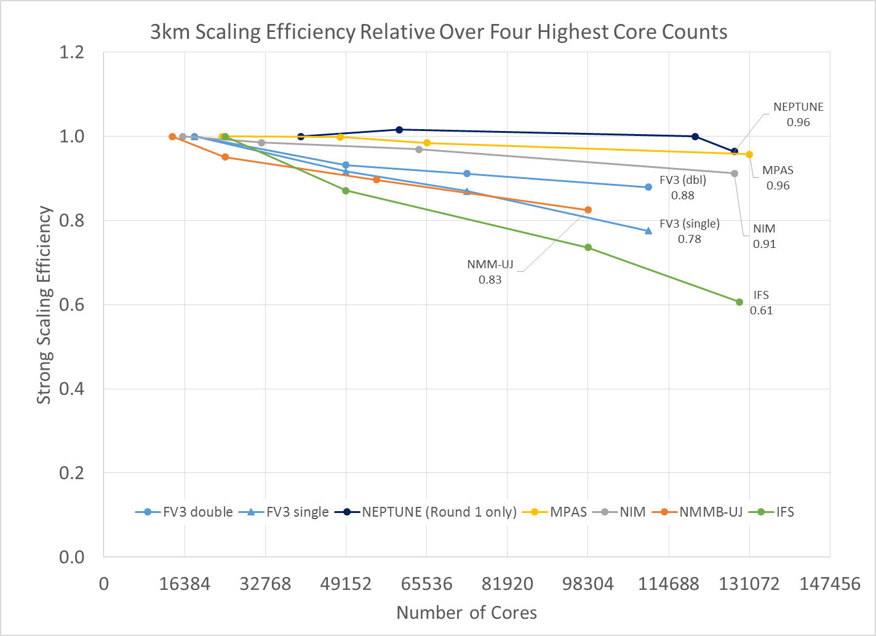
Scaling efficiency at 3km
IFS
(Michalakes et al, NGGPS AVEC report, 2015)

Slide 11
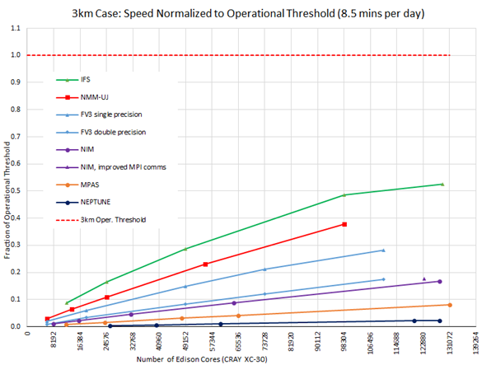
Time-to-solution 3km
Operational need!
IFS
(adapted from Michalakes et al, NGGPS AVEC report, 2015)

Slide 12

RAPS14 performance
ECMWF-HRES
EC-Earth, AR5
EC-Earth, AR6

Slide 13
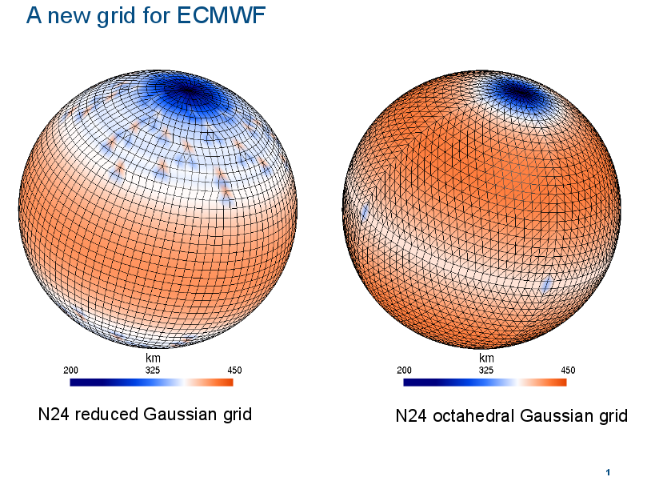

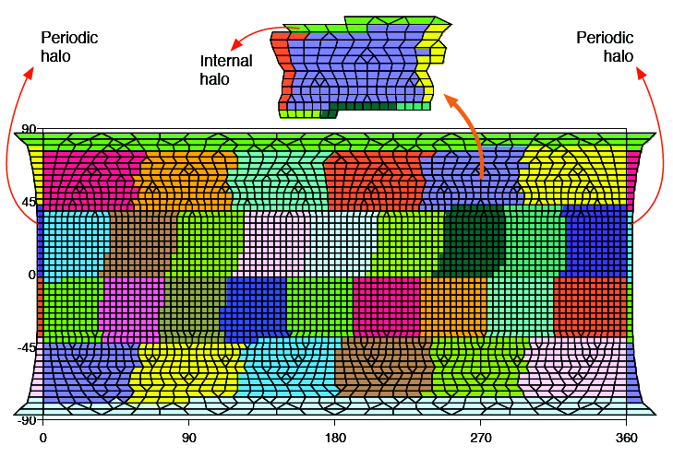
A new grid for ECMWF
Equal area (MPI) parallel decomposition (1600 tasks)
6,599,680 points x 137 levels at ~9km just below 1 billion points

Slide 14


Equations beyond the hydrostatic system
Finite-volume module (FVM)
O640 - Held-Suarez with real orography:
surface pressure after 50 days of simulation
→ Compressible equations provide the most
efficient solution as well as flexibility on the solution procedure in time
[Courtesy Piotr Smolarkiewicz, Christian Kühnlein]

Slide 15
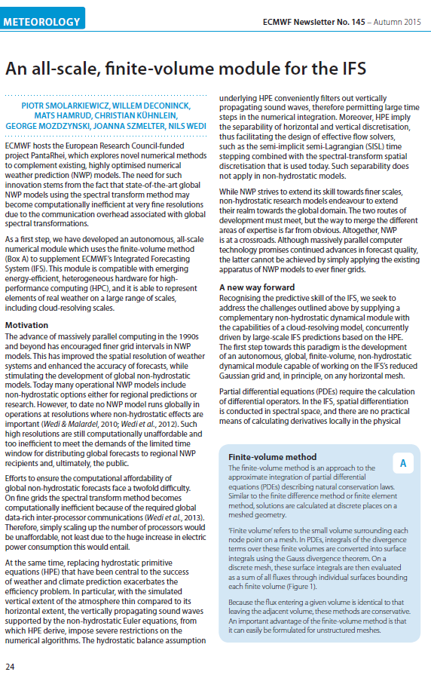

Further reading:

Slide 16
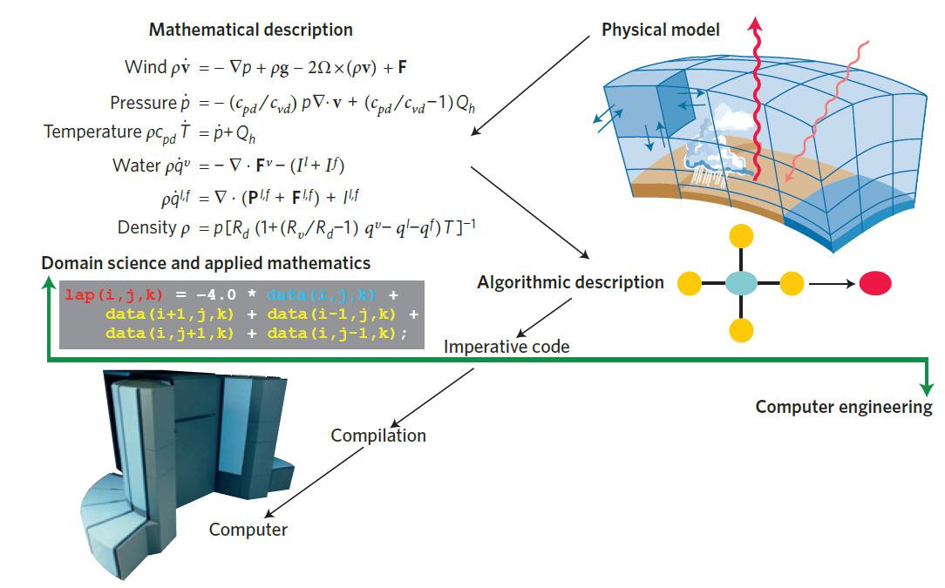
Traditional science workflow
  [Schulthess 2015]

Slide 17

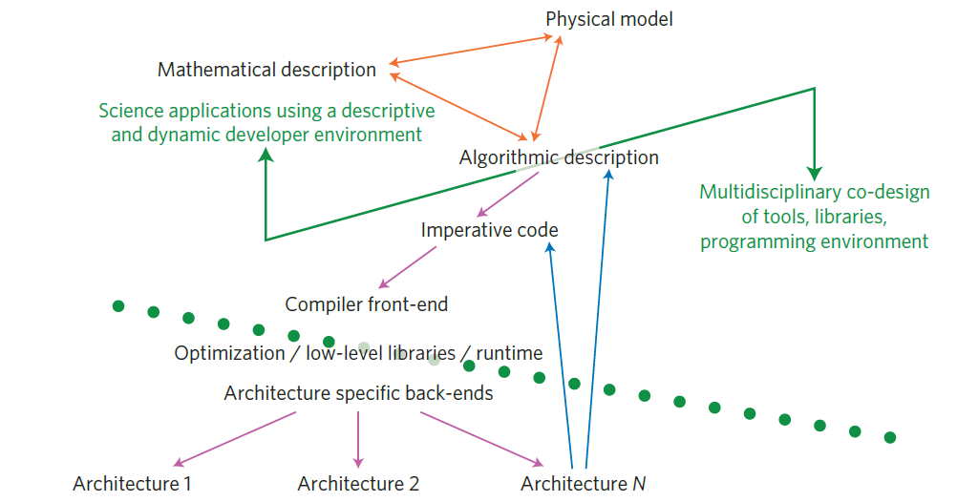

Future science workflow
Energy efficient SCalable Algorithms for weather Prediction at Exascale
→ www.hpc-escape.eu
↑ science specific code
↓ generic code
  [Schulthess 2015]

Slide 18

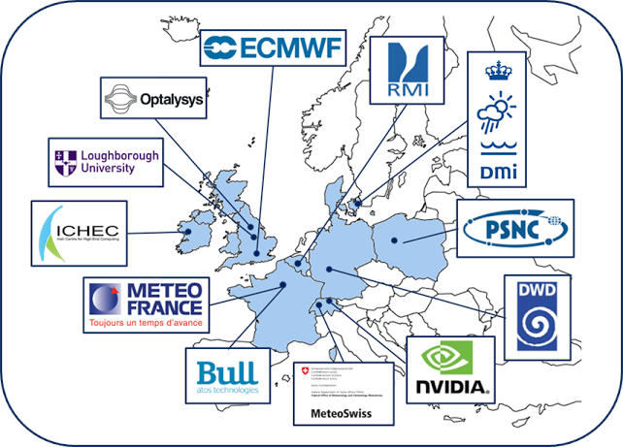
Energy efficient SCalable Algorithms
for weather Prediction at Exascale: ESCAPE
The ESCAPE project has received funding from the European Union’s Horizon 2020 research and innovation programme
under grant agreement No 671627. This material reflects only the author's view and the Commission is not responsible for any use that may be made of the information it contains.

Slide 19
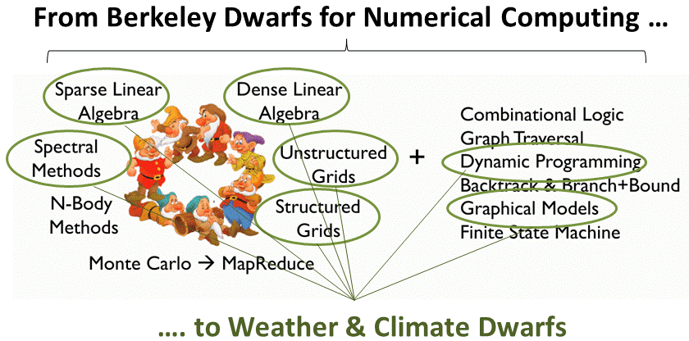
What is a NWP & climate dwarf?
A dwarf encapsulates a relevant characteristic or required functionality of a weather/climate prediction model and it is meant to be a runnable and verifiable mini-application
Candidates:
Spectral transforms (FT/LT and bi-FT)……………..very memory and communication bandwidth intensive, possibly limited scalability
2 & 3-dimensional elliptic solver…………………….new, compute and communication latency intensive, possibly limited scalability
Semi-Lagrangian advection…………………………….communication intensive, possibly limited scalability
Cloud physics parameterization……………………… expensive computation, scalable
Radiation parameterization…………………………….expensive computation, scalable
Many more to come …
Notes:
At 5 km global resolution (TCo1999) about 30% of CPU time is spent on communication (of which 6% i.e. 1/5 is SL-communication, the rest is transforms)

Slide 20
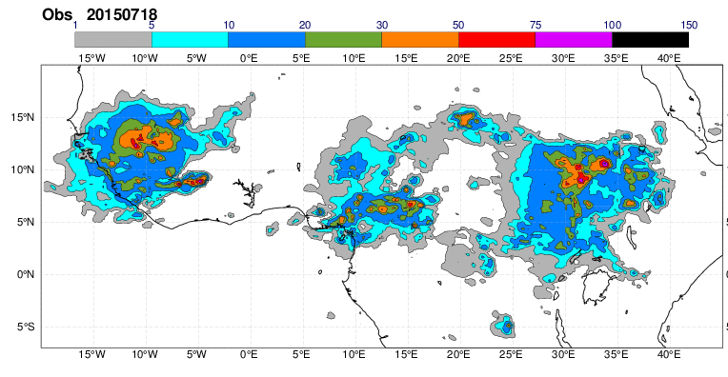
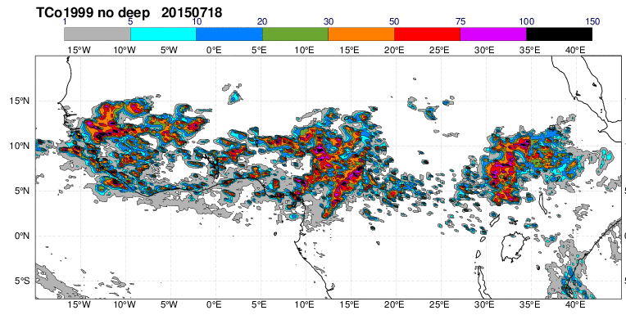
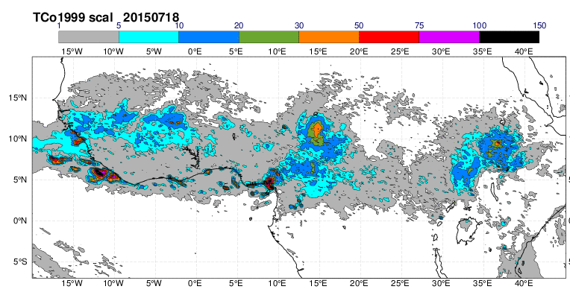
Example 1: Parameterized versus permitted global convection
NOAA FEWS
P. Bechtold in collaboration with DWD
presented in ECMWF’s Annual Seminar on physical processes in present and future large-scale models, 2015
5km simulation with rescaled
mass-flux parameterization

Slide 21
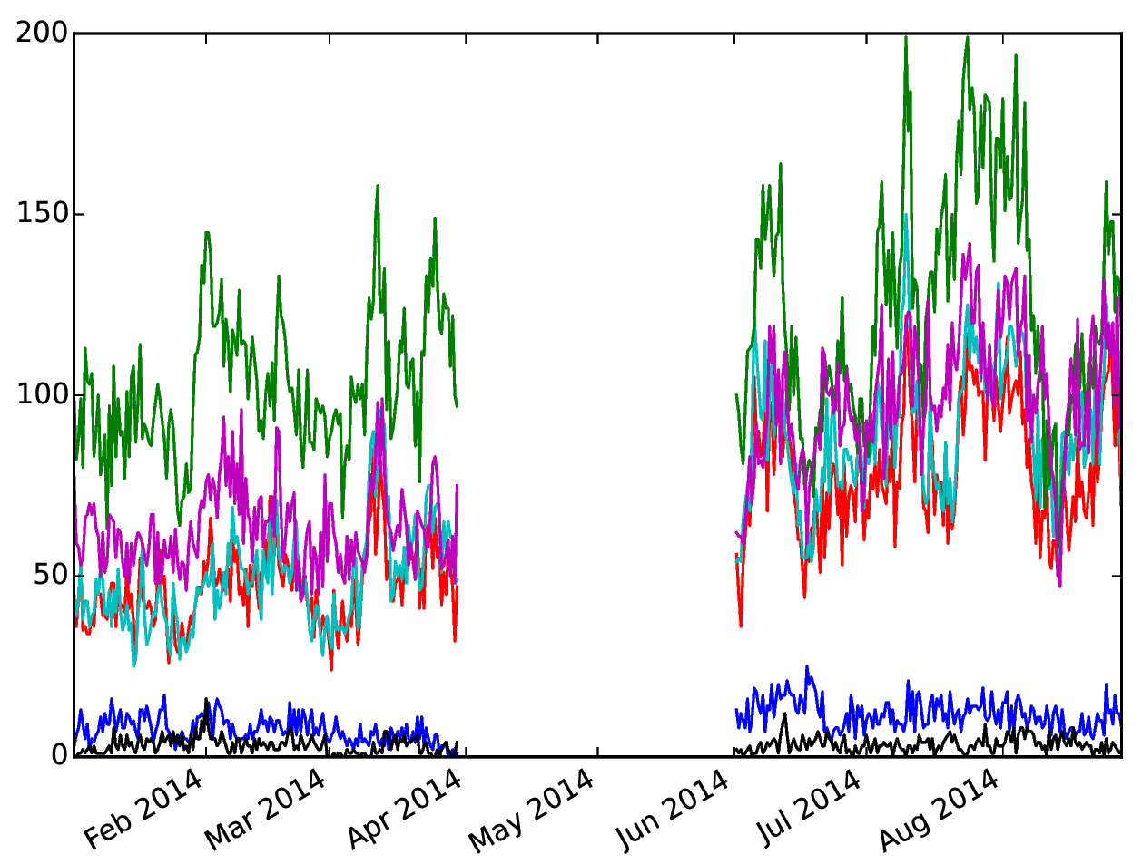
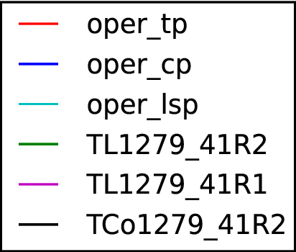
“Resolved (lsp)” precipitation
(Ervin Zsoter & Sylvie Malardel)
Number of >50mm events in a 5day forecast
Linear grid (TL1279)
Cubic grid (TCo1279)

Slide 22
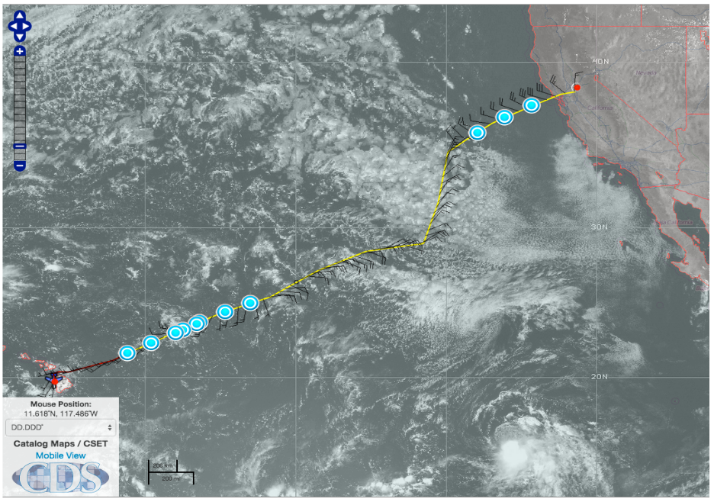
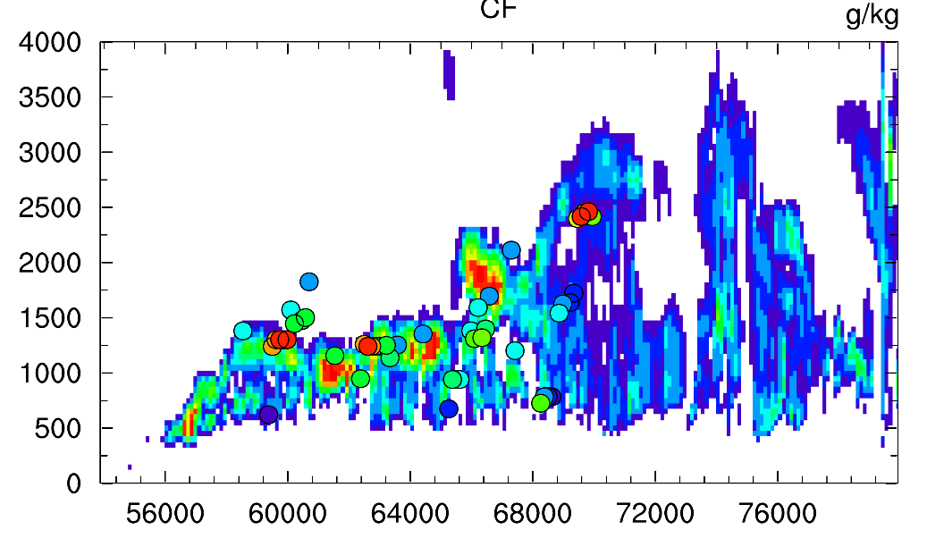
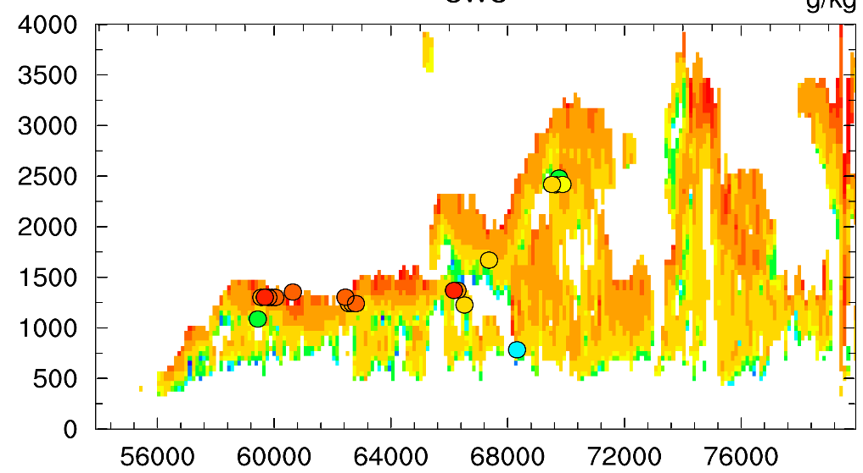
CSET RF10
Example of evaluating forecasts against observational campaigns (CSET Bretherton et al. Jul/Aug 2015)
CF/CWC IFS (~ 9km at HRES)
Notes:
This is from a recent campaign in the East Pacific, top picture shows the flight path and the drop sondes locations. Below is the cloud fraction, left and cloud water content, right from the 41r2 HRES cycle, the observations are denoted by the symbols with the same colours… and actually it is quite good

Slide 23
Consistent and efficient dual (dry+moist) mass flux + K-diffusion + cloud treatment
Subgrid vertical transport, mixing and condensation
“Diffusion scheme” does K-diffusion in moist conserved variables +dry mass flux
The convective boundary-layer height Zi and cloud base Zb are determined by the same test parcel as in the shallow convection
Shallow and deep convection provide the moist convective transport (also in Sc !), the condensate detrainment is the main source term for the cloud scheme
Clouds are computed in the prognostic cloud scheme (for condensation RH>80%) using convective detrainment and moisture tendency from diffusive mixing
Additional K-mixing, entrainment in ‘elevated’ cloud and shear layers
K
K
z_{i}
Zi=Zcb
K
z_{cb}
K
K
z_{i}
M
dry
M
moist
K
K
Mixed layer
dry BL
Stratocumulus
Shallow cumulus
Deep cumulus

Slide 24
How does the model actually create BL clouds?
What the model should do
Net tendency: deposit moisture in cloud
Sh. conv.
EDMF
EDMF
EDMF
EDMF
Convection takes moisture from BL and deposits it in cloud layer
Mixing distributes moisture through BL
no cloud base
cloud base found
cloud base found,
and strong inversion
Test parcel ascent
Moisture tendency
Convection removes moisture from a dry layer -> evaporation of cloud from below
EDMF doesn’t mix all the way to cloud base
Working on the interaction between the schemes!
What the model does
Moisture tendency

Slide 25
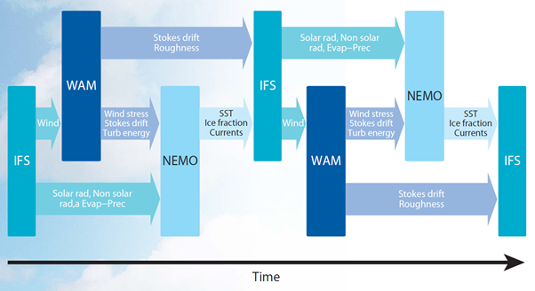
Example 2: Ocean-sea-ice-wave-coupling
Issues: Initialization
Complexity to balance potential increase in predictive skill

Slide 26
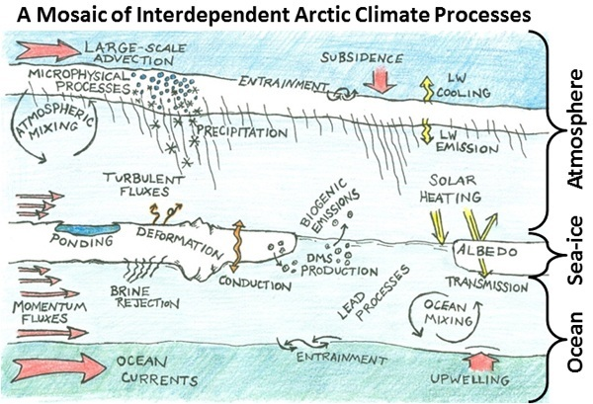
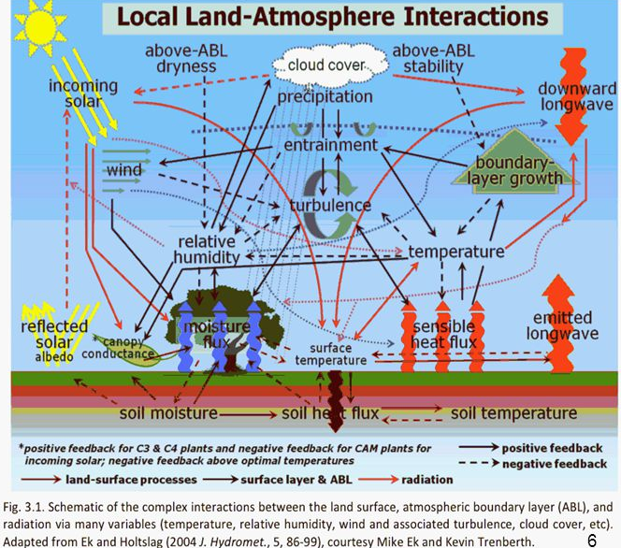
How complex are the coupled processes over land and ocean/sea-ice?
Source: Mosaic project
Source: GEWEX imperatives

Slide 27
Coupled ocean vs uncoupled simulation
Tropical cyclone Neoguri with TCo1279
uncoupled
coupled
Buoy observation at 22°N, 128°E
4-day forecast SSTs from the coupled forecast initialised at 0UTC on 6 July 2014 at the location of a buoy with approximate position 22°N, 128°E.
(Rodwell et al, ECMWF Technical Report 759, 2015)

Slide 28
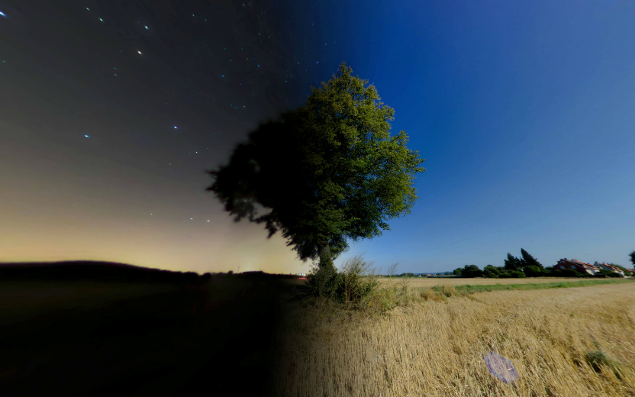
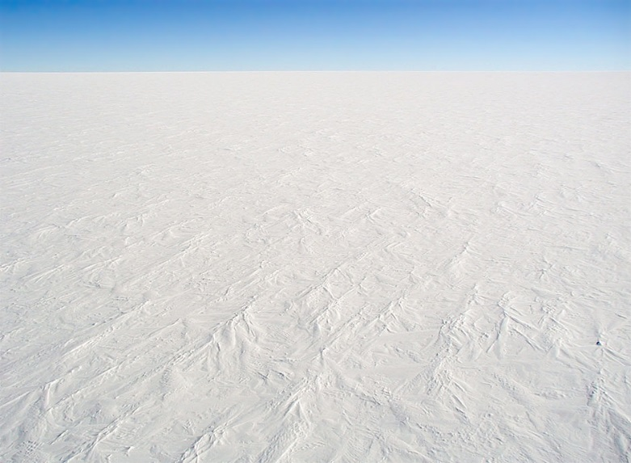
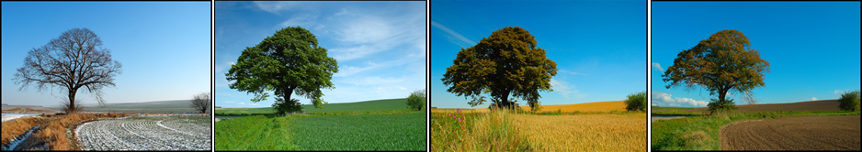
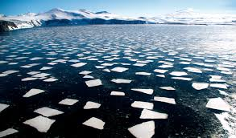
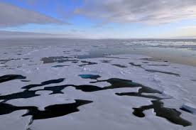
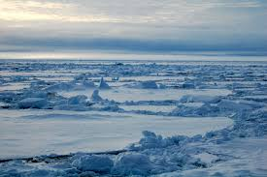
Coupled Processes at the surface interface: What are the challenges?
The processes that are most relevant for near-surface weather prediction are also those that are the most interactive and exhibit positive feedbacks or have a key role in energy partitioning
Studying and constraining positive feedback processes is key to advance seamless forecasting, embracing a larger amount of physical processes while still maintaining model realism
Night
Day
Night
Day
  Over Land
    Snow-cover, ice freezing/melting are in a positive feedback via the albedo
    Vegetation growth and variability and interaction with turbulence
    Vertical heat transport in soil/snow
  Over Ocean/Cryosphere
    Transition from open-sea to ice-covered conditions
    Sea-state dependent interaction wind induced mixing/waves
    Vertical transport of heat

Slide 29

Example 3: High resolution CO₂ forecast
[ppm]
  Interacting atmosphere, land-surface, radiation,
  ocean and chemical
  processes
Above background CO₂
Below background CO₂
Total column average atmospheric CO₂: September 2013
the work of Anna Agusti-Panareda

Slide 30
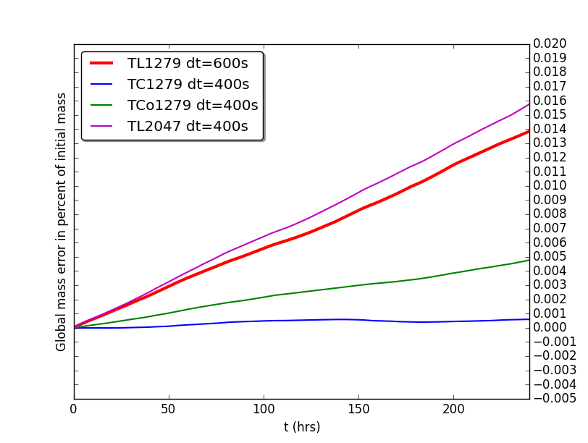
Global mass conservation in IFS

Slide 31
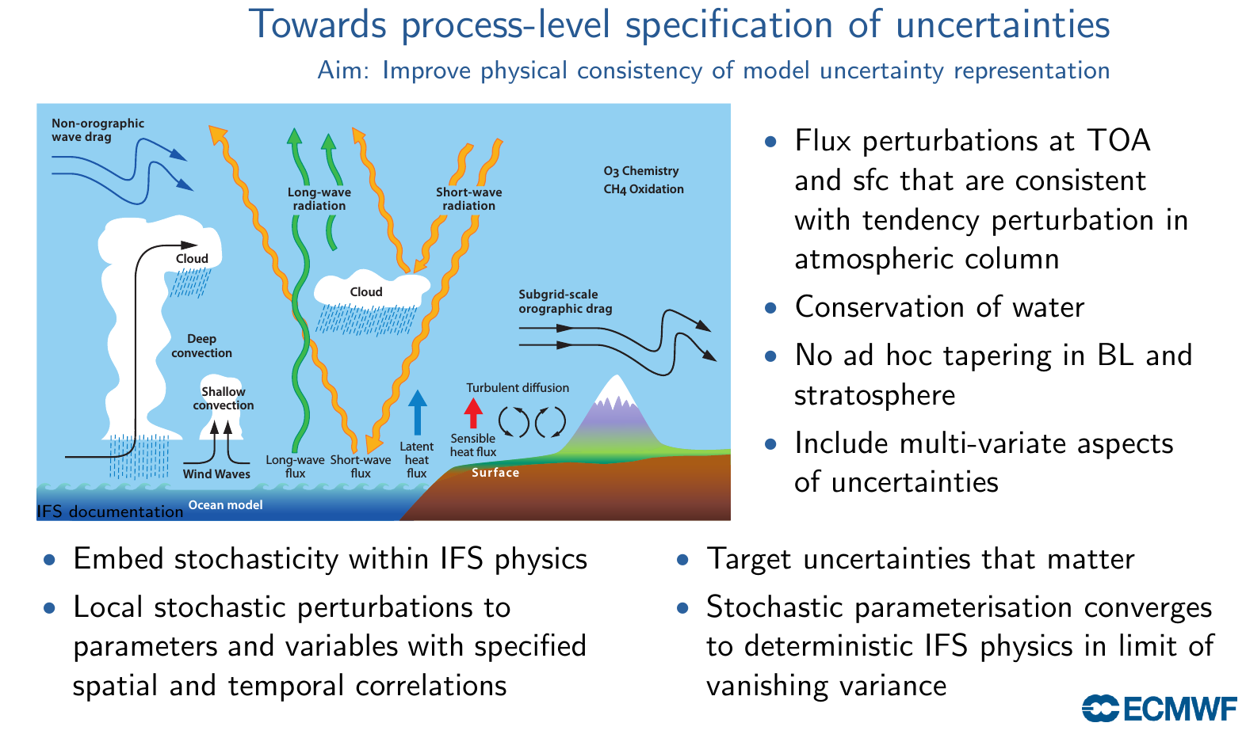
Model uncertainty representation

Slide 32
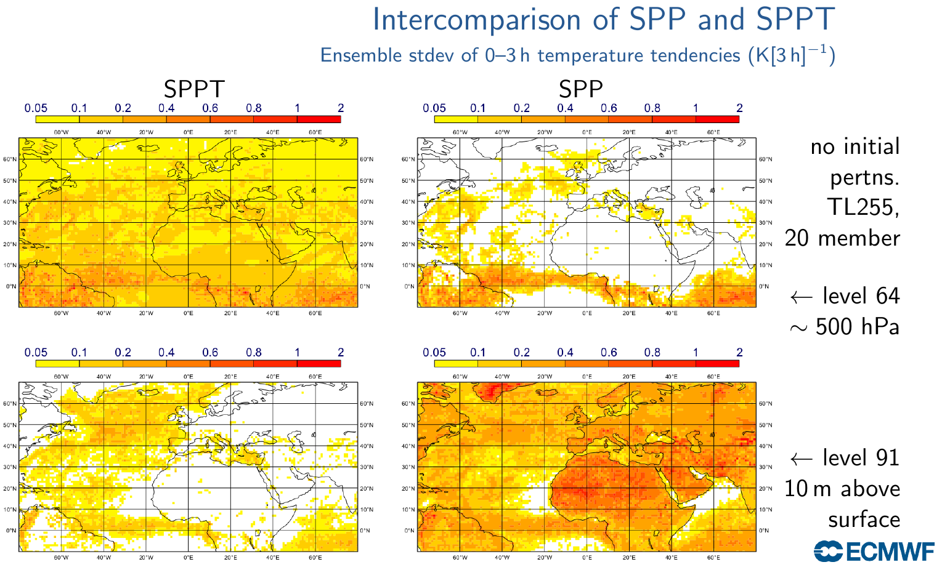
Model uncertainty representation

Slide 33
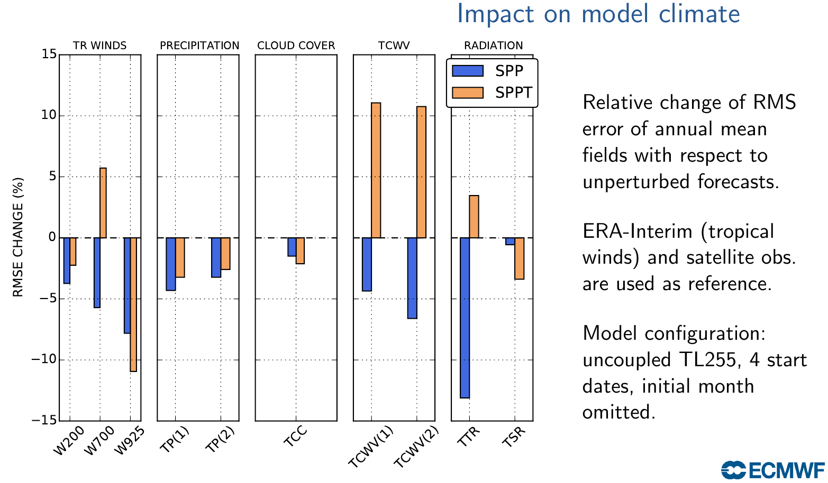
Model uncertainty representation

Slide 34
Key challenges
Extract predictive skill from a complete description of the Earth-System
Optimize time-to-solution, energy-to-solution and information density
Provide computational efficiency to enhance forecast reliability
Apply adaptive numerical techniques and tools for forecast reliability but also for application resilience in a computing environment that itself may be subject to (partial) failure

Slide 35
(open for discussion and my attempt to address the questions posed)
Where do you think we ought/need to be with our ability to simulate climate, say 10 years from now?
Follow more closely the technical ability of global NWP, while feeding back the changing nature of the boundary forcing to NWP
What should we be doing in the coming 10 years to get there?
Use explicitly hierarchical structures to parallelise, simulate and understand multi-scale behaviour
What are the principal barriers preventing us from getting there?
Lack of suitable numerical frameworks to advance the current state of knowledge
Is there more we could be doing collaboratively to get there?
Enhance synergies between NWP and climate centres to advance seasonal prediction
If yes, what should we be doing to achieve this, in practice?
Invest in people: stable 5-to-7 year funding in the spirit of ERC grants
Chicheley Hall meeting 2016, organised by Tim Palmer

Slide 36
Additional slides

