Slide 1
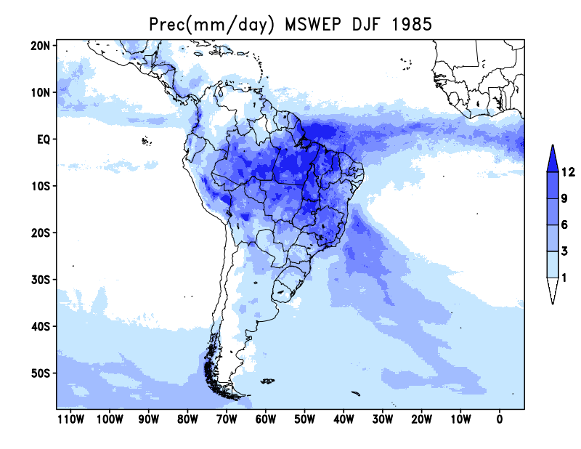
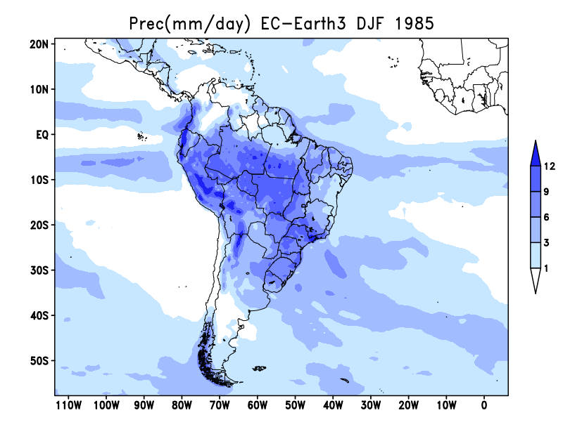
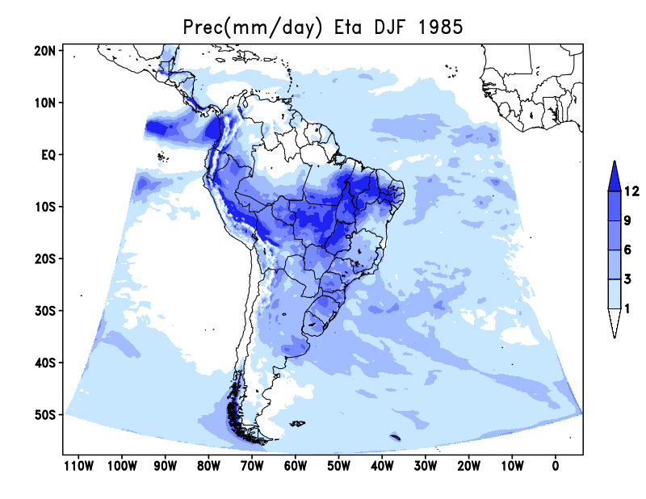
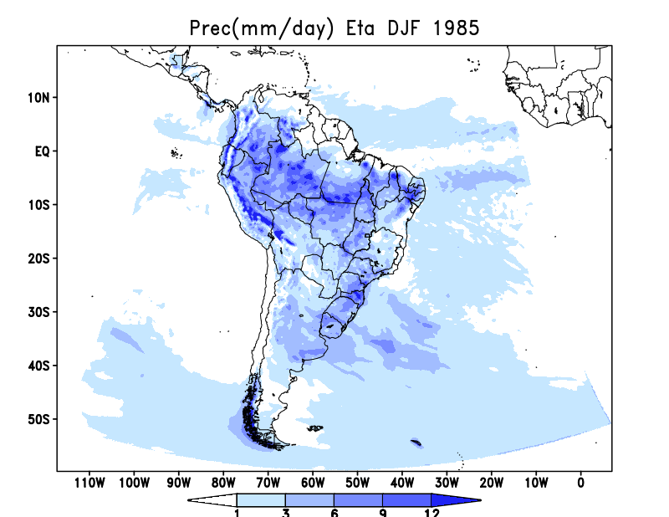
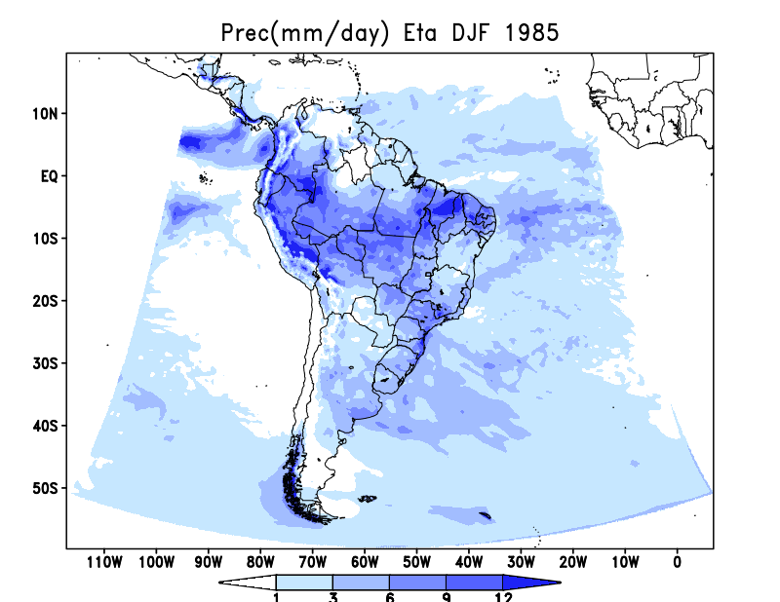
MSWEP
EC-Earth3
DJF 1985
Cuparm MC
Cuparm J
Cuparm H
T_dry Czil_dyn Albupdt
MIXLEN_23ee czil0.2 Albupdt
T_dry Czil_dyn Albupdt ssolar0.93

Slide 2
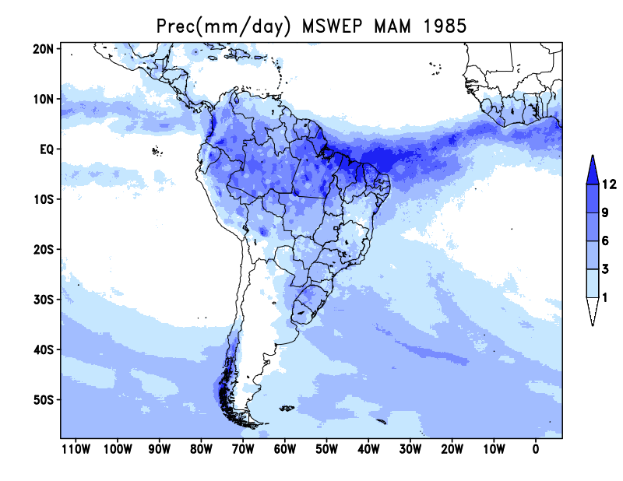
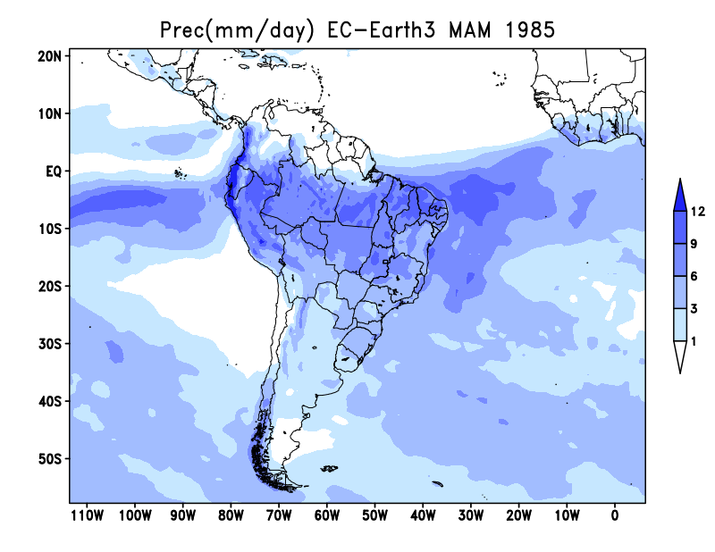
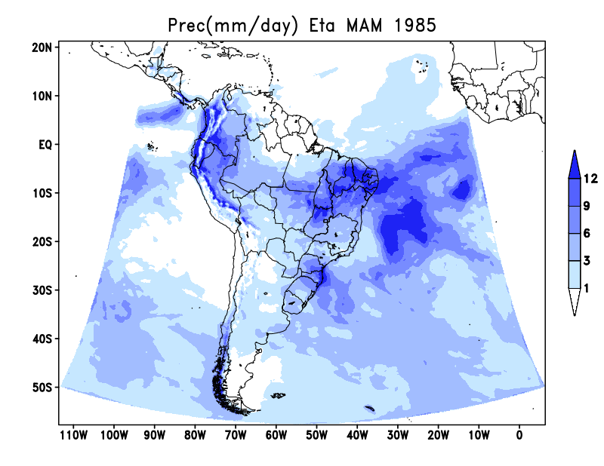
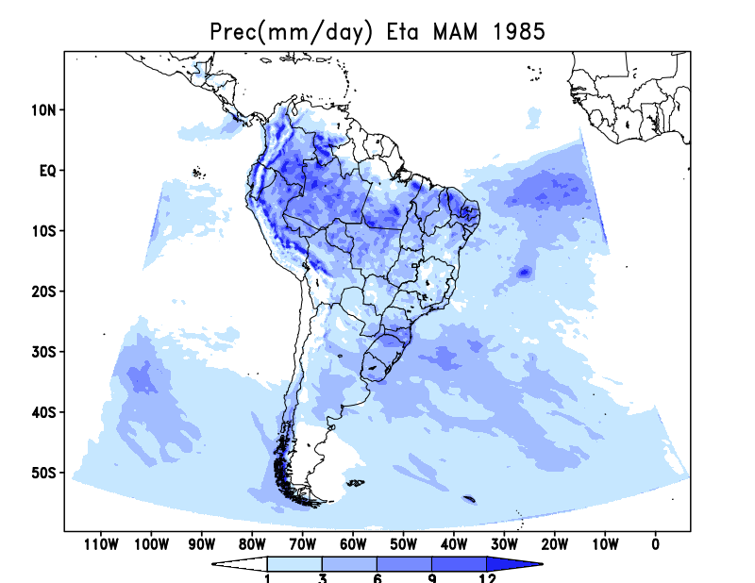
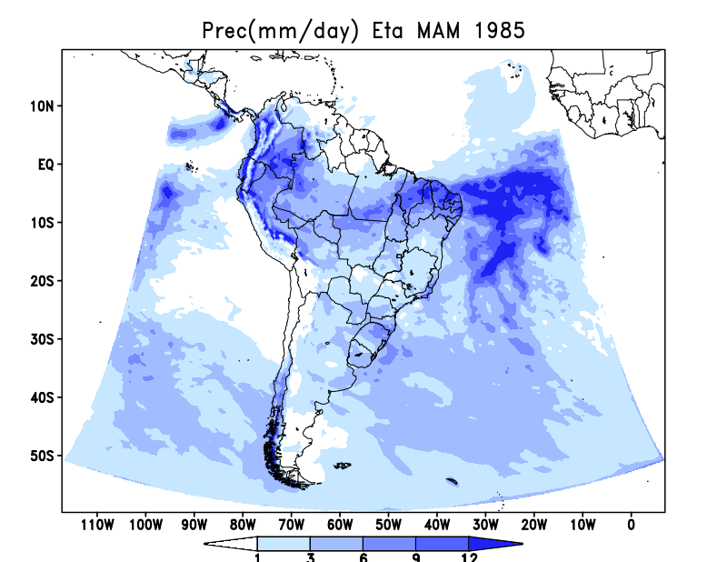
MSWEP
EC-Earth3
MAM 1985
Cuparm MC
Cuparm J
Cuparm H
T_dry Czil_dyn Albupdt
MIXLEN_23ee czil0.2 Albupdt
T_dry Czil_dyn Albupdt ssolar0.93

Slide 3
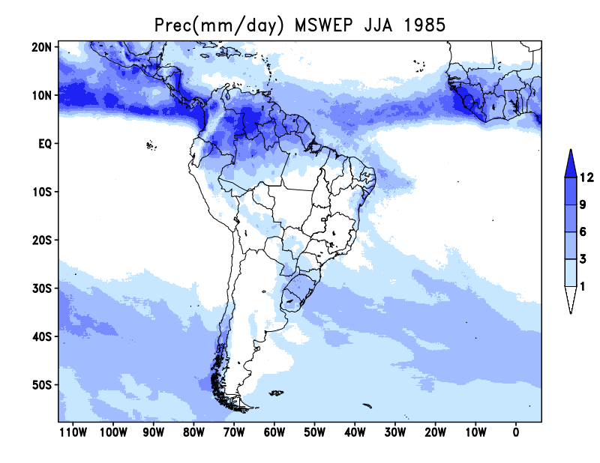
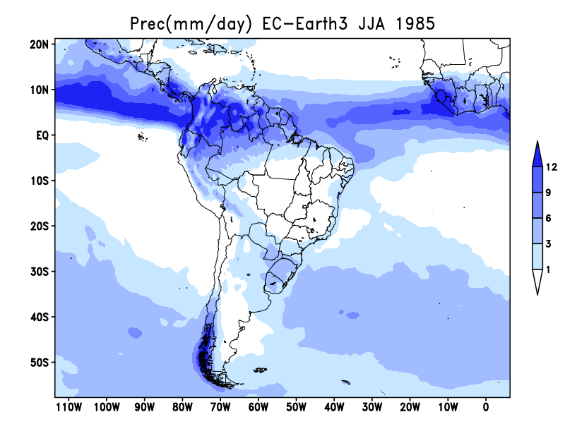
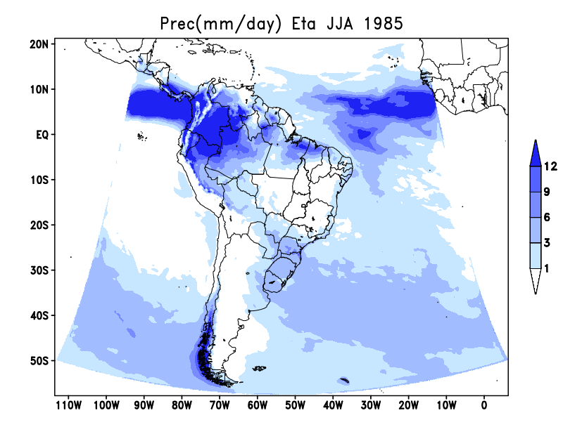
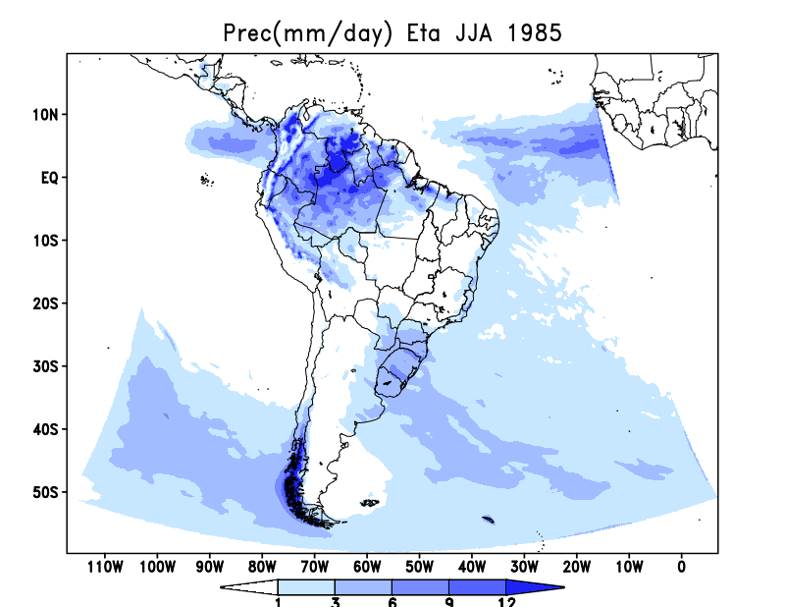
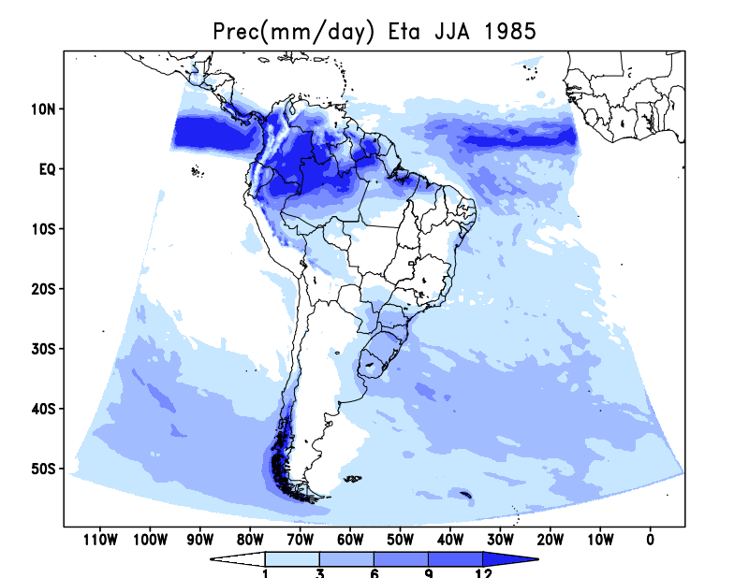
MSWEP
EC-Earth3
JJA 1985
Cuparm MC
Cuparm J
Cuparm H
T_dry Czil_dyn Albupdt
MIXLEN_23ee czil0.2 Albupdt
T_dry Czil_dyn Albupdt ssolar0.93

Slide 4
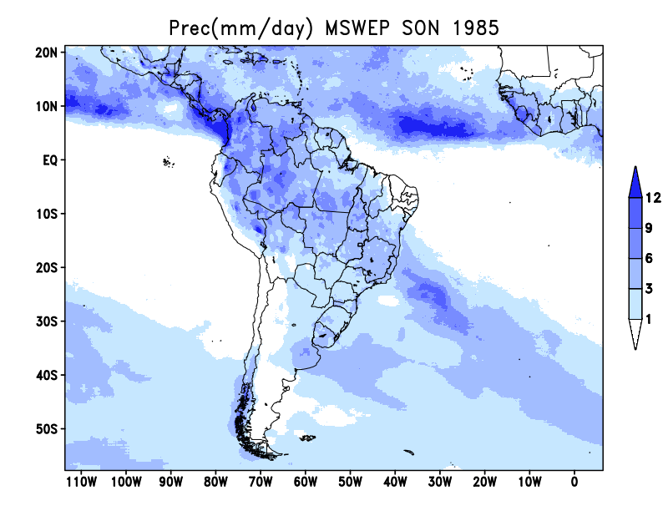
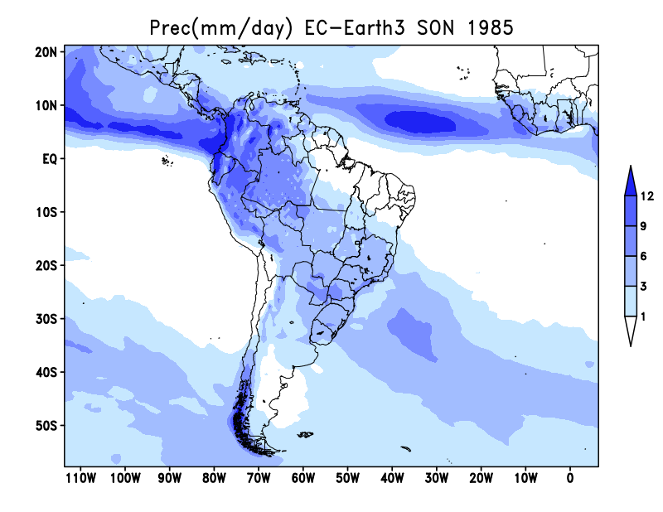
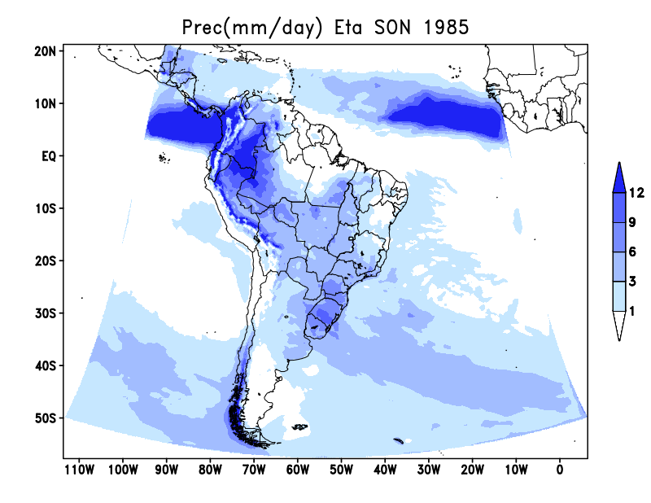
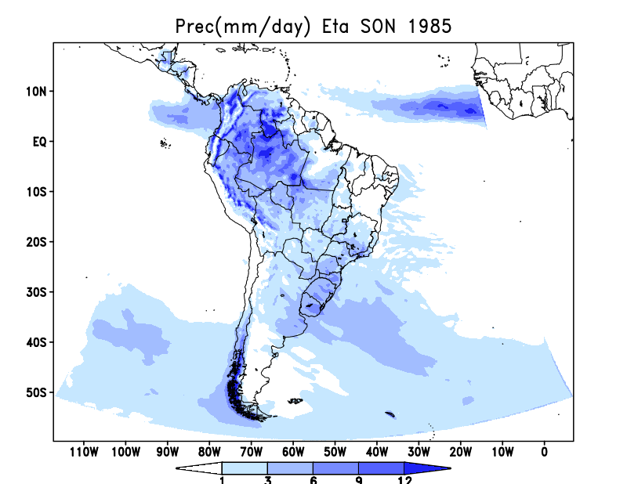
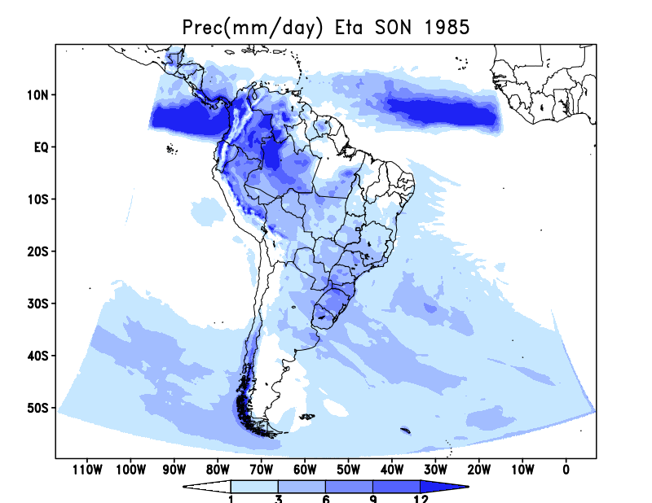
MSWEP
EC-Earth3
SON 1985
Cuparm MC
Cuparm J
Cuparm H
T_dry Czil_dyn Albupdt
MIXLEN_23ee czil0.2 Albupdt
T_dry Czil_dyn Albupdt ssolar0.93

Slide 5
Parâmetro | V1.1.0 cuparm -Terceira comunicação Nacional | V1.3.0 cuparm - inicial | V1.3.0 cuparm – Diego Campos | V1.3.0 cuparm – Diego Campos modificado | V1.3.0 cuparm – chou (HDIFFS x HDIFF) | V1.4.2 cuparmdata_MC Mudanças climáticas | V1.4.2 cuparmdata_J Mudanças climáticas | V1.4.2 cuparmdata_H Mudanças climáticas
FSS | .85 | .85 | 1.00 | 0.80 | 0.80 | 0.80 | 1.00 | 1.00
DSPBFS | -3875 | -3400 | -4500 | -4500 | -4500 | -3500 | -2000 | -1500
DSP0FS | -5875 | -4400 | -5500 | -5500 | -5500 | -5500 | -3000 | -2500
DSPTFS | -1875 | -1500 | -1875 | -1875 | -1875 | -1875 | -1000 | -1000
FSL | .85 | .85 | 1.00 | .95 | 1.00 | 1.00 | 1.00 | 1.00
DSPBFL | -4500 | -4000 | -4000 | -4000 | -4000 | -4000 | -2000 | -2000
DSP0FL | -5500 | -4800 | -3500 | -3500 | -5000 | -5000 | -3000 | -3000
DSPTFL | -2000 | -1800 | -2000 | -2000 | -2000 | -2000 | -1000 | -1500
rhgrdl=0.95
rhgrds=0.96
vsowadst=0.7
Notes:
&CUPARMDATA
STABS=1.0,STABD=0.95,STABFC=1.00,DTTOP=0.0,
RHF=0.10,EPSUP=1.00,EPSDN=1.05,EPSTH=0.0,
PBM=13000.,PQM=20000.,PNO=1000.,PONE=2500.,PSH=29000.,
PFRZ=15000.,PSHU=45000.,
UNIS=.FALSE.,UNIL=.FALSE.,OCT90=.FALSE.,
FSS=0.8,EFIMN=.20,EFMNT=.70,FCC=.50,
DSPBFL=-2000.,DSP0FL=-5000.,DSPTFL=-2000.,FSL=1.0,
DSPBFS=-3500.,DSP0FS=-5500.,DSPTFS=-1850.,
TREL=3250.,EPSNTP=.0010,EFIFC=5.0,
DSPC=-3000.,EPSP=1.E-7,
STEFI=1.,
&END

Slide 6
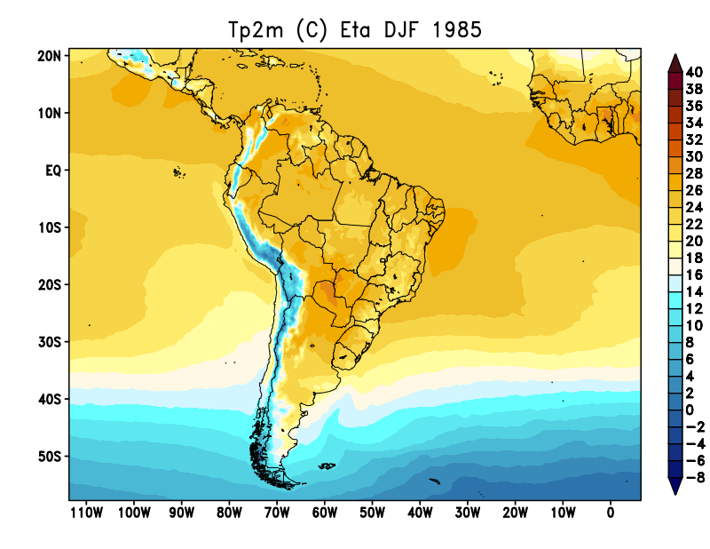
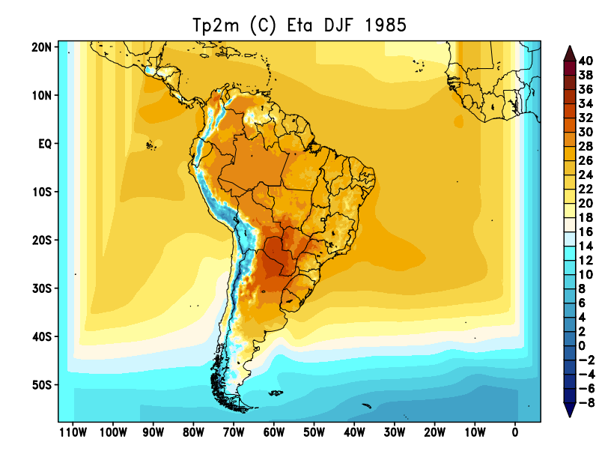
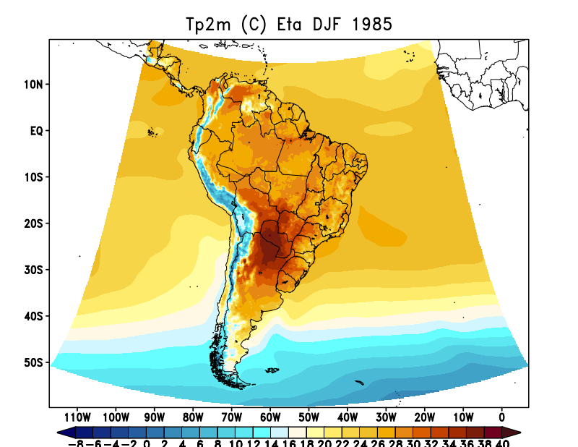
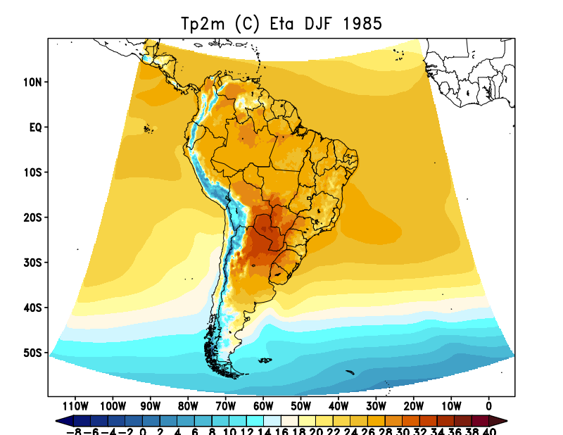
ERA5
DJF 1985
Cuparm MC
Cuparm J
Cuparm H
T_dry Czil_dyn Albupdt
MIXLEN_23ee czil0.2 Albupdt
T_dry Czil_dyn Albupdt ssolar0.93

Slide 7
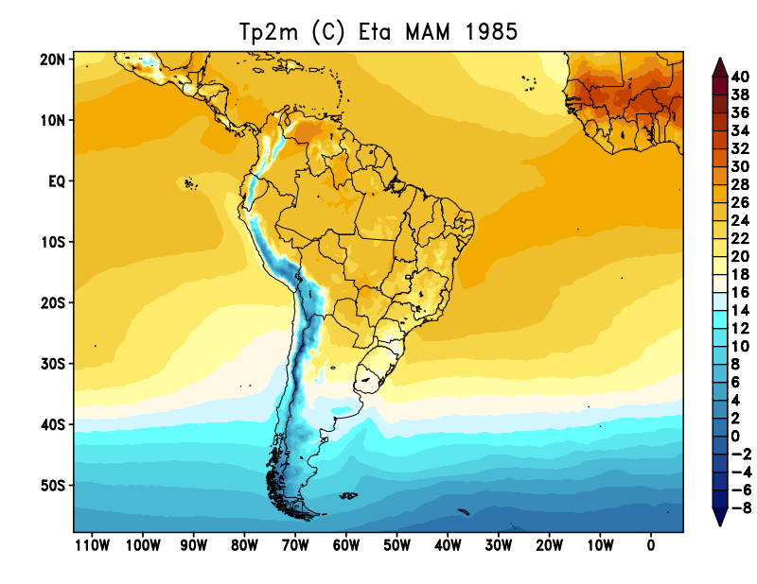
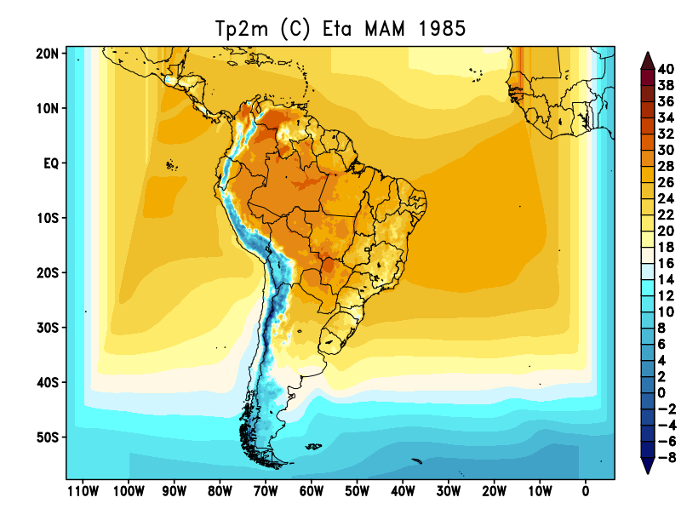
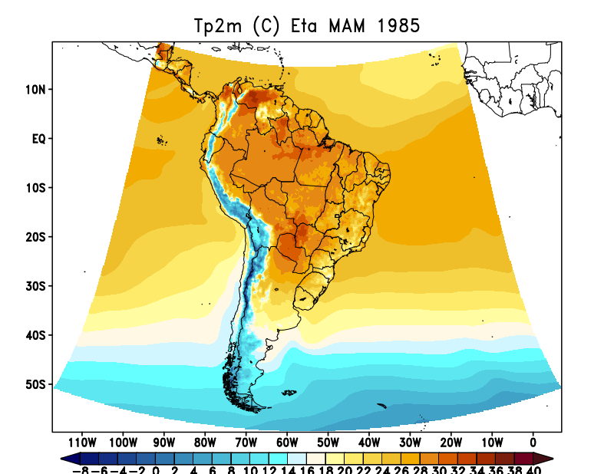
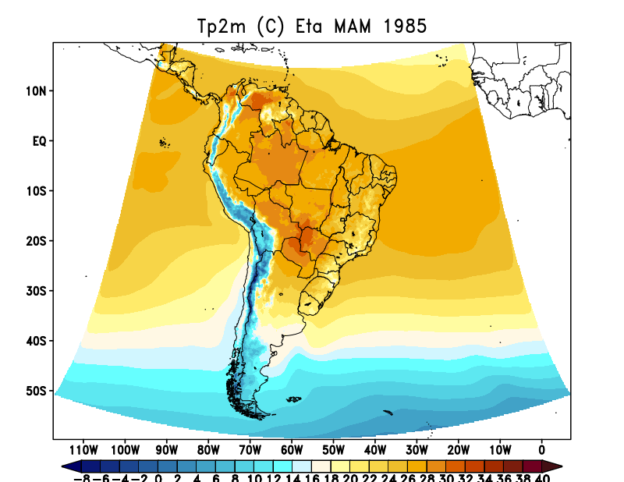
ERA5
MAM 1985
Cuparm MC
Cuparm J
Cuparm H
T_dry Czil_dyn Albupdt
MIXLEN_23ee czil0.2 Albupdt
T_dry Czil_dyn Albupdt ssolar0.93

Slide 8
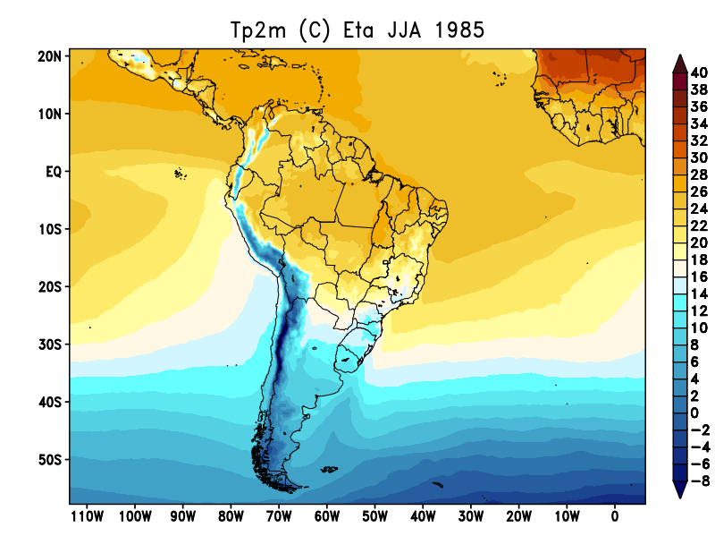
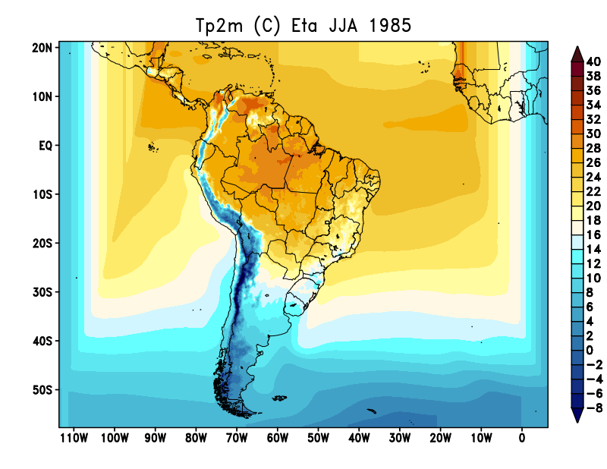
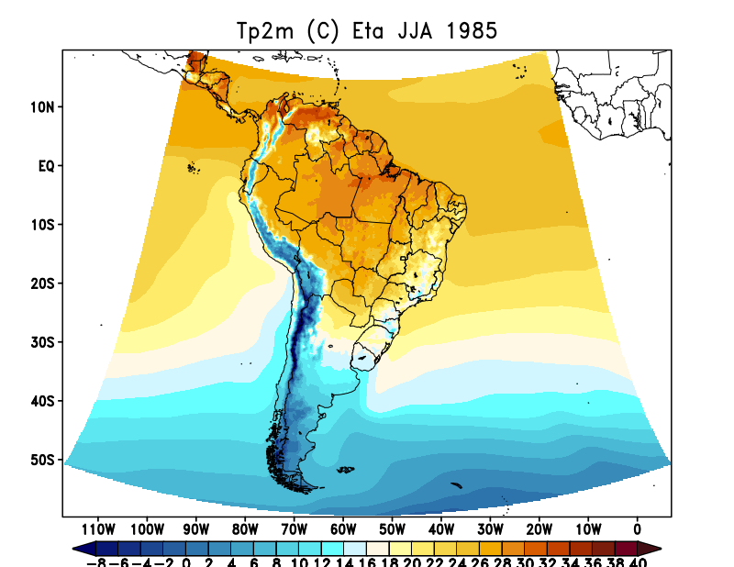
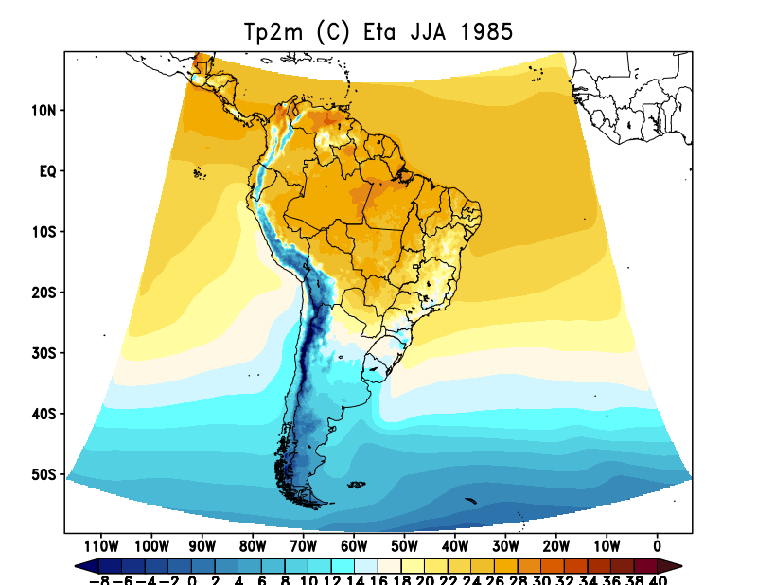
ERA5
JJA 1985
Cuparm MC
Cuparm J
Cuparm H
T_dry Czil_dyn Albupdt
MIXLEN_23ee czil0.2 Albupdt
T_dry Czil_dyn Albupdt ssolar0.93

Slide 9
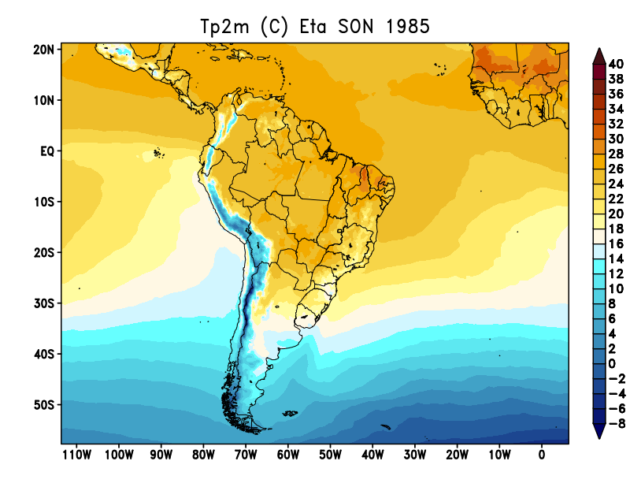
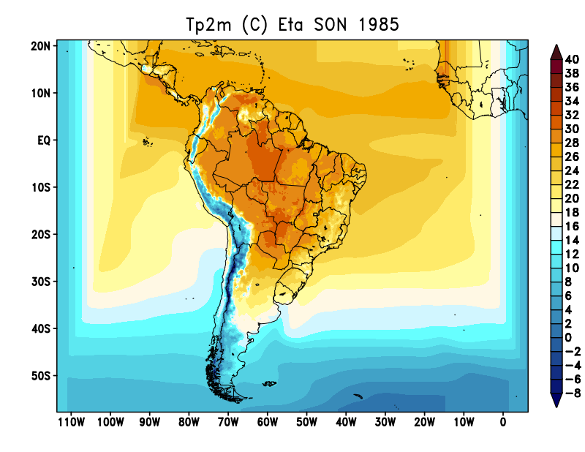
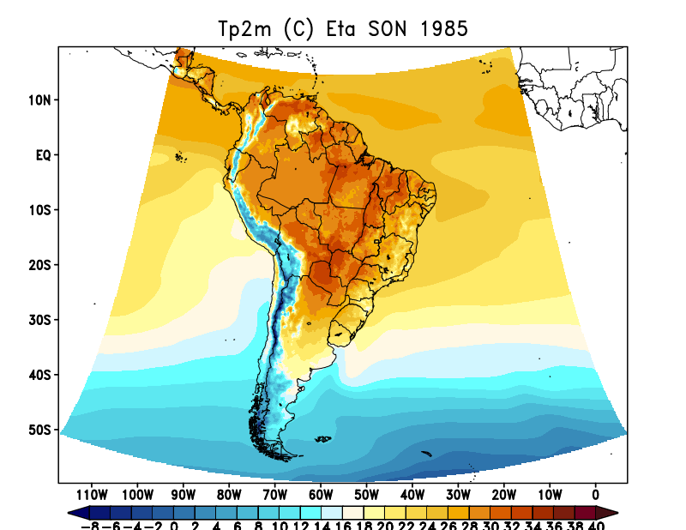
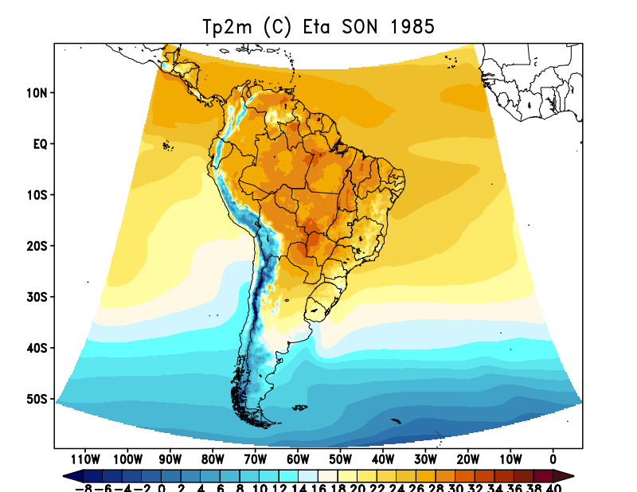
ERA5
SON 1985
Cuparm MC
Cuparm J
Cuparm H
T_dry Czil_dyn Albupdt
MIXLEN_23ee czil0.2 Albupdt
T_dry Czil_dyn Albupdt ssolar0.93

Slide 10
Comparação Czil 0.2 x Czil 0.1

Slide 11
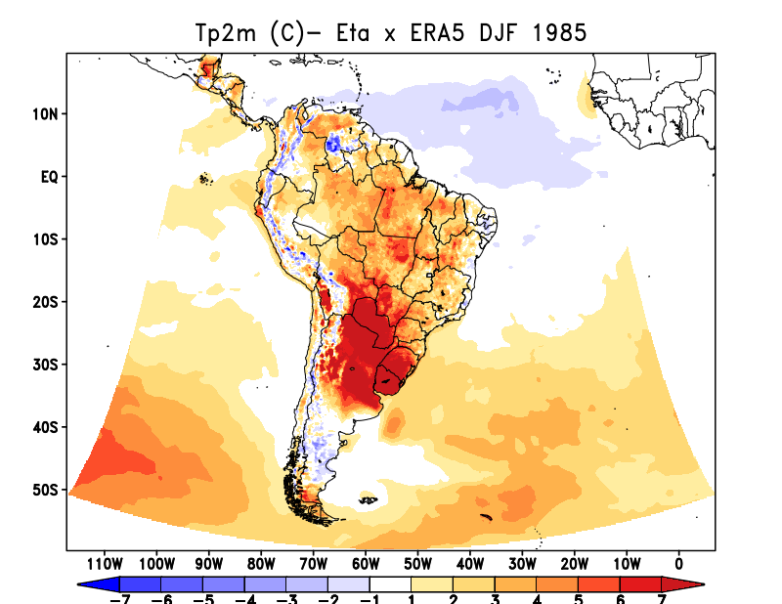
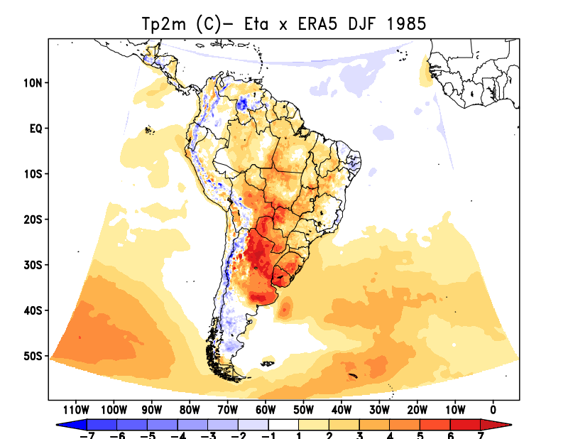
ERA5
DJF 1985
MIXLEN_23ee czil0.2 Albupdt
T_dry Czil_dyn Albupdt ssolar0.93

Slide 12
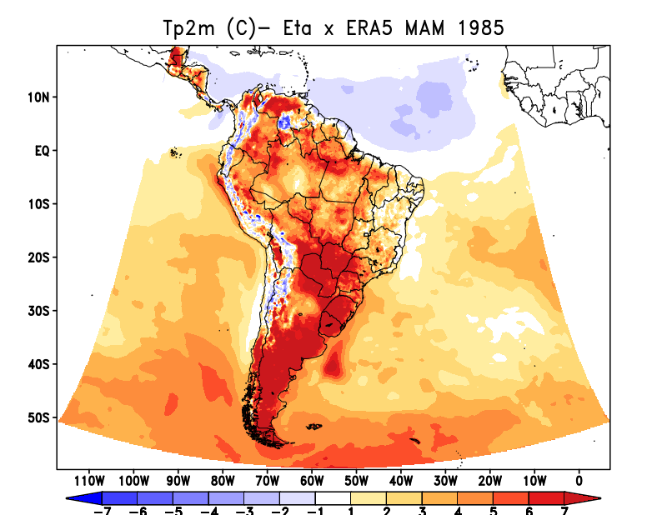
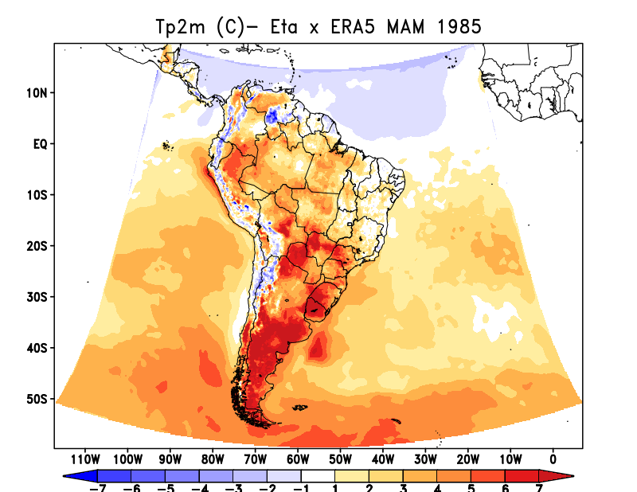
ERA5
MAM 1985
MIXLEN_23ee czil0.2 Albupdt
T_dry Czil_dyn Albupdt ssolar0.93

Slide 13
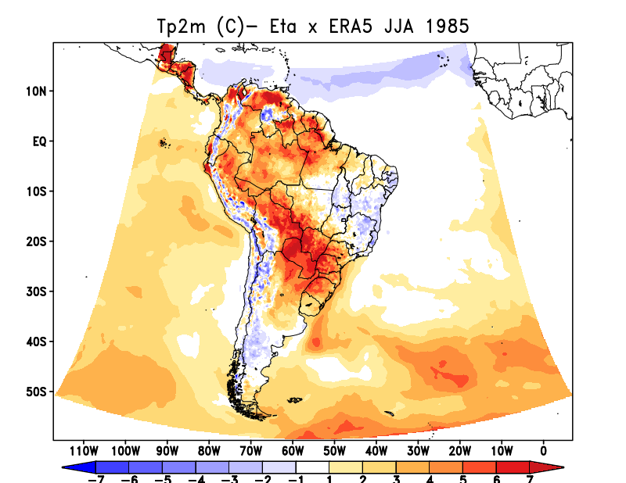
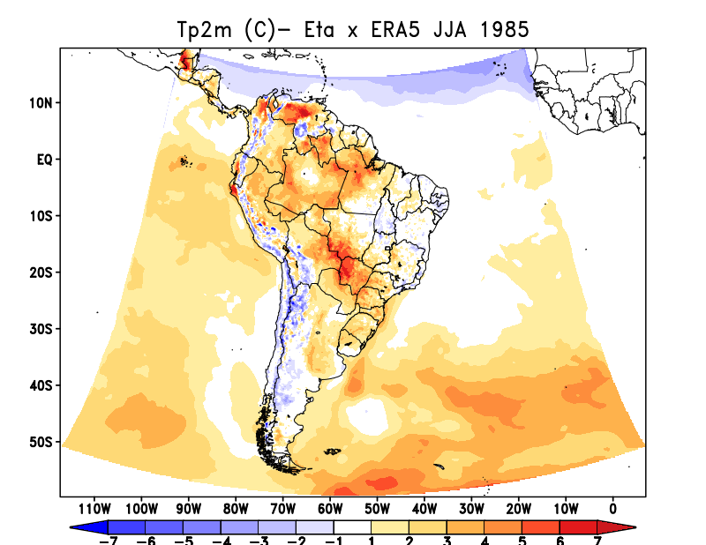
ERA5
JJA 1985
MIXLEN_23ee czil0.2 Albupdt
T_dry Czil_dyn Albupdt ssolar0.93

Slide 14
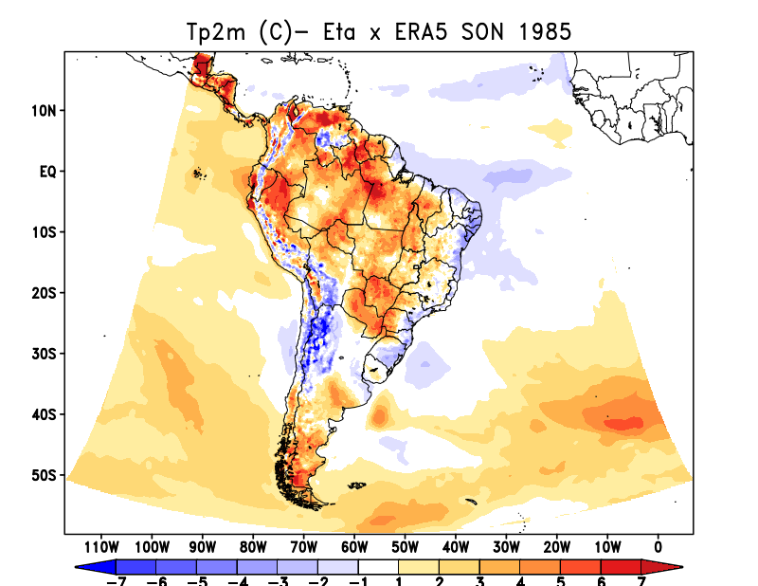
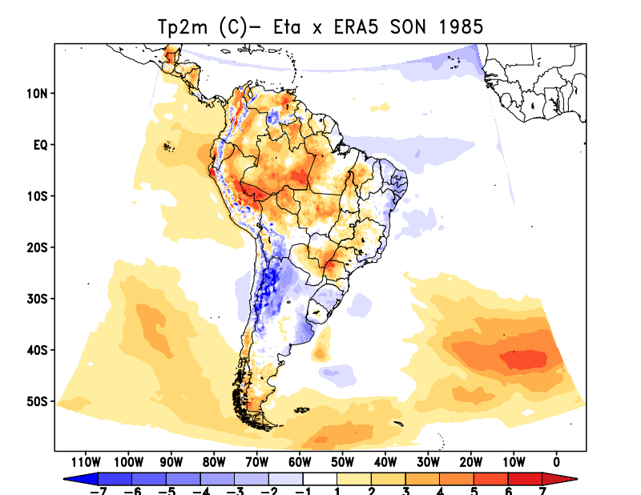
ERA5
SON 1985
MIXLEN_23ee czil0.2 Albupdt
T_dry Czil_dyn Albupdt ssolar0.93

Slide 15
Prec x Prcv x Prge

Slide 16
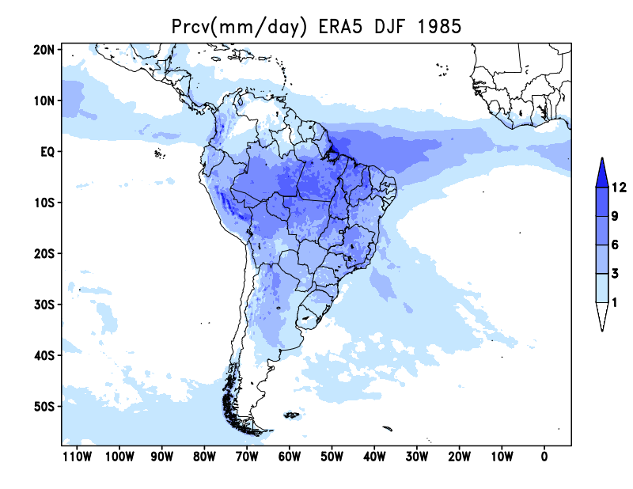
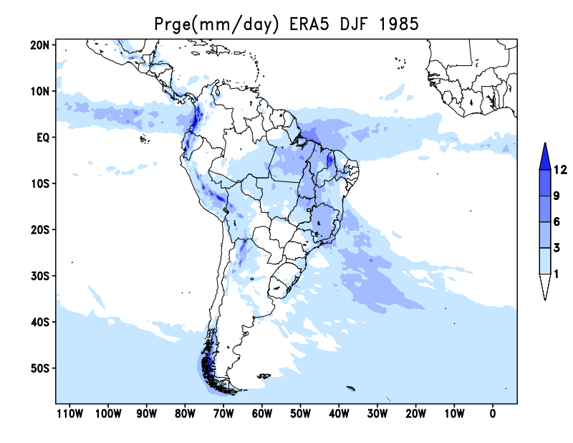
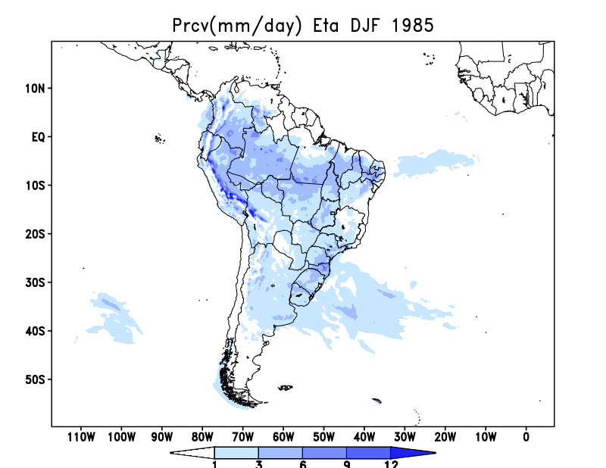
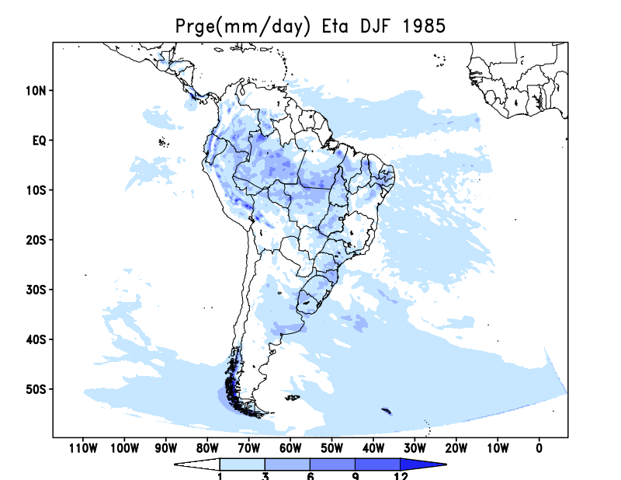
MSWEP prec
ERA5 prcv
ERA5 prge
DJF 1985
Eta prec
Eta prcv
Eta prge

Slide 17
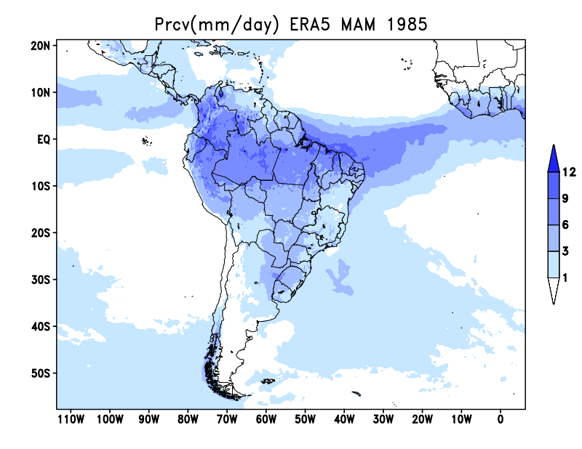
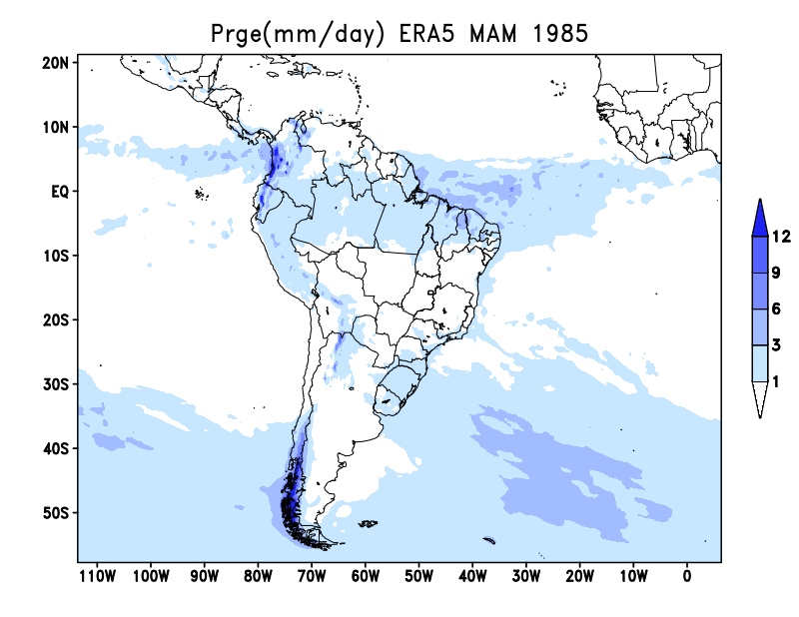
MSWEP prec
ERA5 prcv
ERA5 prge
MAM 1985
Eta prec
Eta prcv
Eta prge

Slide 18
MSWEP prec
ERA5 prcv
ERA5 prge
JJA 1985
Eta prec
Eta prcv
Eta prge

Slide 19
MSWEP prec
ERA5 prcv
ERA5 prge
SON 1985
Eta prec
Eta prcv
Eta prge

